Slide 1
Fractal Dimension of Cell Colony Boundaries
Gabriela Rodriguez
April 15, 2010

Slide 2
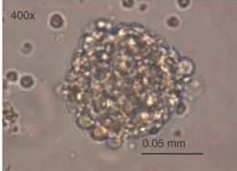
Tumor Boundaries
Isolated tumor growing in a Petri dish
Interested in roughness
of boundary in 2-D
How can roughness
be measured?

Slide 3
Fractal Dimension
Measure of “roughness”
(Mandelbrot ): a boundary is a fractal if its
Practical method of estimating fractal dimension: Box-counting
covering dimension fractal dimension

Slide 4
Outline
Definitions:
Preliminary concepts
Covering dimension
Fractal dimension
Box-Counting method
Box-Counting Theorem
Application to Tumor Boundaries
Biological Significance

Slide 5
Preliminary Concepts
Neighborhood
Limit point
Closed set
Bounded set
Compact set
Open cover

Slide 6
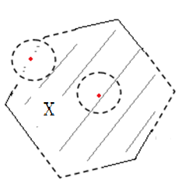
Limit Points in
An ε-neighborhood of
is an open disk , with
radius , centered at p.
is a limit point of
iff for all .
ε
p

Slide 7
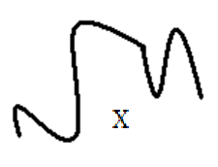
Compact Sets in
is closed if it contains all its limit points.
X is bounded if it lies in a finite region of .
X is compact in if it is closed and bounded.

Slide 8
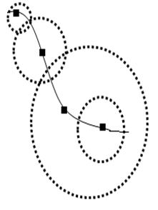
Open Covers of Compact Sets in
An open cover of a compact set is a collection of neighborhoods of points in X whose union contains X.
Heine-Borel Theorem
Every open cover of a compact set
contains a finite sub-cover.

Slide 9
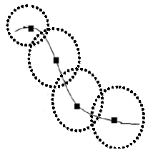
Covering Dimension
The covering dimension of a compact is the smallest integer n for which
there is an open cover of X such that
no point of X lies in more than n+1 open disks.
The covering dimension of the curve is n = 1 because some points of the curve must lie in
2 =1+1 open disks.

Slide 10
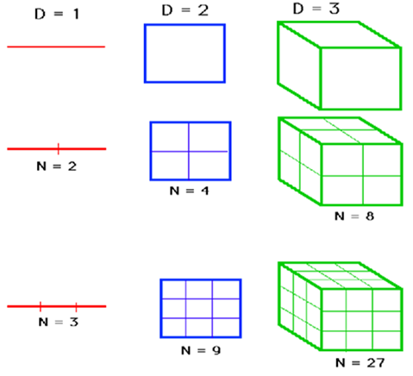
Another View of Dimension
KEY
ε: section size
N: # of sections
D: dimension

Slide 11
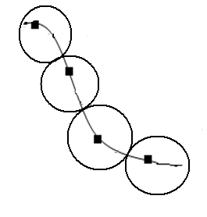
Closed Covers of Compact Sets in
A closed cover of a compact set is a collection of closed disks centered at points in X whose union contains X.

Slide 12
Fractal Dimension
Let X be a compact subset of .
The fractal dimension D of X is defined as
(if this limit exists),
where is the smallest number of closed disks of radius
needed to cover X.

Slide 13
Box-Counting Method
Cover with a grid,
whose squares have side length .
Let be the number of grid squares (boxes) that intersect X.
, the fractal dimension of X.
Plot vs. .
Slope of plot D.

Slide 14
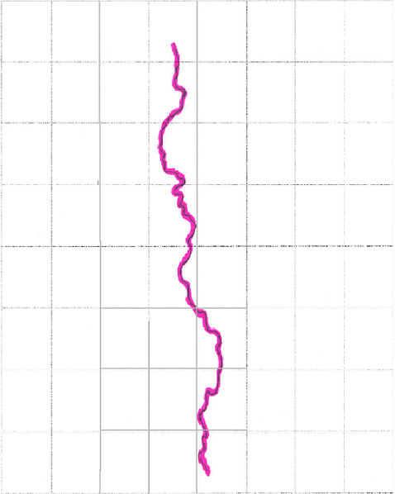
,

Slide 15
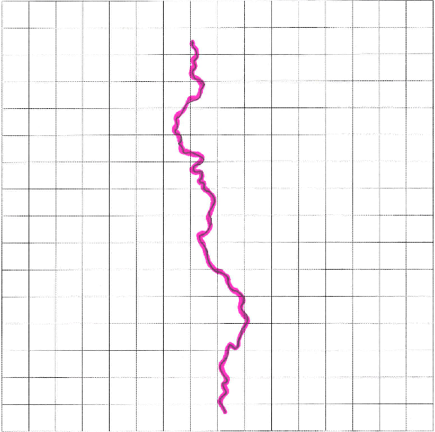
,

Slide 16
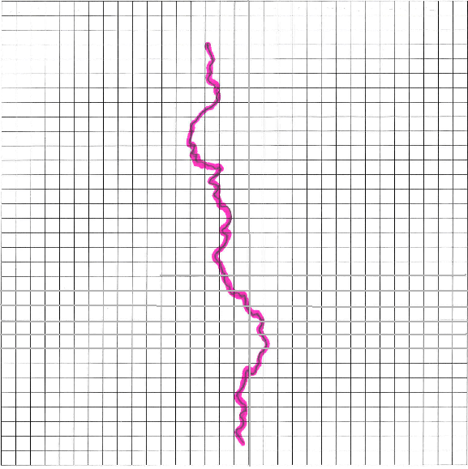
,

Slide 17
(slope)

Slide 18
Box-counting Theorem
Let X be a compact subset of ,
let be the “box-count” for X
using boxes of side , and
suppose exists.
Then L = D, the fractal dimension of X.

Slide 19
Outline of Proof
Let be the smallest number of closed disks of radius needed to cover X.
Step 1:
Step 2:
Step 3: , since

Slide 20
Step 1:
A closed disk of radius can intersect at most 4 grid boxes of side .
Therefore .

Slide 21
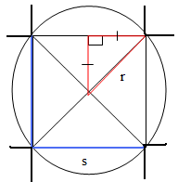
Step 1:
A square box of side s can fit inside a ball of radius r iff .
Pythagoras:
Therefore every disk intersects at least 1 box: .

Slide 22
Step 2:

Slide 23
Step 3: Prove that .
As ,
since

Slide 24
Boundary of Human Lymphocyte

Slide 25
(slope)

Slide 26
Biological Significance
Bru (2003) and Izquierdo (2008) have shown that fractal dimension and related critical exponents can be used to classify growth dynamics of a cell colony.
A model of growth dynamics can potentially predict tumor stages.

Slide 27
References
Aker, Eyvind. "The Box Counting Method." Fysisk Institutt, Universitetet I Oslo. 10 Feb. 1997. Web. 15 Mar. 2010. <http://www.fys.uio.no/~eaker/thesis/node55.html>.
Bauer, Wolfgang. "Cancer Detection via Determination of Fractal Cell Dimension." 1-5. Web. 15 Mar. 2010.
Barnsley, M. F. Fractals Everywhere. Boston: Academic, 1988. Print.
Bru, Antonio. "The Universal Dynamics of Tumor Growth." Biophysical Journal 85 (2003): 2948-961. Print.
Baish, James W. "Fractals and Cancer." Cancer Research 60 (2000): 3683-688. Print.
Clayton, Keith. "Fractals & the Fractal Dimension." Vanderbilt University | Nashville, Tennessee. Web. 15 Mar. 2010. <http://www.vanderbilt.edu/AnS/psychology/cogsci/chaos/workshop/Fractals.html>.
"Fractal Dimension." OSU Mathematics. Web. 15 Mar. 2010. <http://www.math.okstate.edu/mathdept/dynamics/lecnotes/node37.html>.
Izquierdo-Kulich, Elena. "Morphogenesis of the Tumor Patterns." Mathematical Biosciences and Engineering 5.2 (2008): 299-313. Print.
Keefer, Tim. "American Metereological Society." Web. 20 Nov. 2009.
Lenkiewicz, Monika. "Culture and Isolation of Brain Tumor Initiating Cells | Current Protocols." Current Protocols | The Fine Art of Experimentation. Dec. 2009. Web. 15 Mar. 2010. <http://www.currentprotocols.com/protocol/sc0303>.
Slice, Dennis E. "A Glossary for Geometric Morphometrics." Web. 20 Nov. 2009.
"Topological Dimension." OSU Mathematics. Web. 15 Mar. 2010. <http://www.math.okstate.edu/mathdept/dynamics/lecnotes/node36.html>.

Slide 28
Special Thanks
Alan Knoerr
Angela Gallegos
Ron Buckmire
Mathematics Department
Family
Friends
“Mis Locas”
♥

