Slide 1
MATH 396
Topics in Applied Mathematics
The ILT Model
for Social Networks
Anthony Bonato
Ryerson University

Slide 2
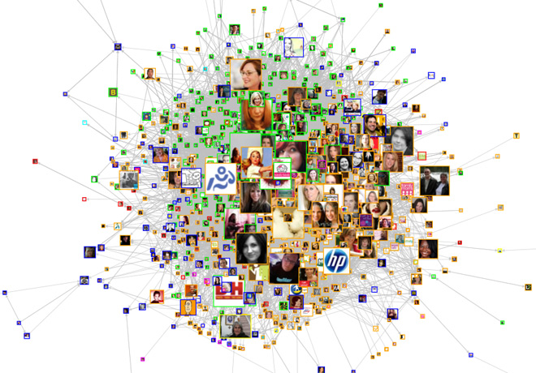
21st century media

Slide 3
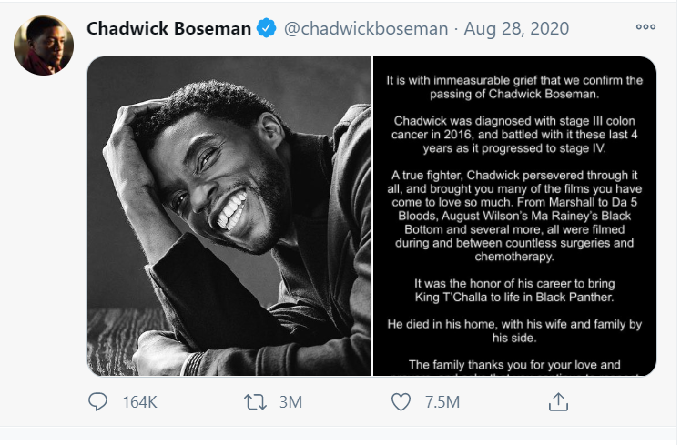
Twitter
one of the world’s most popular social media platforms
tweets are at most 280 characters
340 million users worldwide
500 million tweets each day, 200 billion a year

Slide 4
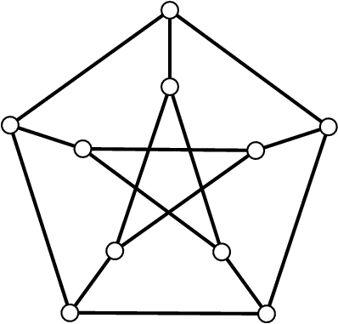
What is a network or graph?
dots (nodes or) corresponds to objects
lines (edges) correspond to interactions between objects
nodes
edges

Slide 5
number of nodes: order, |V|
number of edges: size, |E|

Slide 6
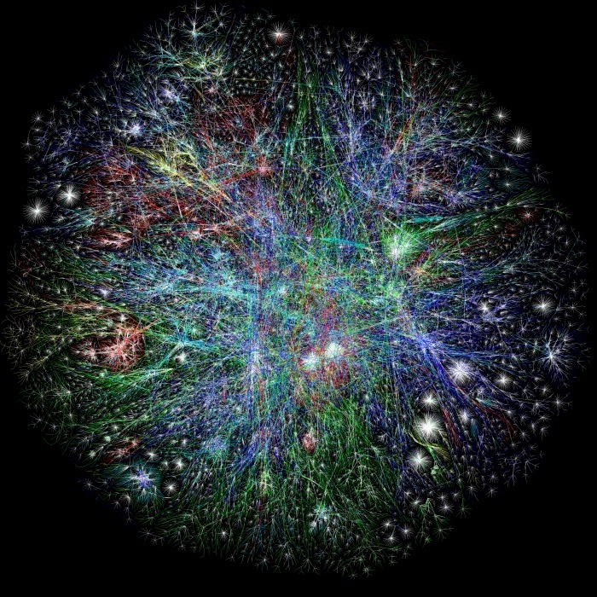
The web graph
nodes: web pages
edges: links
over 1 trillion nodes, with billions of nodes added each day

Slide 7
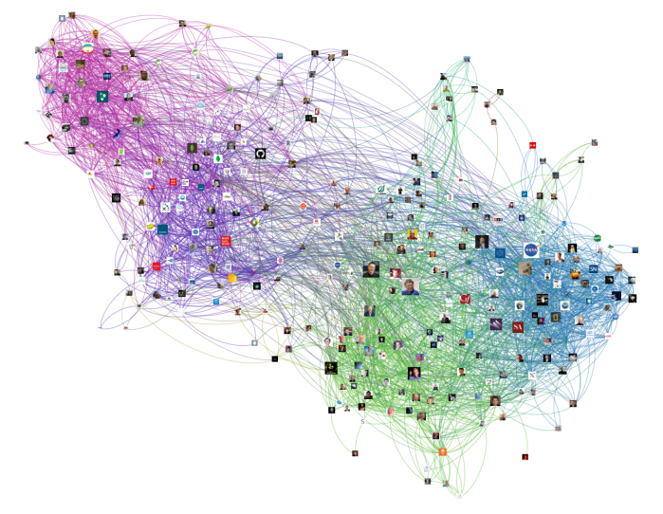
Social networks
nodes: people
edges: social interaction

Slide 8
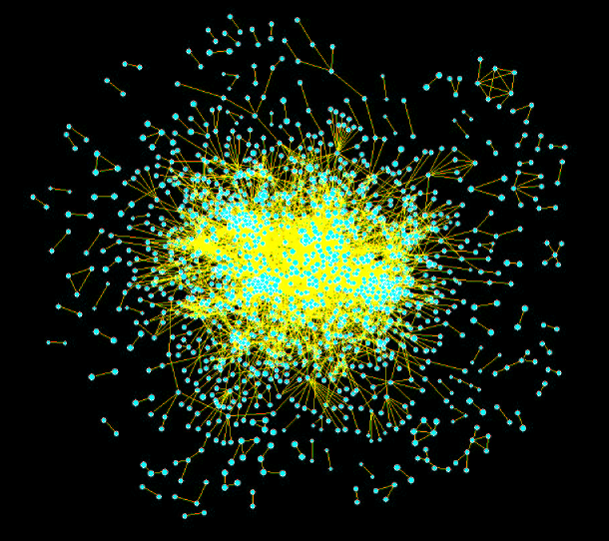
Proteomic networks
Yeast:
2401 nodes
11000 edges

Slide 9
Complex networks
the web graph, OSNs, proteomes, collaboration, connectomes, Bitcoin transactions, … are examples of
complex networks:
large scale, evolving
small world property
power law degree distributions
densification…

Slide 10
Degrees
the degree of a node x, written
deg(x)
is the number of edges incident with x
Theorem - First Theorem of Graph Theory:
$$\sum_{x∈V(G)}{\text{deg}(x)=2|E(G)|}$$

Slide 11
Distance
d(x,y) = distance between x and y
the length of a shortest path connecting x and y (∞ otherwise)
the diameter of G, written diam(G), is the maximum of d(x,y) over all pairs x and y

Slide 12
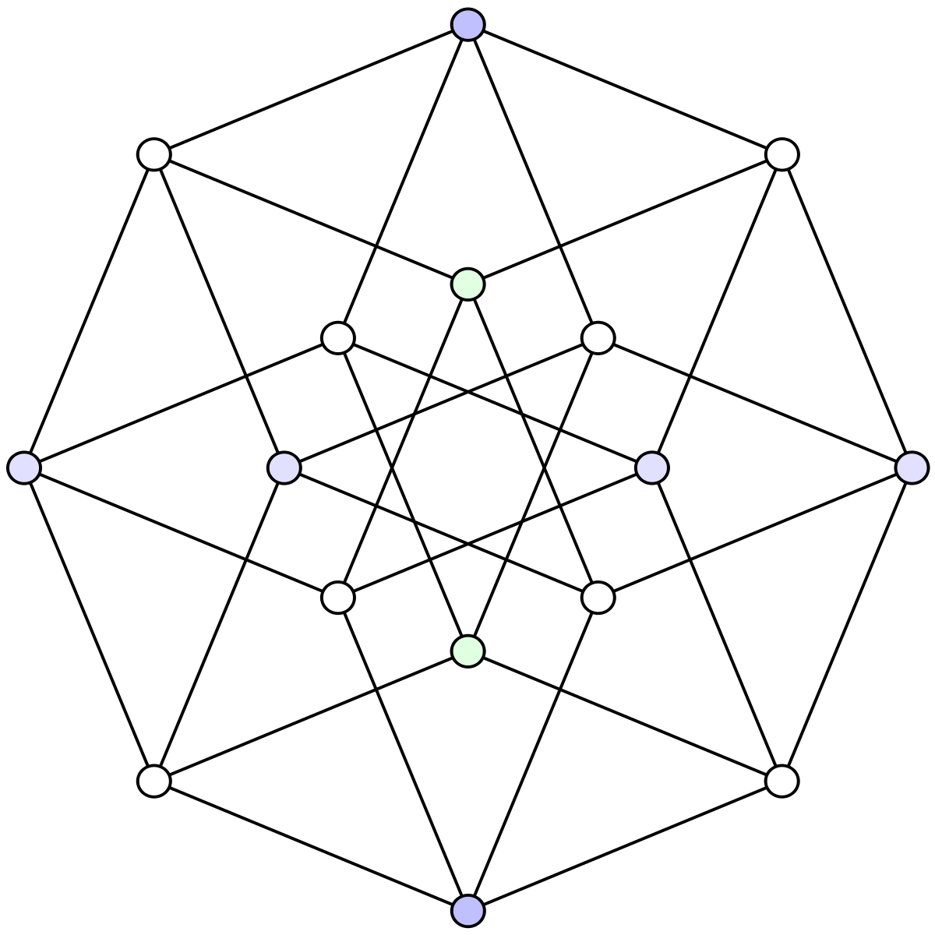
Example

Slide 13
Collaboration distance

Slide 14
Other graph parameters
average distance:
clustering coefficient:
$$L(\text{G})=\sum_{u,v∈V(G)}{d(u,v){\left(\begin{matrix}n \\ 2\end{matrix}\right)}^{−1}}$$
W(G)
$$c(x)= |E(N(x))|{\left(\begin{matrix}\deg{(}x) \\ 2\end{matrix}\right)}^{\text{−1}}\text{, }C(\text{G})=n^{−1}\left(\sum_{x∈V(G)}{c(x)}\right)$$

Slide 15
Small world property (Watts,Strogatz,98)
low distances
diam(G) = O(log n)
L(G) = O(loglog n)
higher clustering coefficient than a binomial random graph with same expected degree

Slide 16
Power law degree distribution
for a graph G of order n and i a positive integer, let N_{i,n} denote the number of nodes of degree i in G
we say that G follows a power law degree distribution if
for some range of i and some b > 2,
b is called the exponent of the power law
$$N_{i,n}≈i^{−b}n$$

Slide 17
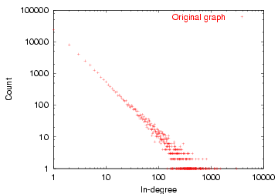
Interpreting a power law
Many low-degree nodes
Few high-degree nodes

Slide 18
Densification power law
networks become more dense over time
average degree is increasing:
|(E(G)| ~ |V(G)|ª
where 1 < a ≤ 2: densification exponent

Slide 19
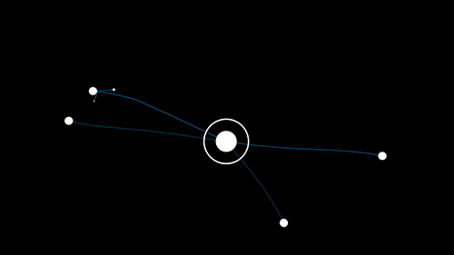
Models for complex networks
simulate one or more properties
“All models are wrong..”
leads to new mathematics
key models:
preferential attachment
spatial models
ranking models
copying models

Slide 20
Transitivity
B
A
C
“friends of friends are friends”

Slide 21
Iterated Local Transitivity (ILT) model (Bonato,Hadi,Horn,Prałat,Wang,11)
start with a graph of order n
to form the graph G_{t+1} for each node x from time t, add a node x$′$, the clone of x, so that xx$′$ is an edge, and x$′$ is joined to each node joined to x

Slide 22
Starting with a single node:
G₀
G₁
G₂

Slide 23
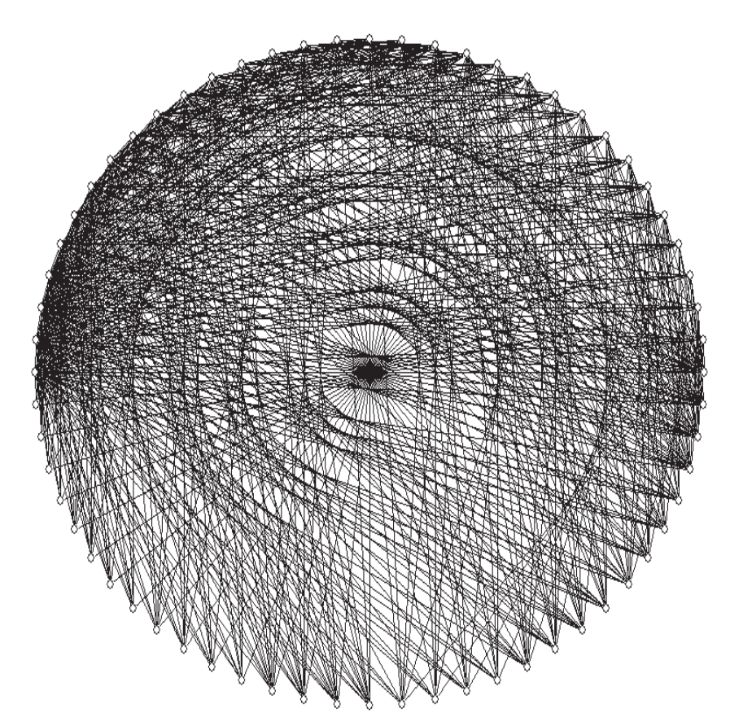
Combinatorial explosion
G₀ : 4-cycle
G₄:

Slide 24
Densification
n_{t} = order of G_{t}, e_{t} = size of G_{t}
Lemma (BHHPW,11): For t > 0,
n_{t} = 2^{t}n₀, e_{t} = 3^{t}(e₀+n₀) - n_{t}.
densification power law:
e_{t} $\sim$ n_{t}ª, where a = log 3 / log 2.

Slide 25
Sketch of proof of densification
G_{t+1}
y$′$
x$′$
$\text{e}\text{t}\text{+1 = }\text{e}\text{t}+$ $\text{e}\text{t}$+ $\text{e}\text{t}$+ $\text{n}\text{t}$
=$\text{3}\text{e}\text{t} \text{+} \text{n}\text{t}$
= 3(3^{t}(e₀+n₀) - n_{t}) $\text{+} \text{n}\text{t}$
= 3^{t+1}(e₀+n₀) - $\text{n}\text{t}\text{+1}$
y
x
G_{t}

Slide 26
Average distance
Theorem (BHHPW,11): If t > 0, then the average distance
of G_{t} is:
$$2\left(\frac{4^{t}\left(W({\text{G}}_{0})+({\text{e}}_{0}+{\text{n}}_{0})\left(1−{\left(\frac{3}{4}\right)}^{t}\right)\right)}{4^{t}{{\text{n}}_{0}}^{2}−2^{t}{\text{n}}_{0}}\right)$$
average distance bounded by a constant
diameter does not change from time 0 (except for cliques)

Slide 27
Sketch of proof for diameter
G_{t+1}
x’
y’
x
y
G_{t}

Slide 28
Clustering Coefficient
Theorem 4.3: If t > 0, then
c(G_{t}) = n_{t}^{log(7/8)+o(1)}.
higher clustering than in a random graph G(n_{t},p) with same order and average degree as G_{t}, which satisfies
c(G(n_{t},p)) = n_{t}^{log(3/4)+o(1)}

Slide 29
Universality
Theorem (BCEKM,20)
Every finite graph eventually appears as an induced subgraph in an ILT graph, regardless of the initial graph.

Slide 30
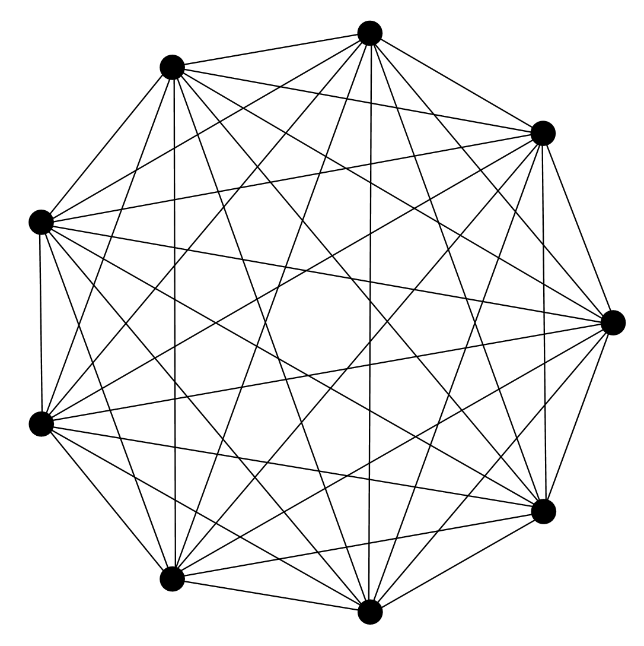
K₉

Slide 31
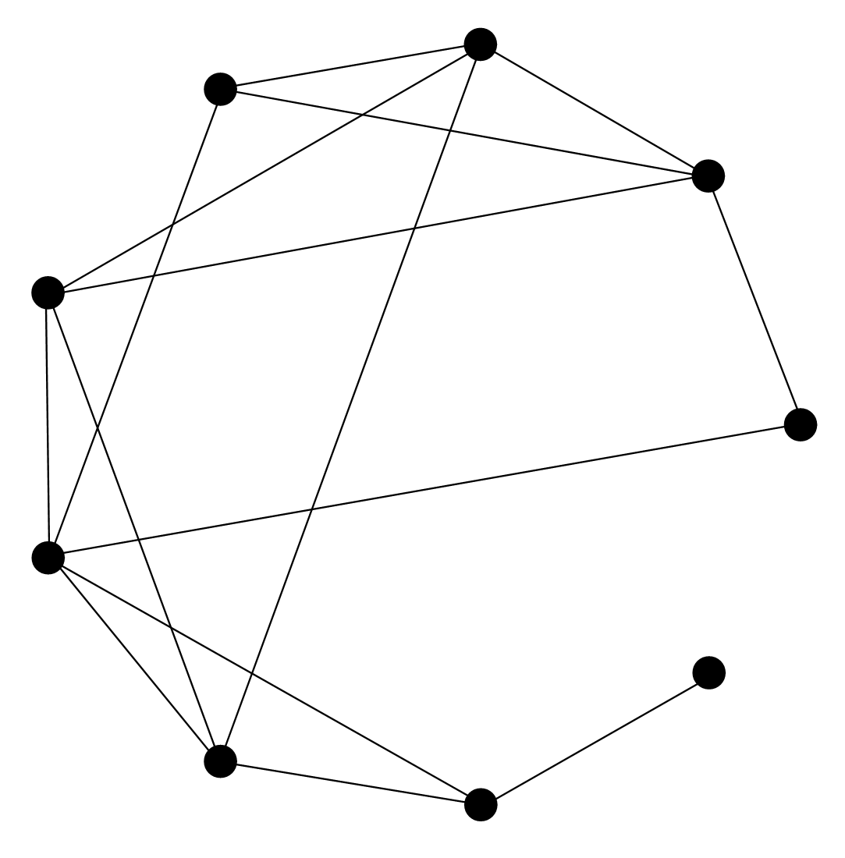

Slide 32
Sketch of proof
find a copy of K_{n} by cloning cliques
can build K_{n} – e in one step:
iteratively delete edges from a sufficiently large clique to give any fixed graph
K_{n}
x
y
t
x’
y’
t+1

Slide 33
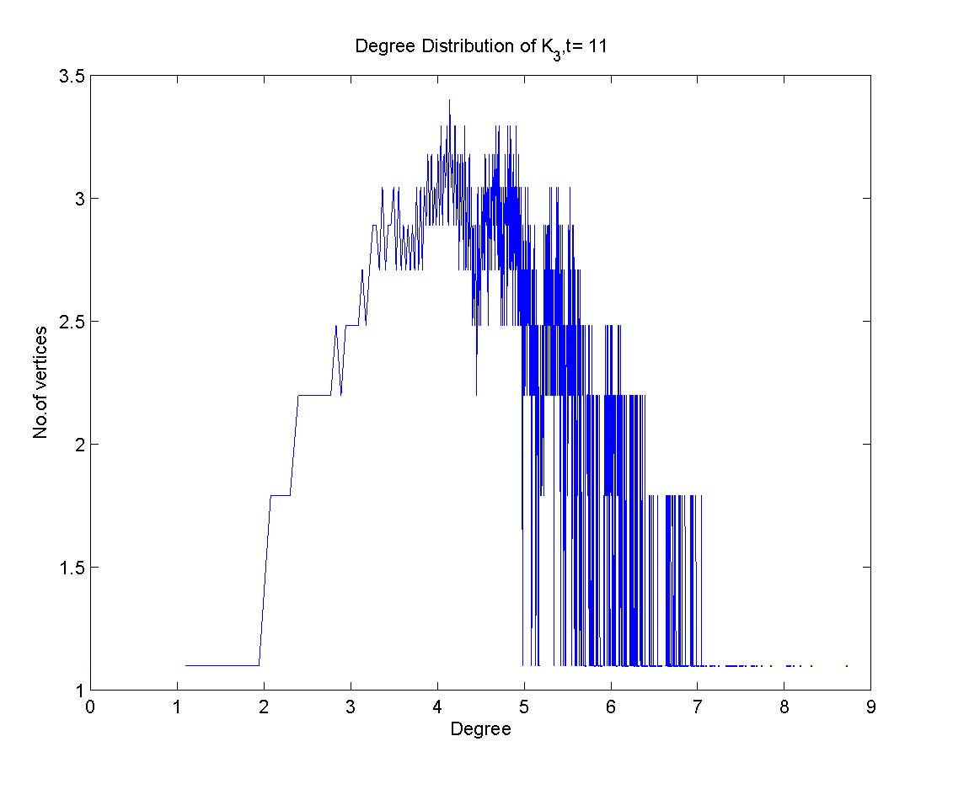
…Degree distribution
generate power law graphs from ILT?
ILT model gives a binomial-type distribution

Slide 34
Other directions
spectral results
random rewiring of clones
ILAT: anti-clones copy non-neighbors
ILM model: clones or anti-clones
ILT digraphs: status theory
ILT hypergraphs: polyadic relationships

Slide 35
Contact
Web: http://www.math.ryerson.ca/~abonato/
@Anthony_Bonato

