Slide 1
Quenching a Thirst with differential equations
By: Emily Clerc, Abigail Martinez, Daniel Mashal

Slide 2
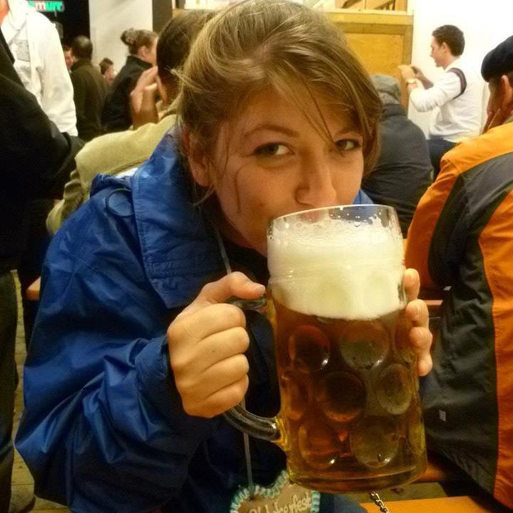
Topic overview
Modelling the behavior of CO₂ bubbles as they grow and rise from the bottom of a glass of beer.

Slide 3
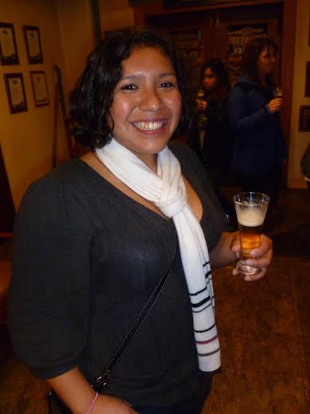
Major results
Created a three dimensional model for the growing and rising of bubbles.
But, through experimentation, model does not hold.

Slide 4
Physics equations used to make our model

Slide 5
Our model

Slide 6
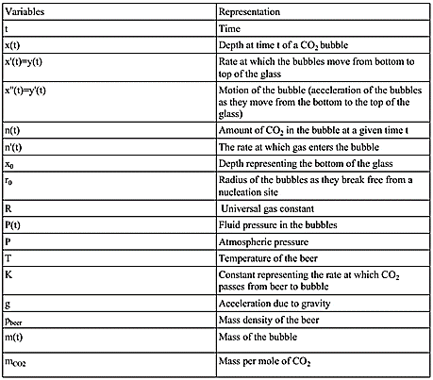

Slide 7
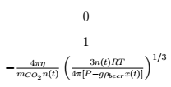
The jacobian matrix

Slide 8
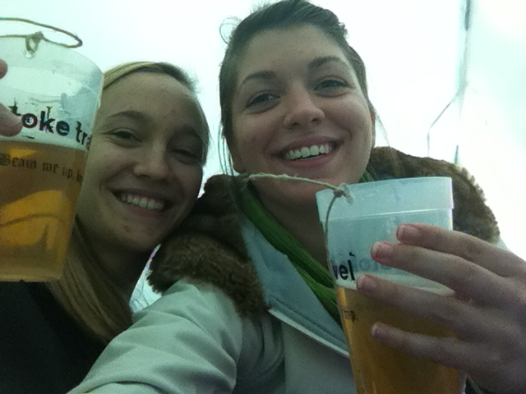
Our Jacobian
We took a Jacobian in order to find a fixed point, eigenvalues, and eigenvectors for our system.
There is not a fixed point since the Jacobian shows that in our first equation the partial derivative is coupled, so it can never be 0.
Since there can never be a fixed point, we cannot find the eigenvalues and eigenvectors at that point in our system.

