Slide 1
Discrete Dynamic Systems

Slide 2
What is a Dynamical System?

Slide 3
Definition of Dynamical System
A dynamical system is characterized by a ‘rule’ (or ‘rules’) that determines how points in the state space of the system change over time
The particular form of a rule depends on the type of dynamical system being studied, and the type of dynamical system depends on the space–time structure of the system.

Slide 4
Two Geometrical Cases of Dynamical Systems
Continuous
$\frac{∂}{∂t}\left(f\left(x\right)\right)=Rf\left(x\right)\left(1−f\left(x\right)\right)$
t is independent variable
Does not always have analytical solutions
Maps R → R
Discrete
$x_{n+1}=rx_{n}\left(1−x_{n}\right)$
n is independent variable
Uses a numerical method
Discretizes the system
Creates sequences through iterations
Maps R → N

Slide 5
Sequences, Bifurcations, and Period Doubling

Slide 6
Sequences in the Logistic Family
R | n | x |  | R | n | x |  | R | n | x
0.4 | 1 | 0.6 |  | 0.6 | 1 | 0.6 |  | 0.8 | 1 | 0.6
 | 2 | 0.384 |  |  | 2 | 0.576 |  |  | 2 | 0.768
 | 3 | 0.37847 |  |  | 3 | 0.586138 |  |  | 3 | 0.570163
 | 4 | 0.376369 |  |  | 4 | 0.582193 |  |  | 4 | 0.784247
 | 5 | 0.375545 |  |  | 5 | 0.583786 |  |  | 5 | 0.541452
 | 6 | 0.375217 |  |  | 6 | 0.583152 |  |  | 6 | 0.794502
 | 7 | 0.375087 |  |  | 7 | 0.583406 |  |  | 7 | 0.52246
 | 8 | 0.375035 |  |  | 8 | 0.583304 |  |  | 8 | 0.798386
 | 9 | 0.375014 |  |  | 9 | 0.583345 |  |  | 9 | 0.515091
 | 10 | 0.375006 |  |  | 10 | 0.583329 |  |  | 10 | 0.799271
 | 11 | 0.375002 |  |  | 11 | 0.583335 |  |  | 11 | 0.513398
 | 12 | 0.375001 |  |  | 12 | 0.583333 |  |  | 12 | 0.799426
 | 13 | 0.375 |  |  | 13 | 0.583334 |  |  | 13 | 0.513102
 | 14 | 0.375 |  |  | 14 | 0.583333 |  |  | 14 | 0.799451
 | 15 | 0.375 |  |  | 15 | 0.583333 |  |  | 15 | 0.513054
 | 16 | 0.375 |  |  | 16 | 0.583333 |  |  | 16 | 0.799455
 | 17 | 0.375 |  |  | 17 | 0.583333 |  |  | 17 | 0.513046
 | 18 | 0.375 |  |  | 18 | 0.583333 |  |  | 18 | 0.799455
 | 19 | 0.375 |  |  | 19 | 0.583333 |  |  | 19 | 0.513045
 | 20 | 0.375 |  |  | 20 | 0.583333 |  |  | 20 | 0.799455
Example of Period Doubling with Logistic Equation $x_{n+1}=4Rx_{n}(1−x_{n})$
First two samples act ‘normally’, while the third oscillates between two values

Slide 7
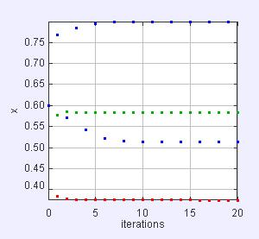
Period Doubling in the Logistic Family
Plots from IterateMapApp.java
Red – R = 0.4
Green – R = 0.6
Blue – R = 0.8
Note how blue seems to oscillate between two equilibria
Figure 1: IterateMapApp.java

Slide 8
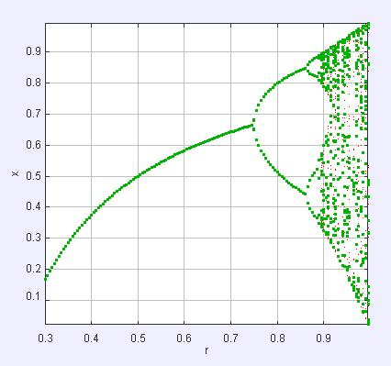

Bifurcations in the Logistic Family
Bifurcation Diagram of $x_{n+1}=4Rx_{n}(1−x_{n})$
Figure 2: BifurcateApp.java

Slide 9
Chaos

Slide 10
What is Chaos?
“Chaos: When the present determines the future, but the approximate present does not approximately determine the future,” Edward Lorentz
Chaos occurs when there is no repeating sequence in later time

Slide 11
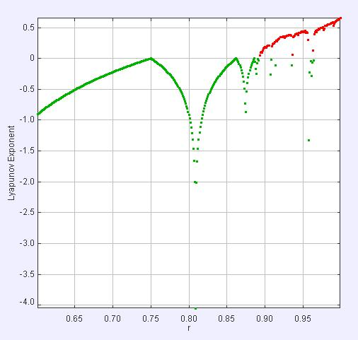
How Do We Quantify Chaos?
Lyapunov Exponents
Figure 3: BifurcateAppDDP3.java

Slide 12
Weakly, Strongly, and Non Chaotic
The continuous and discrete equations describe the same system. However… 1) In continuous we only need to worry about the roughness in the inputs/ initial conditions. But in discrete we also have to worry about the roughness in our time step.

