Slide 1
Baseball Trajectories: A Game of Inches
Jim Hildensperger
Kyle Spaulding
Dale Garrett

Slide 2
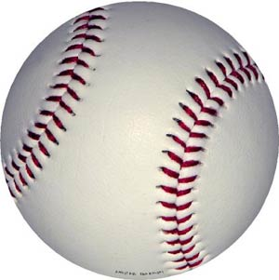
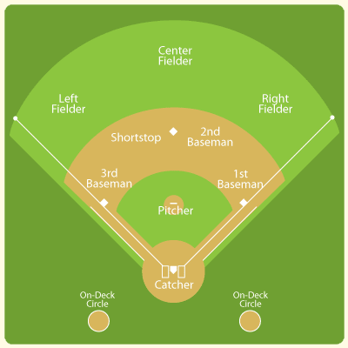
Baseball: Take Me out to the Ball Game
-Why is baseball considered a game of inches?
-Importance of the pitcher batter confrontation
-According to USA Today, hitting a baseball is the absolute hardest
thing to do in sports. “Considering that a major-league pitch can reach
speeds more than 95 mph, hitters have only 0.4 seconds to find the ball, decide
where the ball is going and swing the bat.
Yale University physics professor Robert Adair explains that it
takes 0.15 seconds for humans to voluntarily blink their eyes in
response to visual signals.
In the MLB, you'll get a multimillion-dollar contract if you can
hit a ball successfully anywhere near three out of 10 times.
-On average, there is approximately 1 home run hit during a full
MLB game. This stat is based on the number of home runs allowed
divided by total number of batters faced, times the average
number of batters per game in that specific league (generally
around 38 batters a game).

Slide 3
Factors Effecting the Trajectory of a Batted Ball
-Initial Velocity (Vo, meters per second): The velocity a ball leaves the bat after contact
-Spin (w, radians per second): The spin rate in which a ball spins as it flies through the air
-Air Temperature (T, degrees Fahrenheit): The average temperature of where the
ball is hit, when it is hit
-Altitude (Y, feet): The measured altitude of the stadium where the baseball is hit
-Angle of Contact (θ, degrees): The angle at which the ball leaves the bat after contact
-Lift and Drag forces (FL and FD, Newton): The Forces acting upon the ball as it
flies through the air

Slide 4

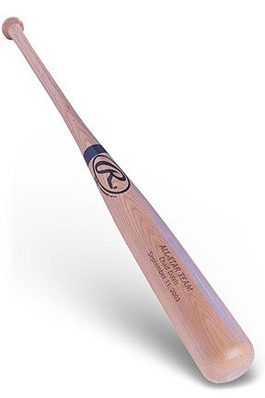
Hypothesis
How do changes in the factors of batted ball’s
Trajectory effect how far it goes?
-The distance a batted ball travels increases as the ball’s rotation rate increases
-The optimum angle of a batted ball depends on its spin rate
-A batted ball travels farther in hotter temperatures and higher altitudes

Slide 5

Newton’s Laws
1st Law- An object in a state of motion tends to remain in motion unless an external force is applied to it.
2nd Law-The relationship between an object's mass m, its acceleration a, and the applied force F is F = ma. In this law the direction of the force vector is the same as the direction of the acceleration vector.
3rd Law-For every action there is an equal and opposite reaction.

Slide 6
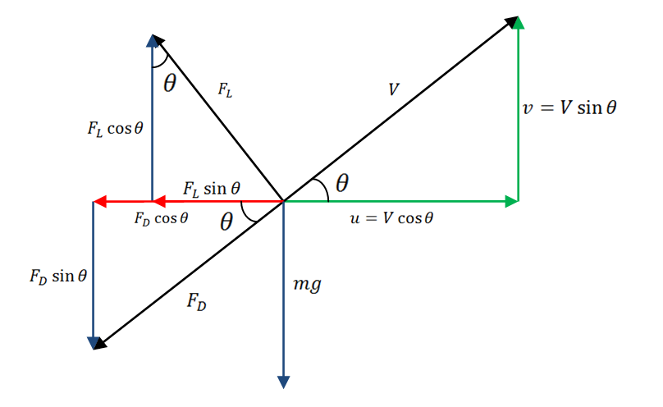
Force Diagram of a Baseball

Slide 7

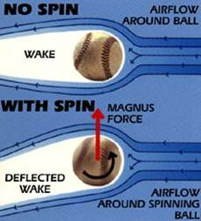




Calculating the Initial Forces

Slide 8
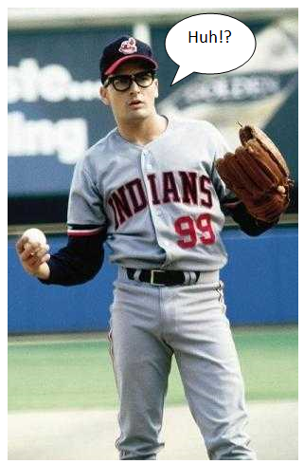





Approximating velocities

Slide 9
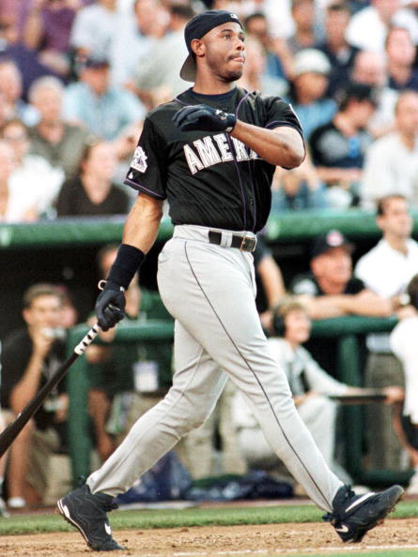



Approximating Distance

Slide 10
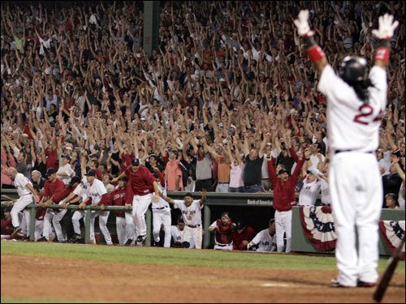
Our modified model
Here it is

Slide 11
Results: Range and Spin Rate
The range of the ball increases as the spin rate increases.
With spin rate of 100 rad/sec, maximum range is 112 meters
With spin rate of 300 rad/sec, maximum range is 121 meters
With a spin rate of 600 rad/sec, maximum range is 134 meters
Range is maximized when the ball is spinning its fastest

Slide 12
Results: Spin Rate and Angle of Contact
A ball with a slower spin rate requires a greater angle of contact to reach its maximum range.
With spin rate of 600 rad/sec, maximum range occurs when angle of contact is 15º
With spin rate of 100 rad/sec, maximum range occurs when angle of contact is 31º

Slide 13
Results: Data

Slide 14
Results: Maximizing Angle of Contact
Spin Rate= 400 rad/sec
Temperature= 56º F
Elevation= 0
Wind= 0
The angle of contact that maximizes the ball’s range (125 meters) is 22º.

Slide 15
Results: Range and Altitude
Elevation affects the range of a batted baseball.
Range can increase as much as 10 meters from an elevation of 5 to 5205 feet.
Major League Baseball ballparks range in altitude from Dolphin Stadium at 5 feet above sea level, to Coors Field at 5198 feet above sea level.
According to our model, there is a distinct advantage to playing at stadiums with higher altitudes.

Slide 16
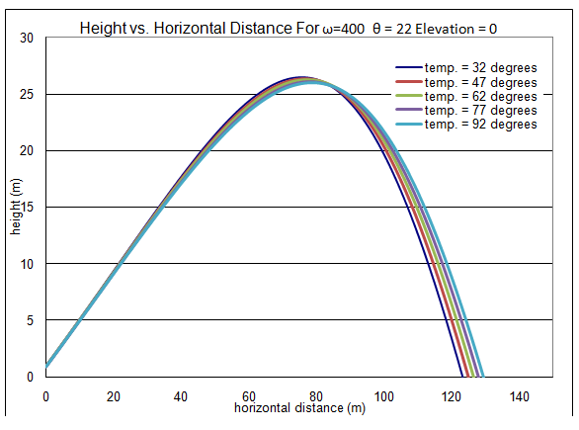
Results: Range and Air Temperature
Temperature also has a significant impact on the range of a ball.
A ball hit in 92º F weather travels up to 6 meters farther than a ball hit in 32º F weather.

Slide 17
Results: Accuracy of Our Model
In comparing our results with those obtained by Watts and Baroni (1989), the maximum ranges and optimum angles of contact for varying spin rates are quite similar.
For a spin rate of 300 rad/sec the maximum ranges and optimum angles are nearly identical.
For other spin rates, the results are not as similar, however they are still reasonably close.
The maximum range between models differs by as much as 9 meters and the angle of contact differs by no more than 7º.

Slide 18
Results: Accuracy of Our Model

Slide 19
Conclusion
Optimal Conditions for Maximizing a Batted Ball’s Trajectory
After analyzing the estimated trajectories of batted baseballs using a modified version
of Professor Nathan’s model, it is apparent that a ball’s range is significantly
affected by spin rate, air temperature, and altitude. As each of these
parameters is increased, the ball’s range increases. Also, the optimum angle for
maximizing the ball’s range is dependent on the spin rate. As the spin rate
of the ball is increased, the angle required to maximize the ball’s range decreases. If
baseball truly is a “game of inches,” such changes in range caused by varying spin
rates, angles of contact, air temperatures, and altitudes are great enough to
significantly alter the outcome of a game.

