Slide 1
Stiff Differential Equations
Numerical Approaches
by Thayer Fisher and Riley James

Slide 2
Outline
Intro
A simple example
Proper definition
Real world example
Solutions
Runge-Kutta, Dormond-Prince/ode23s
Conclusion

Slide 3
What is a Stiff Differential Equation?
A differential equation
Numerically unstable, requiring a small step size to solve using traditional methods
Includes a term that leads to rapid variation in the slope
Often this is variation around a stable solution as t gets large
The problem caused by stiffness is the time it takes to solve
Extremely simple ODE’s can fail under traditional numerical methods

Slide 4
A Simple Example
Consider the simple ODE:
$$\frac{dy}{dt}= −10y$$
$$y(0)=1.$$
We know that the solution to this ODE is:
$$y(t)=e^{−10t}$$
However, the numerical solution using Euler’s Method runs into some problems...

Slide 5
A Simple Example
y(t)
t

Slide 6
A-Stability
How do we quantify the stability of the numerical solution?
$y_{n+1}=y_{n}+h∗f(y_{n})$
$y_{n+1}=y_{n}−10h∗y_{n}$
$y_{n+1}=\left(1−10h\right)y_{n}$
By Induction:
$y_{n}=y_{0}∗{\left(1−10h\right)}^{n}$
Which is convergent for $\left|1−10h\right|<1$ or $h<\frac{2}{10}$

Slide 7
More A-Stability
Generalizing this concept for the test equation $y^{′}=−λy, y\left(0\right)=1$
$y_{n+1}=\left(1−λh\right)y_{n}$=$φ\left(z\right)y_{n}$ , where $z=λh$
The numerical method is called A-Stable if
$\left|φ\left(z\right)\right|<1, ∀z∈C,Re\left(z\right)<0$
Note that this region corresponds to the left half-plane, since z can be complex
A-Stability tells us that the numerical method is always stable around the origin
Further, if it is also the case that $φ\left(z\right)→0$as $z→−∞$, the numerical method is called L-Stable. L-Stable methods are good for solving stiff equations.

Slide 8
A More In-Depth Example
Stiffness can be seen in several differential equations that model the real world:
Propagating Flame Model:
$\frac{dy}{dt}=y^{2}−y^{3}$
$y(0)= δ$, where $δ$ is small (.0001)
$0<t<\frac{2}{δ}$

Slide 9
Runge-Kutta Method
4th order Runge-Kutta, modified version is ode45:
$k1=F\left(y_{n}\right)$
$k_{2}=f\left(y_{n}+0.5h∗k_{1}\right)$
$k3=f\left(y_{n}+0.5h∗k_{2}\right)$
$k_{4}=f(y_{n}+h∗k_{3})$
$y_{n+1}=y_{n}+\frac{h}{6} (k1+2k2+2k3+k4)$
y_{n} is the value of y at the n^{th} timestep and h is the step size
Variation on Euler's Method, using the weighted averages of 4 intervals between t_{n} and t_{n+1}

Slide 10
Applied to our IVP
h = 1$→$
$k1={.0001}^{2}−{.0001}^{3}=9.999∗{10}^{−9}$
$k_{2}=f\left(y_{0}+0.5h∗k_{1}\right)$
$$={\left(.0001+.5∗9.999∗{10}^{−9}\right)}^{2}−{\left(.0001+.5∗9.999∗{10}^{−9}\right)}^{3}=9.999∗{10}^{−9}$$
$k3=f\left(y_{0}+0.5h∗k_{2}\right)=9.999∗{10}^{−9}$
$k_{4}=f\left(y_{0}+h∗k_{3}\right)={\left(.0001+9.999∗{10}^{−9}\right)}^{2}−{\left(.0001+9.999∗{10}^{−9}\right)}^{3}=1.000∗{10}^{−8}$
$y_{1}=.0001+\frac{1}{6} \left(k1+2k2+2k3+k4\right)=1.0001∗{10}^{−4}$

Slide 11
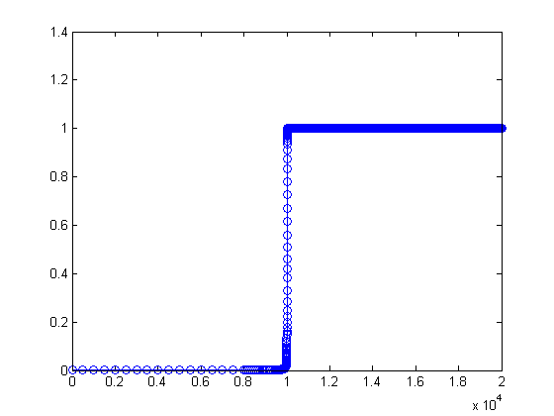
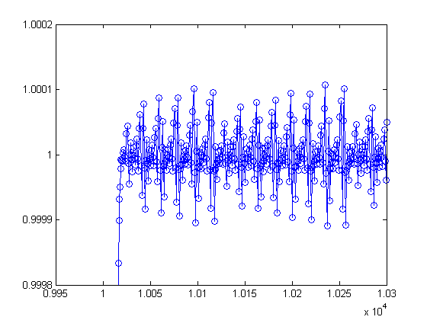
Plot of flame propagation system using ode45 zoomed around (1,1)
Plot of the flame propagation system using ode45 with δ = .0001

Slide 12
Dormand-Prince Method
Matlab ODE Suite has several modifications on the previous methods that work on surpassing the stiffness of a system
ode23s
Modified implicit Rosenbrock method of orders 3 and 2
Used to recognize drastic changes in the system at both the beginning and the end of each step
New Jacobian formed at each step
Components can change in each step, warranting a new Jacobian
Relatively quick to compute the Jacobian, which is what we care about in the first place

Slide 13
Matlab’s ode23s
hawks
When going from tn,yn to $t_{n+1}$= $t_{n}+h$:
$$F_{o}=hF(t_{n},y_{n}),$$
$$k1=W^{−1}(F_{0}+hdT),$$
$$F_{1}=F(t_{n}+0.5h,y_{n}+0.5hk_{1}),$$
$$k_{2}=W^{−1}(F_{1}−k_{1})+k_{1},$$
$$y_{n+1}=y_{n}+hk_{2},$$
$$F_{2}=F(t_{n+1},y_{n+1}),$$
$$k_{3} =W^{−1}[F_{2}−c_{32}(k_{2}−F_{1})−2(k_{1}−F_{0}+hdt],$$
$$error ≈\frac{h}{6}(k_{1}−2k_{2}+k_{3}),$$
where $W=I−hdJ, d=\frac{1}{2+\sqrt{2}}, c_{32}=6+\sqrt{2}, J ≈\frac{∂f}{∂y}\left(tn,yn\right), and T ≈\frac{∂f}{∂t}(tn,yn).$

Slide 14
Its Just an IVP
$\frac{dy}{dt}=y^{2}−y^{3}$,$t_{0}=0,y_{0}= δ=0.0001\text{, } 0<t<\frac{2}{δ},h=1→$
$$J=2y−3y^{2}, W=1−\frac{2y−3y^{2}}{2+\sqrt{2}}=1−\frac{2\left(.0001\right)−3{\left(.0001\right)}^{2}}{2+\sqrt{2}}=.99994$$
$$F_{0}=F\left(0,.0001\right)= {.0001}^{2}−{.0001}^{3}=9.99×{10}^{−9},$$
$$k_{1}={\left(.99994\right)}^{−1}\left(9.99×{10}^{−9}\right)=9.99×{10}^{−9},$$
$$F_{1}=F\left(0.5,.000100004\right)=9.99×{10}^{−9},$$
$$k_{2}={\left(.99994\right)}^{−1}\left(9.99×{10}^{−9}−9.99×{10}^{−9}\right)+9.99×{10}^{−9}=9.99×{10}^{−9},$$
$$y_{1}=.0001+9.99∗{10}^{−9}=.00010001$$
$$F_{2}=F\left(1,.00010001\right)=1.0001×{10}^{−8},$$
$$k_{3}={\left(.99994\right)}^{−1}[1.0001×{10}^{−8}−\left(6+\sqrt{2}\right)\left(9.99×{10}^{−9}−9.99×{10}^{−9}\right)−2\left(9.99×{10}^{−9}−9.99×{10}^{−9}\right)=9.9986×{10}^{−9}$$
$$error ≈\frac{1}{6}\left(9.99×{10}^{−9}−2×9.99×{10}^{−9}+9.9986×{10}^{−9}\right)=.0014×{10}^{−9}$$

Slide 15
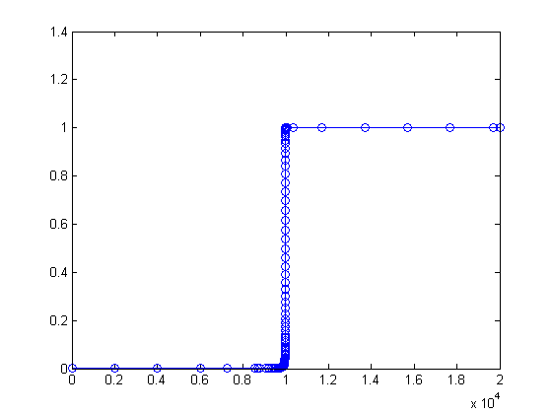
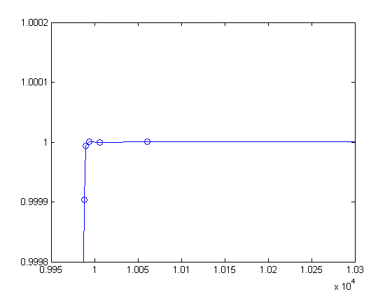
Flame propagation system plotted using ode23s, zoomed around (1,1)
Flame propagation system plotted using ode23s

Slide 16
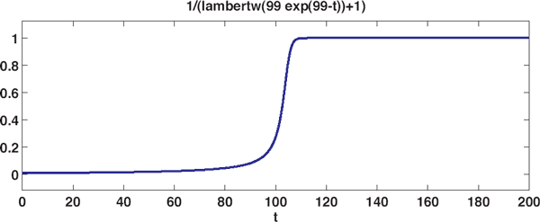
Finding an Exact Solution
The exact solution for the system of a propagating flame can be expressed:
$y\left(t\right)=\frac{1}{W\left(a e^{a−t}\right)+1}$
where a = 1/δ -1. The function W(z), the Lambert W function, is the solution to
$W\left(z\right)e^{W\left(z\right)} = z$
The graph of the exact solution is shown here:

Slide 17
Conclusion
From this we can conclude:
Stiff equations can be solved without being computationally expensive
Implicit methods are superior to explicit methods
Adjust for drastic changes around equilibrium
Explicit methods are more expensive, and require smaller step sizes, but have a higher degree of accuracy than implicit methods for non-stiff ODE’s

Slide 18
References
Ashino, Ryuichi, Michihiro Nagase, and Remi Vaillancourt. "Behind and Beyond the MATLAB ODE Suite." Behind and Beyond the MATLAB ODE Suite ∗ (n.d.): n. pag. Web.
Dahlquist, Germund (1963), "A special stability problem for linear multistep methods", BIT 3 (1): 27–43
Frank, Jason. "Optimal Implicit SSP Runge—Kutta Methods." Strong Stability Preserving Runge-Kutta and Multistep Time Discretizations (2011): 91-107. Utrecht University. Utrecht University. Web.
Moler, Cleve. "Ordinary Differential Equations, Stiffness 3." Cleves Corner Cleve Moler on Mathematics and Computing Ordinary Differential Equations Stiffness Comments. MATLAB, n.d. Web. 12 Nov. 2015.
Shampine, Lawrence F., and Mark W. Reichelt. "The Matlab ODE Suite." THE MATLAB ODE SUITE (n.d.): n. pag. Mathworks. Mathworks. Web.
Weisstein, Eric W. "Runge-Kutta Method." From MathWorld--A Wolfram Web Resource.

