Slide 1
Various Applications of Hopf Bifurcations
Matt Mulvehill, Kaleb Mitchell, Niko Lachman

Slide 2
Characteristics and Namesake
The Poincaré-Andronov-Hopf Bifurcation
A bifurcation is the point where the character of a solution to a differential equation changes
There are many types of bifurcation points
In class we learned about one of these types called a saddle-node bifurcation
- Made up of the phase lines

Slide 3
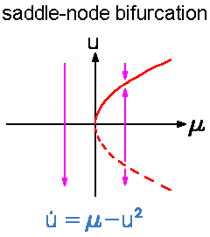
Saddle vs. Hopf Bifurcations

Slide 4
Important Concepts
A limit cycle is a closed trajectory that solutions tend towards either as time goes to infinity or towards negative infinity.
“subcritical bifurcation”: limit cycle appears for negative values of the parameter; solutions tend away from the limit cycle
“supercritical bifurcation”: limit cycle appears for positive values of the parameter; solutions tend towards the limit cycle

Slide 5
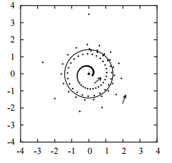
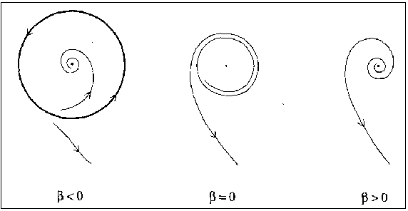
Supercritical versus Subcritical
Subcritical Bifurcation
Supercritical Bifurcation
Re(λ)<0 ; source at equilibrium value
Solutions are stable closed orbits(periodic) ; amplitude of the orbit increases when parameter increases
Re(λ)>0; sink at equilibrium value
Solutions are unstable closed orbits; amplitude of the orbit increases when parameter gets more negative

Slide 6
Hopf Bifurcation Example
Non-autonomous
Non-linear
First order
Ordinary Differential Equation

Slide 7
Solving for Equilibrium Points
The equilibrium point for the system is (0,0) for any α (alpha)

Slide 8
Linearize the System
Use the Jacobian to linearize the system of differential equations
Evaluate the Jacobian at the equilibrium point (0,0)

Slide 9
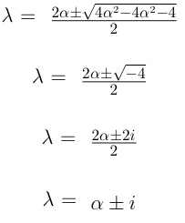
Solve for the Eigenvalues of the System
det
= 0

Slide 10
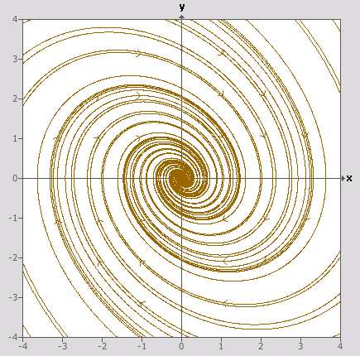
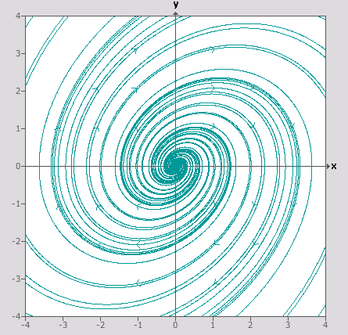
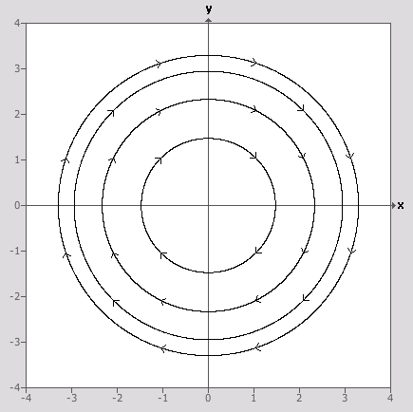
Complex Eigenvalues What We know...
λ=α±iβ
Re(λ)<0 , α<0
Stable Spiral Sink
Re(λ)>0 , α>0
Unstable Spiral Source
Re(λ)=0 , α=0
Unstable Center

Slide 11
What we don’t know…
What does the phase portrait look like when α changes?
How does this system of differential equations differ from ones that we have studied previously?
…and how do we find out?

Slide 12
Supercritical or Subcritical?
Check α = 0 and plug points into the equations to determine if the bifurcation of the system is supercritical or subcritical.
= -y + x³ + xy²
At α = 0, the phase portrait is a source due to the direction vector pointing away from the equilibrium point (0,0)
dx/dt = -10
@ (0,10)
= y + yx² + y³
dy/dt = 1010

Slide 13
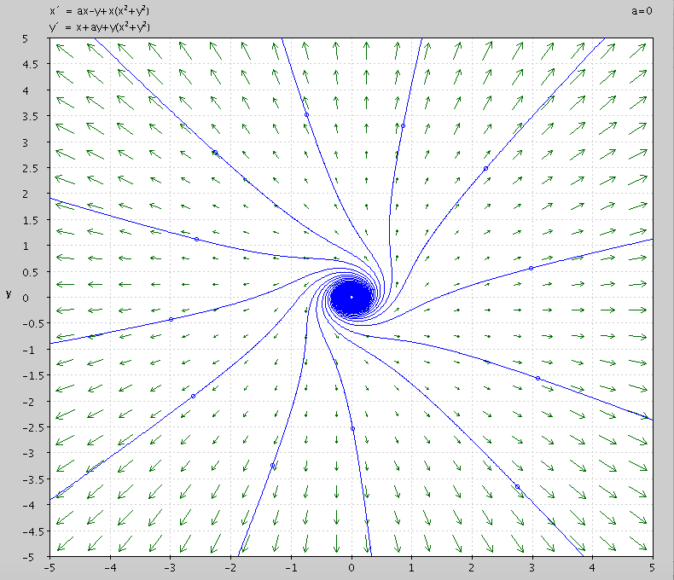
Subcritical Bifurcation Phase Portrait at α = 0

Slide 14
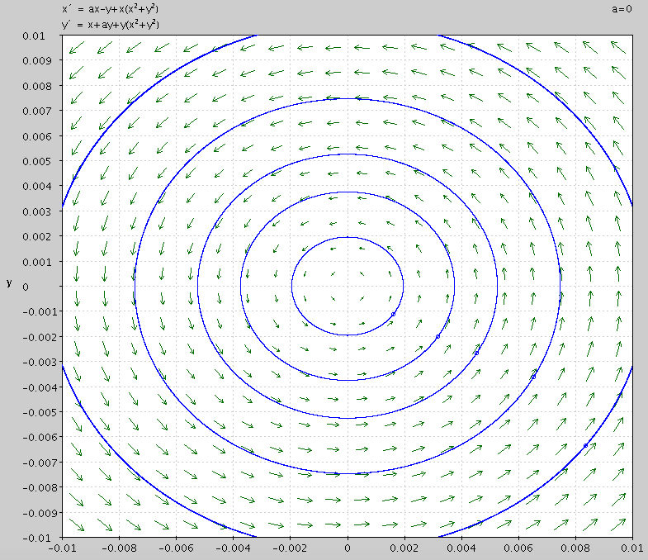
So what happened to the unstable center at Re(λ)=0?
ITS STILL THERE!
But only for small x and y values

Slide 15
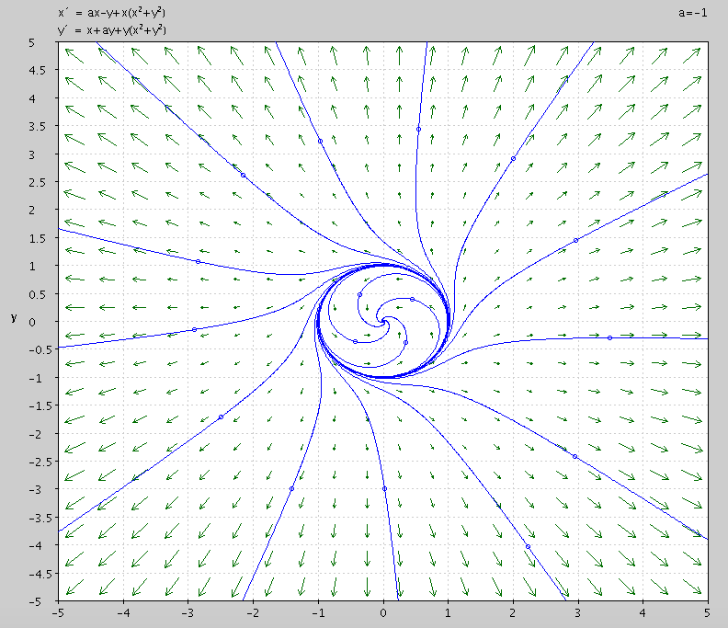
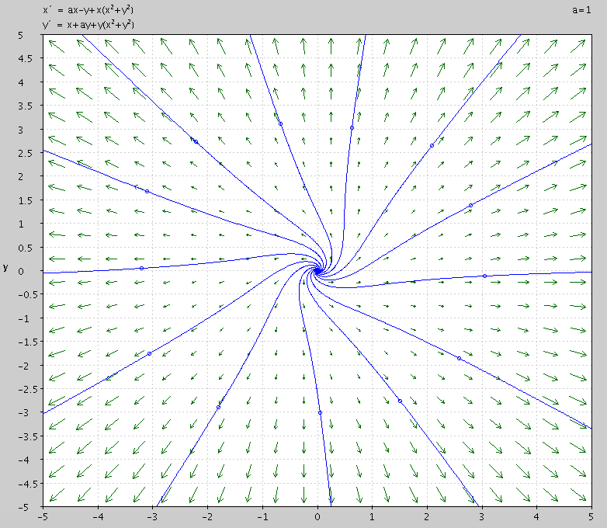
All Phase Portraits for α, subcritical
α < 0
α = 0
α > 0

Slide 16
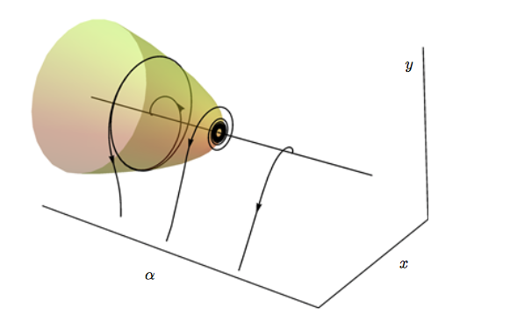
Cool Picture

Slide 17
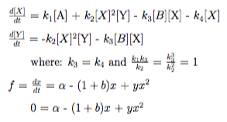
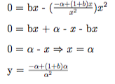
Brusselator Reaction Example

Slide 18
Jacobian

Slide 19
Eigenvalues

Slide 20
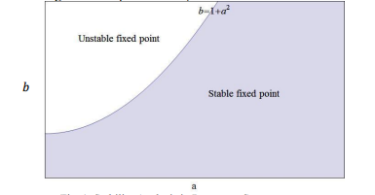
Eigenvalues cont.
b - α^2 - 1 > 0 Source at the equilibrium point with level set
b - α^2 - 1 = 0 Source-Level set ends/begins
b - α^2 - 1 < 0 Stable sink

Slide 21
Lienard’s Equation
Differential equation used to model oscillating circuits
To analyze this second-order differential equation it is easiest to turn it into a system of first-order differential equations
Set: y= $\frac{dx}{dt}$ ; this gives us:

Slide 22
Linearizing the DE
Step 1: Find the equilibrium values; equate both differential equations to zero
Step 2: Linearize using the Jacobian

Slide 23
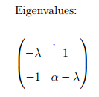
Analysis
The eigenvalues of the equations are:
Hopf Bifurcations have complex eigenvalues
If we choose a point far away from our equilibrium point we can learn whether the bifurcation is subcritical or supercritical
In this case there is a source at (0,0) which makes it a supercritical bifurcation

