Slide 1
Harmonic Oscillators
Will Bergman and Mike Ma

Slide 2
Overview
Simple Harmonic Motion
Spring and Mass
General Form
Damped Simple Harmonic Oscillators
Underdamped Case
Overdamped Case
Critically Damped Case
Driven Simple Harmonic Oscillators
Periodic Driving Force
Resonance
Tacoma Bridge Example
Conclusion and Further Applications

Slide 3

Spring and Mass
$F=ma$
$m\frac{d^{2}x}{dt^{2}}=−kx$
Guess: $x\left(t\right)=e^{rt}$
$r_{1}=+i\sqrt{\frac{k}{m}} ,r_{2}=−i\sqrt{\frac{k}{m}}$
$x\left(t\right)=C_{1}x_{1}\left(t\right)+C_{2}x_{2}\left(t\right)$
$x\left(t\right)=C_{1}e^{r_{1}t}+C_{2}e^{r_{1}t}$
(Taylor, 2003)
https://commons.wikimedia.org/wiki/File:Simple_harmonic_oscillator.gif

Slide 4
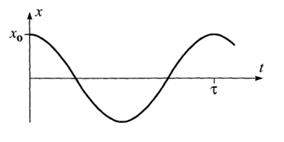

General Form
$m\frac{d^{2}x}{dt^{2}}=−kx$
$x\left(t\right)=\left(C_{1}+C_{2}\right)cos\left(wt\right)+i\left(C_{1}−C_{2}\right)sin\left(wt\right)$
${x\left(t\right)=B}_{1}cos\left(wt\right)+B_{2}sin\left(wt\right)$
(Taylor, 2003)

Slide 5
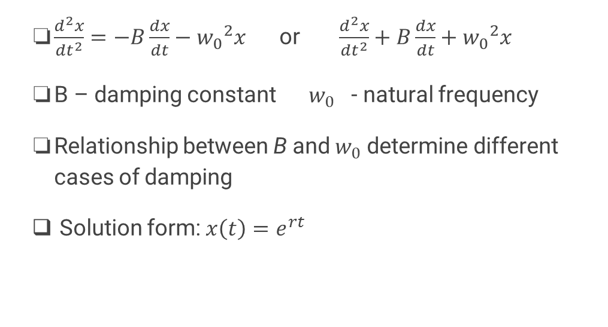
Damped Simple Harmonic Oscillators
$\frac{d^{2}x}{dt^{2}}=−B\frac{dx}{dt}−{w_{0}}^{2}x$ or $\frac{d^{2}x}{dt^{2}}+B\frac{dx}{dt}+{w_{0}}^{2}x$
B – damping constant ${w_{0}}^{}$- natural frequency
Relationship between B and $w_{0}$ determine different cases of damping
Solution form: $x\left(t\right)=e^{rt}$

Slide 6
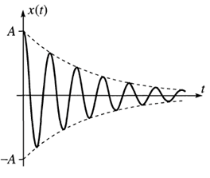
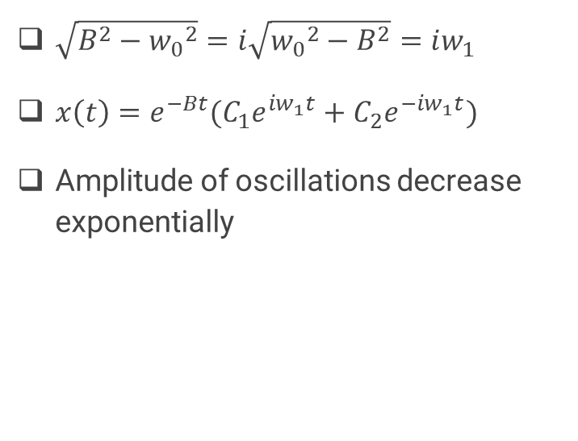
Underdamped Case ($B<w_{0}$)
$\sqrt{B^{2}−{w_{0}}^{2}}=i\sqrt{{w_{0}}^{2}−B^{2}}=iw_{1}$
${x\left(t\right)=e}^{−Bt}(C_{1}e^{iw_{1}t}+C_{2}e^{−iw_{1}t})$
Amplitude of oscillations decrease exponentially
(Taylor, 2003)

Slide 7
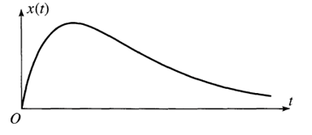

Overdamped Case ($B>w_{0})$
$x\left(t\right)=e^{−Bt}(C_{1}e^{\sqrt{B^{2}−{w_{0}}^{2}}t}+C_{2}e^{−\sqrt{B^{2}−{w_{0}}^{2}}t})$
No Oscillations!
(Taylor, 2003)

Slide 8
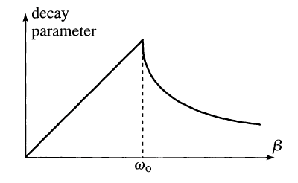

Critically Damped Case ($B=w_{0}$)
Repeated Eigenvalues
$B=w_{0}$ is a bifurcation value
$x\left(t\right)=e^{−Bt}$
${x(t)=te}^{−Bt}$
$x\left(t\right)={C_{1}e}^{−Bt}+C_{2}{te}^{−Bt}$
(Blanchard et al., 2012)
(Taylor, 2003)

Slide 9
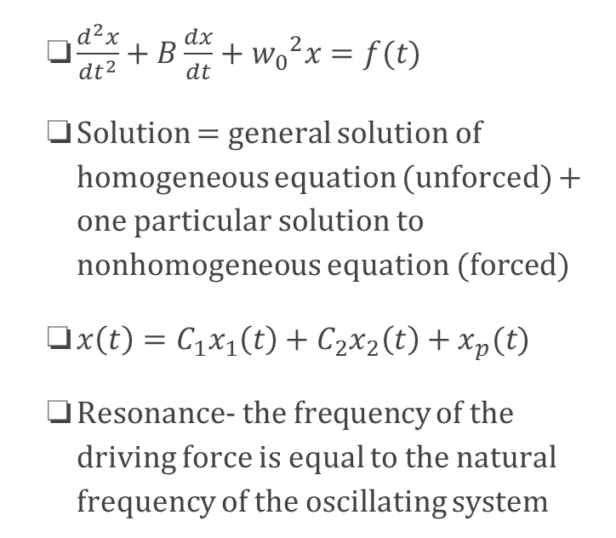
Driven Simple Harmonic Oscillators
$\frac{d^{2}x}{dt^{2}}+B\frac{dx}{dt}+{w_{0}}^{2}x=f(t)$
Solution = general solution of homogeneous equation (unforced) + one particular solution to nonhomogeneous equation (forced)
$x\left(t\right)=C_{1}x_{1}\left(t\right)+C_{2}x_{2}\left(t\right)+x_{p}(t)$
Resonance- the frequency of the driving force is equal to the natural frequency of the oscillating system
http://www.acs.psu.edu/drussell/Demos/SHO/mass-force.html

Slide 10
Conclusion and Further Applications of Theory
https://www.youtube.com/watch?v=vPZuHFrawz4
https://www.youtube.com/watch?v=3mclp9QmCGs

Slide 11
References
https://commons.wikimedia.org/wiki/File:Simple_harmonic_oscillator.gif
Taylor, John R. "Chapter 5: Oscillations." Classical Mechanics. Sausalito, CA: U Science, 2005. 161-203. Print.
Blanchard, Paul, Robert L. Devaney, and Glen R. Hall. "Chapter 2.3: The Damped Harmonic Oscillator." Differential Equations. Boston, MA: Brooks/Cole, Cengage Learning, 2012. 183-88. Print.
http://www.acs.psu.edu/drussell/Demos/SHO/mass-force.html

