Slide 1
CHAOS THEORY
Gloria Mayorga-Garcia
Erin Kim
Noorsher Ahmed
Notes:
+Introduction

Slide 2
So, what is Chaos Theory?
Chaos Theory is the field of mathematics that studies complex systems and their behaviors.
Initial Conditions
Apparent disorder
Underlying order
Notes:
Chaos, with reference to chaos theory, refers to an apparent lack of order in a system that nevertheless obeys particular laws or rules;
the impossibility of making predictions for complex systems; despite the fact that these are determined by underlying conditions, precisely what those conditions are can never be sufficiently articulated to allow long-range predictions.

Slide 3
Robert Devaney’s Definition of Chaos
A map f, with an interval I = [α, β], is chaotic if:
(1) Periodic points of f are dense in I; a subset U is dense in I if there are any points in U arbitrarily close to any point in the larger set I;
(2) f is transitive on I; given any two subintervals U₁ and U₂ in I, there is a point x₀ ∈ U₁ and an n > 0 such that f ^{n}(x₀) ∈ U₂ , where n denotes the iterate of f;
(3) f has sensitive dependence on initial conditions; there is a sensitivity constant β such that, for any x₀ ∈ I and any open interval U about x₀, there is some seed y₀, ∈ U and n > 0 such that |f ^{n}(x₀) − f ^{n}(y₀)| > β.¹¹

Slide 4
Tent Map: An Example of a Chaotic System
T(x) = 2x if 0 ≤ x < ½
2(1-x) if ½ ≤ x ≤ 1
The graph of the tent map T and its higher iterates T ² and T ³ on [0,1].
Periodic points of T are dense on [0,1].
T is transitive on [0,1].
Theorem: If f: X → X is transitive and has dense periodic points then f has sensitive dependence on initial conditions
=> T has sensitive dependence on initial conditions.

Slide 5
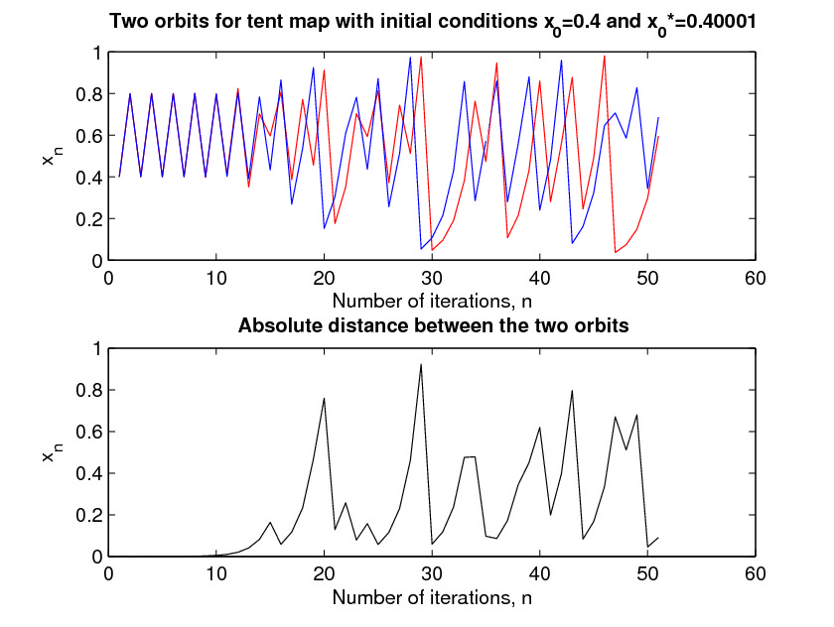
Sensitive Dependence on Initial Conditions
The orbits are very close initially, but bear little resemblance after iteration 16.
Notes:
These graphs show visually that the tent map is sensitive to a small change in the initial condition. Above, we see two orbits with initial conditions that are different by 0.00001. Below, we see the absolute distance between the two orbits. The orbits are very close initially, but bear little resemblance after about iteration 16.

Slide 6
The Butterfly Effect
Edward N. Lorenz’s Paper: “Predictability: Does the Flap of a Butterfly’s Wings in Brazil Set Off a Tornado in Texas?”
Asked whether the influence of a single butterfly will generally, after sufficient time, evolve into two situations differing by as much as the presence of a tornado.
Weather = chaotic system; flap of butterfly’s wings = small change in IC.
Small errors grow rapidly with time, which makes long-term weather forecasts difficult.
Conclusion: Errors in weather forecasting are not due to the structure of weather patterns but our failure to perfectly know all variables that affect it.

Slide 7
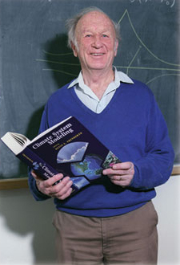
Edward N. Lorenz
In 1960, the meteorologist Edward N. Lorenz accidentally discovered the presence of chaos in his model of the weather. Lorenz has a system of twelve equations that related several factors such as wind speed, temperature and pressure. One day, he decided to repeat a set of his calculations but he started at the midpoint. Lorenz let the system run and upon his return, he was greeted by completely different results.
Notes:
- running computerized equations to theoretically model and predict weather conditions
-He eventually figured out that the second time, only three digits were used in calculations (0.506) vs. six digits in the first round (0.50612)². This slight discrepancy impacted the system greatly, or in other words, the system was highly sensitive to the initial conditions. Since then, Lorenz is often credited with discovering chaos, or at least, credited with a lot of the work done around chaos.
-Lorenz was studying a two-dimensional fluid cell that was heated from below and cooled from above. The motion of this cell was difficult to describe, but it could be done with a system of differential equations consisting of many variables.

Slide 8
Lorenz System
Two Variables:
The rate of convective “overturning”
Temperature variation in both horizontal and vertical directions
x' = σ(y-x)
y' = rx-y-xz
z' = xy-bz
Notes:
-Lorenz simplified his original system in order to study chaos more in depth
-equations model the flow of fluid, particularly air, from a hot area to a cold area aka convective fluid flow
-In this system, the three parameters σ, r, and b, which are assumed to be positive, represent physical characteristics of airflow and more specifically, σ > b + 1.⁴ The variables x, y, and z represent “the amplitude of convective current in the air cell, temperature difference between rising and falling currents, and the deviation of temperature from the normal temperature of the cell”

Slide 9
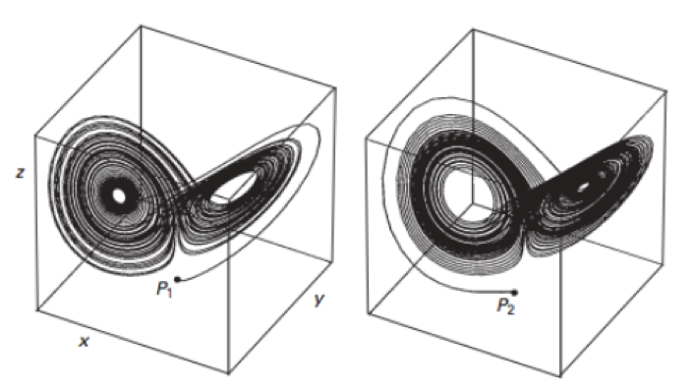
Lorenz Strange Attractor
Two solutions with Initial Conditions P₁ = (0,2,0)
and P₂ = (0, -2, 0)
Notes:
All solution curves after a certain time, exhibit a similar behavior: the curves begin to wind around two certain points in space. This object that the solutions tend toward is also referred to as a strange attractor. The description as a “strange” attractor comes from the fact that this object far different from other forms of equilibrium points that we have studied

Slide 11
Control of Chaos
A chaotic system can be seen as shadowing some periodic behavior at a given time, and erratically jumping from one periodic orbit to another.
To control chaos, one can apply small perturbations as the trajectory approaches a desired periodic orbit to stabilize the orbit.
Since small perturbations can cause large responses with time, one can direct the trajectory to wherever we want in the attractor.
One can produce an infinite number of desired dynamical behaviors (periodic or nonperiodic) using the same chaotic system if tiny perturbations are chosen properly.

Slide 12
Robotics: An application of chaos theory
It is very difficult to program robots for every possible robot-environment interaction (Example: robot leg getting stuck in a hole)
On the other hand, a simple insect can approach a new and unique situation by generating new behaviors (such as changing its gait to get out of a hole) on its own
(Not so) Recently a team in Germany figured out how to replicate this behavior in a robot

Slide 13
AMOS-WD06
2:00-
2:30
System Designed by Steingrube et. al. @ the Bernstein Center for Computational Neuroscience in Germany

Slide 14
AMOS-WD06
At least it’s better than pathetically walking forever while stuck
AMOS-WD06 (the robot) has a two-neuron module that serves as a central pattern generator (CPG) that can generate different gaits (walking patterns) in an adaptive way while coordinating walking and orienting
Input from 13 sensors determine the parameters that affect the dynamics of the chaotic system modeled in the CPG
CPG output coordinates 18 different motors that make AMOS-WD06 walk

Slide 15
Chaos control in the CPG
The output states of the CPG , are such that the circuit satisfies:
σ(x) is a sigmoid activation function
θ_{i} and w_{ij} are different parameters related to neural network functionality
c_{i}^{(p)} are control signals that depend on p, the period of the orbit of the chaotic system to be controlled (the output)

Slide 16
Chaos control in the CPG
The period p is uniquely determined by sensory inputs based on different situations (rough terrain, downward slope, light, etc.)
When c_{i}^{(p)}=0, the CPG exhibits chaotic dynamics, allowing the robot to undertake new gaits

Slide 17
Chaos control in the CPG
Basically:
Without any control of p, the CPG signal is chaotic producing new original gaits
Because the chaotic attractors in the system contain an almost infinite number of unstable periodic orbits, it is possible for the robot to “discover” an almost infinite amount of gaits
This is what enables the function of the CPG
With control of p, the CPG dynamics switch to one of many preset outputs
Combining the CPG with a standard postprocessing unit enables the robot to conduct sensor-driven control of a very large repertoire of behaviors

Slide 18
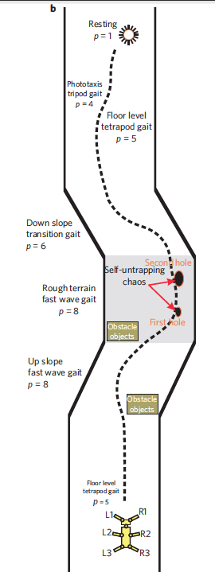

Slide 19
Chaos control in the CPG
The chaos control in the CPG physically manifests in the robot’s ability to self-untrap
Steingrube et. al. also gave their robot the ability to remember useful gaits it “discovers”
This allows for quicker response times when stuck in repeated difficult situations over time

Slide 20
Mind = Blown
AMOS-WD06 uses a chaotic system and chaos control as the driving force for its ARTIFICIAL INTELLIGENCE!

Slide 21
Conclusion
Chaos Theory is a mathematical tool that can help shed light on some of the most complex and difficult problems.
It can be used to model systems that are determinstic in nature but HIGHLY sensitive to initial conditions
Limitation of using chaos theory is not our lack of knowledge of all variables...it is the inaccuracy of our measurements of these variables

Slide 22
Conclusion
Fortunately, we have more mathematical tools to extract useful information from chaos theory:
Most chaotic systems of interest take place on a strange attractor
A large set of initial conditions will lead to orbits that converge to a chaotic region
Gives chaotic systems a resemblance of some periodic behavior at a given time
Chaos control can take advantage of strange attractors for useful applications
Chaos control occurs when small perturbations are applied to the system to stabilize an orbit around a strange attractor

Slide 23
Conclusion
Chaos theory can be used for some of the following interesting applications and more!
Prediction of stock market crashes
Prediction of “dragon-king events” in climate science
Prediction of heart attacks and epileptic seizures
Predicting the next strain of the flu before the current one mutates
Modeling fisheries with more accuracy
Modeling the brain
Artificial Intelligence
Modeling sociological interactions in urban environments
SimCity (the video game)

