Slide 1
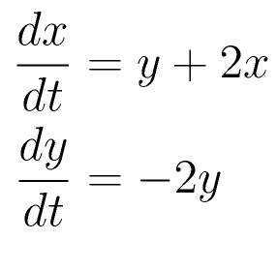
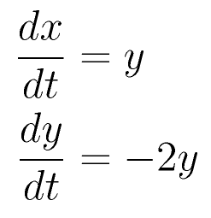
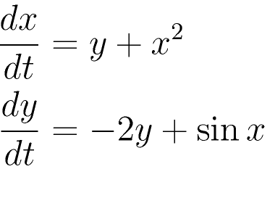
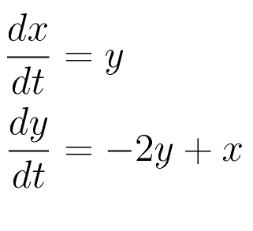
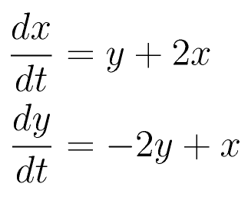
Set #8, Question 1
B.
C. D.

Slide 2
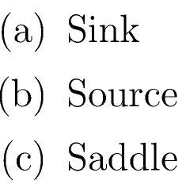
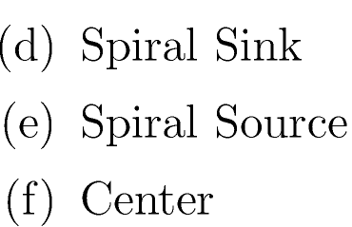
Set #8, Question 2

Slide 3
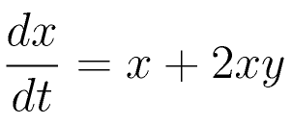
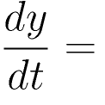
Set #8, Question 3

Slide 4
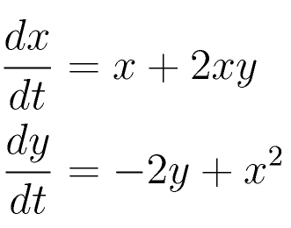
Set #8, Question 4
The following nonlinear system is a Hamiltonian system.
A. TRUE B. FALSE

Slide 5
Set #8, Question 5
The following nonlinear system is a gradient system.
A. TRUE B. FALSE

