Slide 1
Set #4, Question 1: When we have y’=7y+2x we should conjecture y=C₀e^{7x}+C₁x+C₂.Why include the C₂?

Slide 2
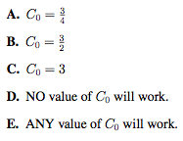
Set #4, Question 2: We are testing the function f(x)=C₀e^{2x}+C₁e^{-2x} as a possible solution to a DE. After we substitute the function and its derivative into the DE we get 2C₀e^{2x} -2C₁e^{-2x} = -2(C₀e^{2x}+C₁e^{-2x})+3e^{2x}. What value of C₀ will allow this function to work as a solution?

Slide 3
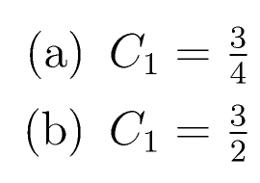
Set #4, Question3: We are testing the function f(x)=C₀e^{2x}+C₁e^{-2x} as a possible solution to a DE. After we substitute the function and its derivative into the DE we get 2C₀e^{2x} -2C₁e^{-2x} = -2(C₀e^{2x}+C₁e^{-2x})+3e^{2x}. What value of C₁ will allow this function to work?

Slide 4
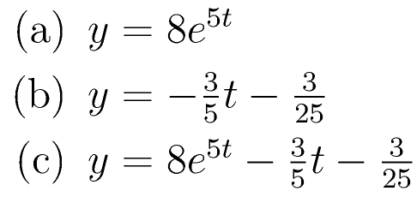
Set #4, Question 4: Which of the following is NOT a solution to y’(t)=5y+3t?

Slide 5
Set #4, Question 5: Consider g’(z)=ag+bcos(cz) where a, b and c are positive parameters. What will the long-term behavior of the system be?

Slide 6
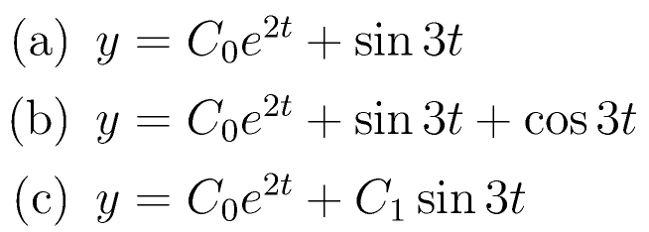
Set #4, Question 6: We have the equation y’=2y+sin(3t). What should our conjecture for y(t) be?

