Slide 1
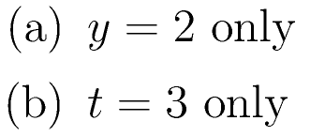
Set 3, #1: The differential equation y’=(y-2)(t-3) has equilibrium values of?

Slide 2
Set 3, #2: Suppose 3 is an equilibrium value of a differential equation. This means that

Slide 3
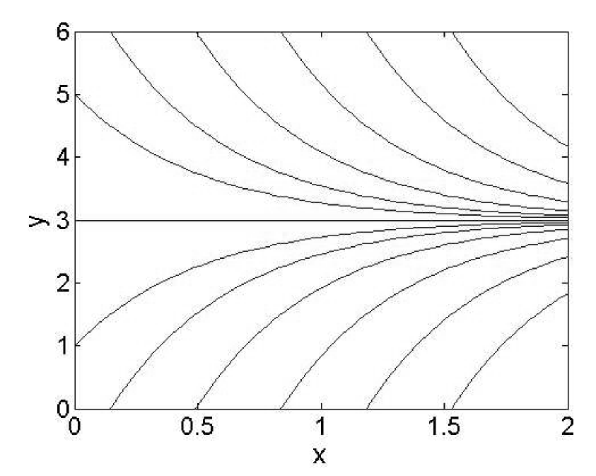
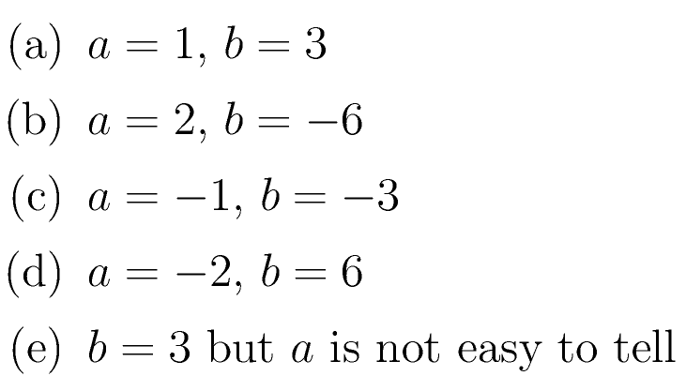
Set 3, #3: The figure plots several solutions of y’=ay+b. What could be the values of a and b?

Slide 4
Set 3, #4: TRUE or FALSE. “A differential equation could have infinitely many equilibria.”
TRUE
FALSE

Slide 5
Set 3, #5: What is the equilibrium value of

Slide 6
Set 3, #6: How many equilibria does the DE y’=y²+r have? (r is a real-valued parameter)
Zero.
One.
Two.
Three.
Not Enough Information Is Given.

Slide 7
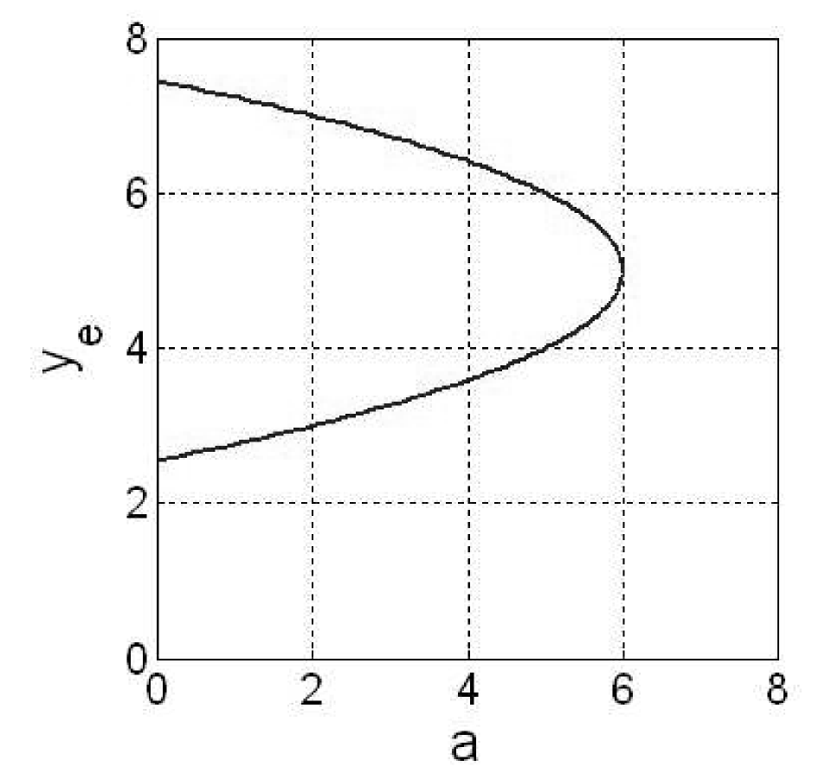
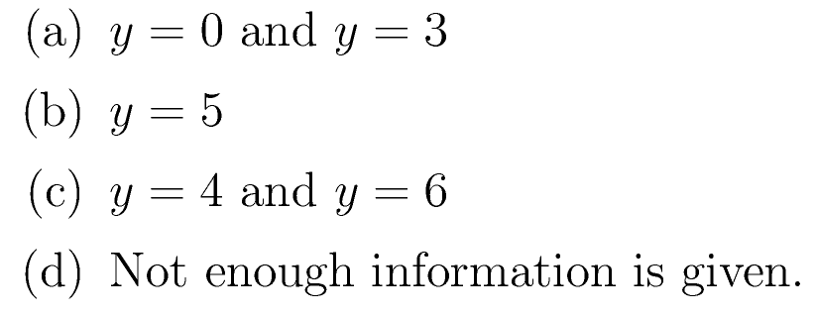
Set 3, #7: A bifurcation diagram plots a DE’s equilibria on the vertical axis and the bifurcation parameter on the horizontal axis. Consider the bifurcation diagram below. When the parameter is a=5, what are the equilibrium values of the differential equation?

Slide 8
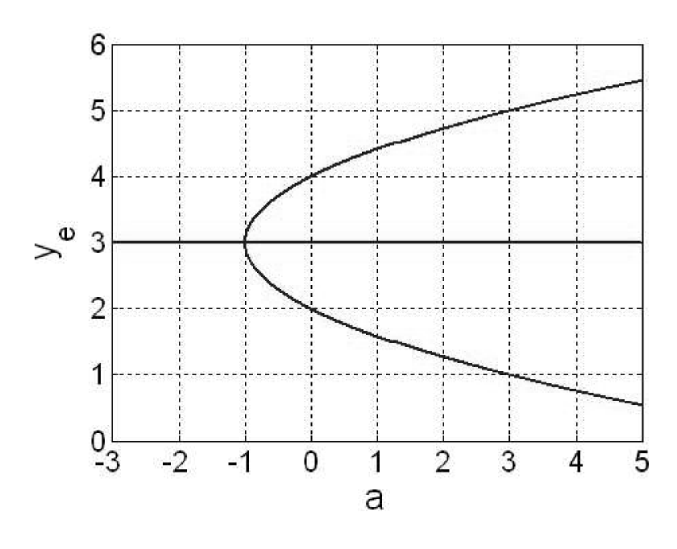
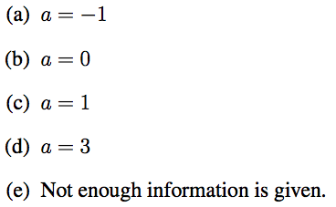
Set 3, #8: Consider the bifurcation diagram below. If the DE has equilibria at y=1, y=3, and y=5 what is the value of the bifurcation parameter a?

Slide 9
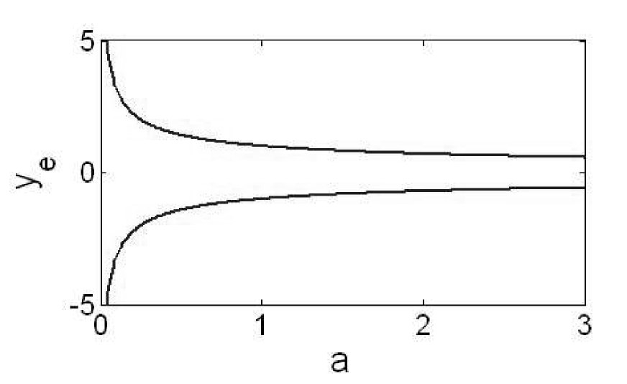
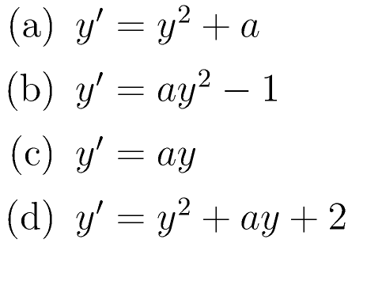
Set 3, #9: Which of the following diferential equations is represented by the bifurcation diagram below?

