Slide 1
Set #1, Question E: TRUE or FALSE: “A differential equation is a type of function.”
A. TRUE B. FALSE.

Slide 2
Set #1, Question F: Consider the differential equation xy’+y=0.The solution of this DE is
A. y =1/x, x > 0
B. y = 1/x, x≠0
C. y =0, x>0
D. y =0, for all x
E. More than one of the above

Slide 3
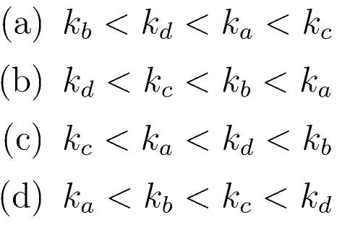
Set #2, Question 1: Each of the following graphs represents solution curves to y’=ky. Order the constants k from smallest to largest.

Slide 4
Set #2, Question 2: Using Euler’s Method, we obtain the difference equation y_{n+1}=y_{n}+cΔt to approximate a differential equation. What is the ODE being estimated?
y’=cy
y’=y+c
y’=c
y’=y+cΔt
None of the above

Slide 5
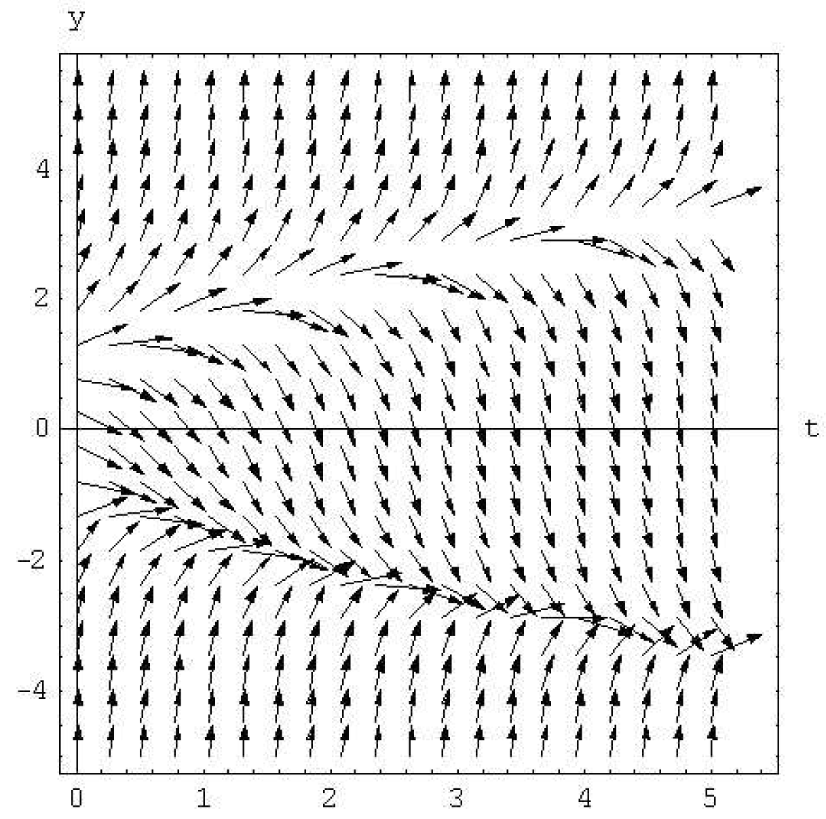
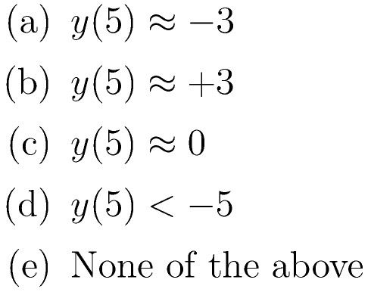
Set #2, Question 3: Consider the slope field which shows the derivative y’ for a range of values for the function y and independent variable t. Suppose y(0)=-4. Predict y(5).

Slide 6
Set #2, Question 4: Consider the differential equation y’=ay+b with parameters a and b.To approximate this differential equation using Euler’s Method, what is the difference equation?

Slide 7
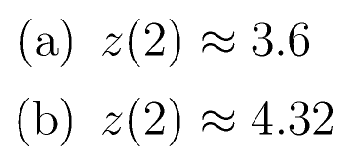
Set #2, Question 5: We have used Euler’s Method to approximate the solution to a differential equation with the difference equation z_{n+1}=1.2z_{n}. We know that the function z(0)=3. Estimate z(2).

Slide 8
Set #2, Question 6: TRUE or FALSE: “All equations have solutions.”
A. TRUE B. FALSE.

Slide 9
Set #2, Question 7: TRUE or FALSE: “Some initial value problems do not have unique solutions.”
A. TRUE B. FALSE.

Slide 10
Set #2, Question 8: TRUE or FALSE: “IF an initial value problem has a solution, THEN it is unique.”
A. TRUE B. FALSE.

