Slide 1
Question 1: What is the order of the following differential equation?
A) 1 B) 2 C) 3 D) 4 E) Impossible to say

Slide 2
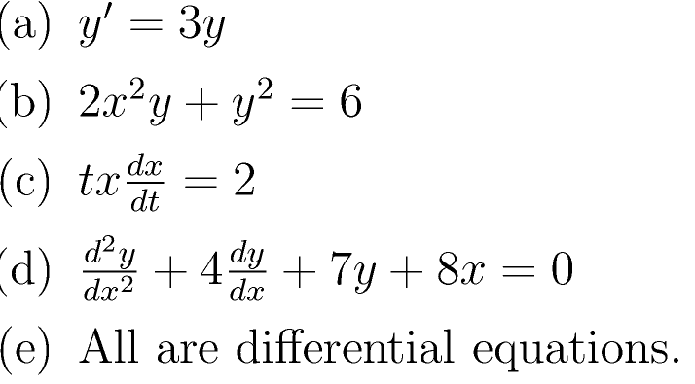
Question 2: Which of the following is NOT a differential equation?

Slide 3
Question 3: The following ODE is a LINEAR differential equation:
A. TRUE B. FALSE.

Slide 4
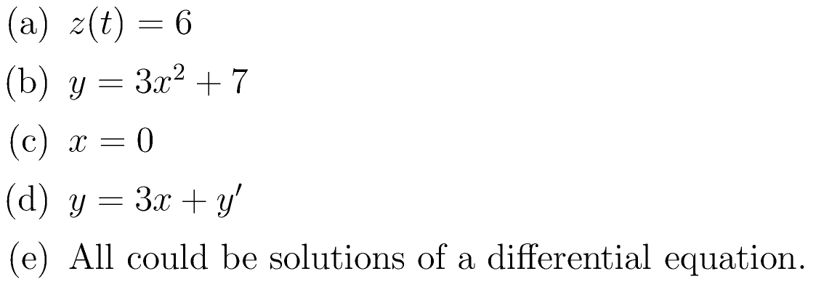
Question 4: Which if the following can NOT be the solution of a differential equation?

Slide 5
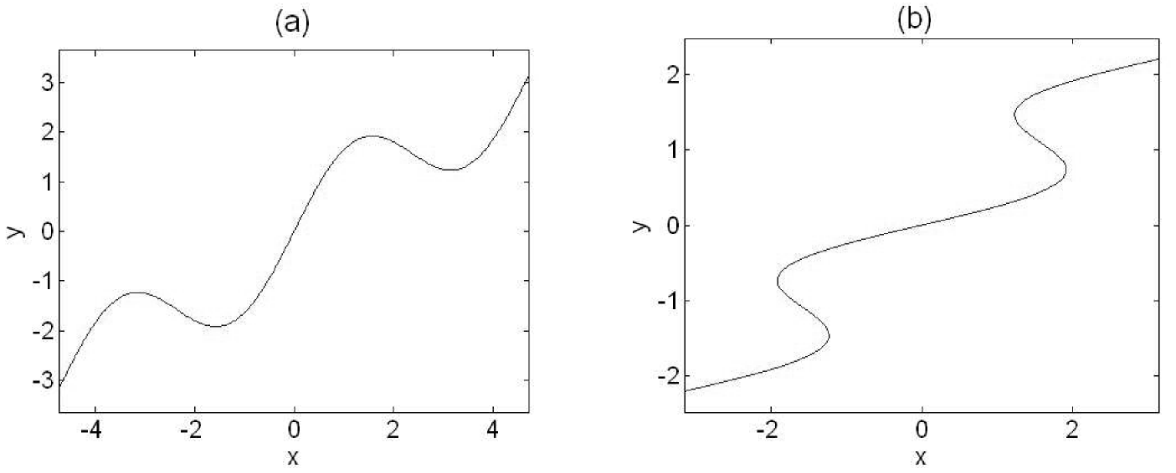
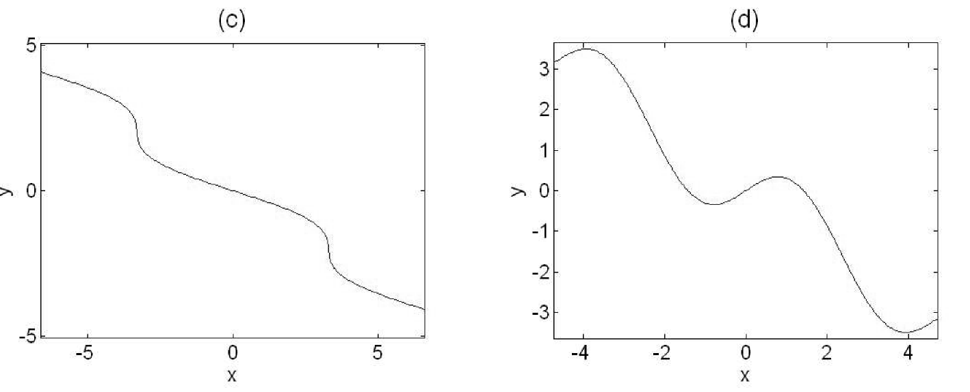
Question 5: Which of the following can NOT represent the solution of a differential equation?

Slide 6
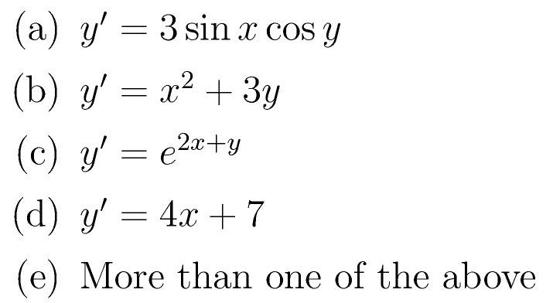
Question 6: Which of the following differential equations is NOT separable?

Slide 7
Question A: What does the differential equation y’=2y tell you about the slope of the solution curves at any point?

Slide 8
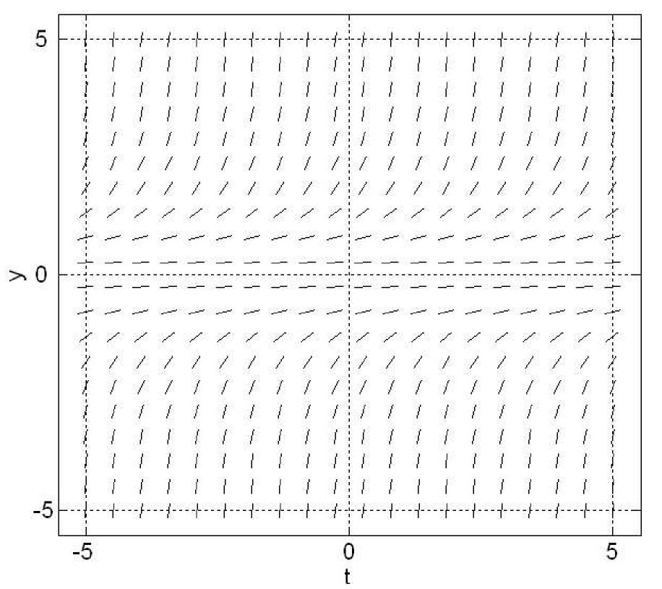
Question B: The slope field below indicates that the differential equation has which form?
y’=f(t)
y’=f(y)
y’=f(t,y)
None of the above.
We don’t have enough information to answer

Slide 9
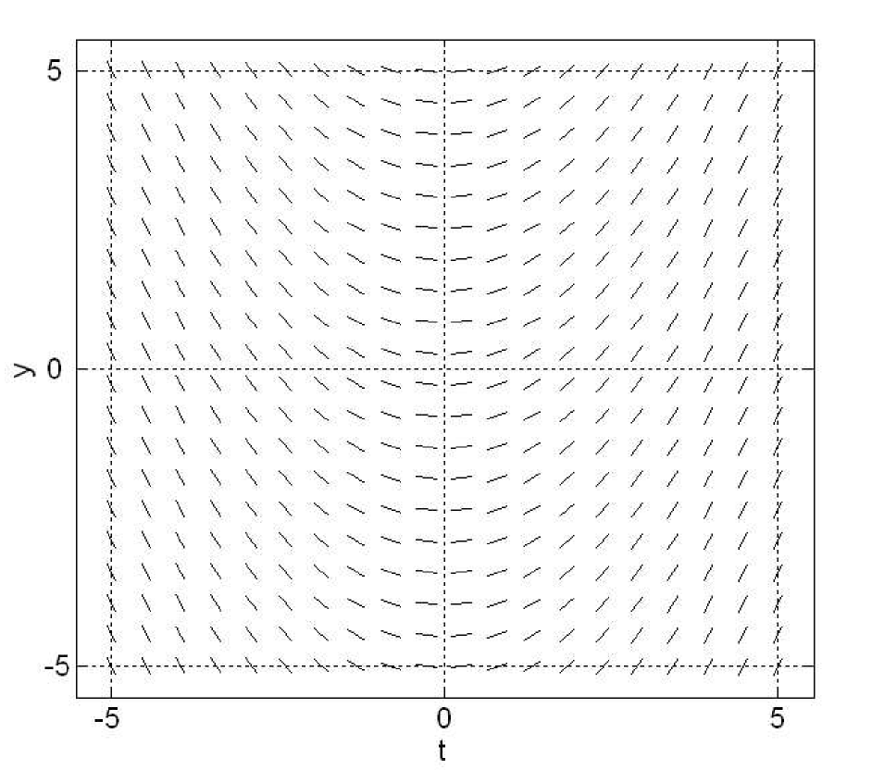
Question C: The slope field below indicates that the differential equation has which form?
y’=f(t)
y’=f(y)
y’=f(t,y)
None of the above.
We don’t have enough information to answer

Slide 10
Question D: TRUE or FALSE: “A solution of a differential equation is a unique function.”
A. TRUE B. FALSE.

Slide 11
Question E: TRUE or FALSE: “A differential equation is a type of function.”
A. TRUE B. FALSE.

Slide 12
Question F: Consider the differential equation xy’+y=0.The solution of this DE is
A. y =1/x, x > 0
B. y = 1/x, x≠0
C. y =0, x>0
D. y =0, for all x
E. More than one of the above

