Slide 1
The Fourier Transform
Ian Li

Slide 2
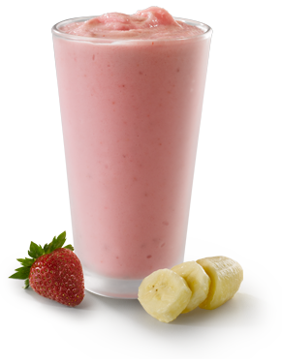

Slide 3
Periodic function

Slide 4
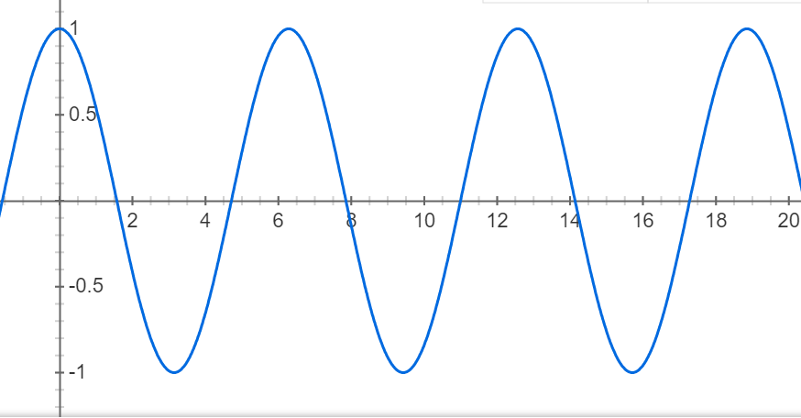
wave
Frequency (f=1/T)
Frequency
Amplitude
Phase
Amplitude
Phase

Slide 5
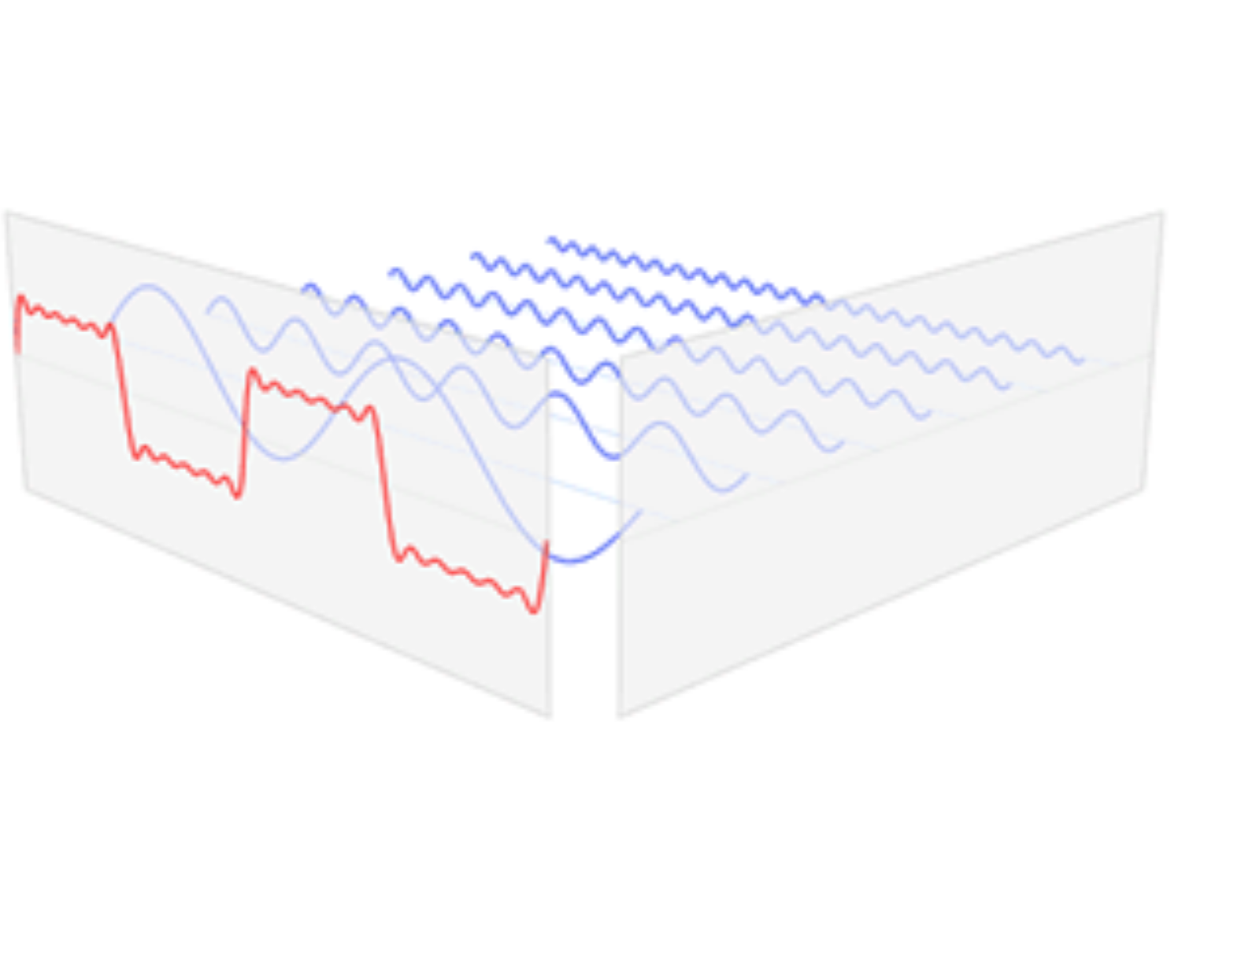
frequency

Slide 6
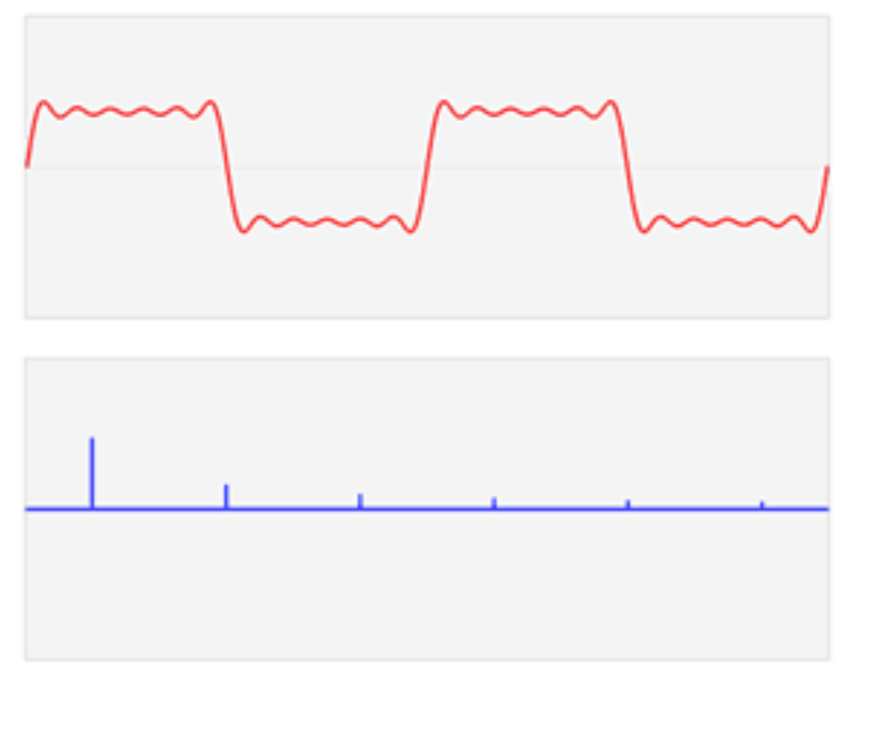
amplitude

Slide 7
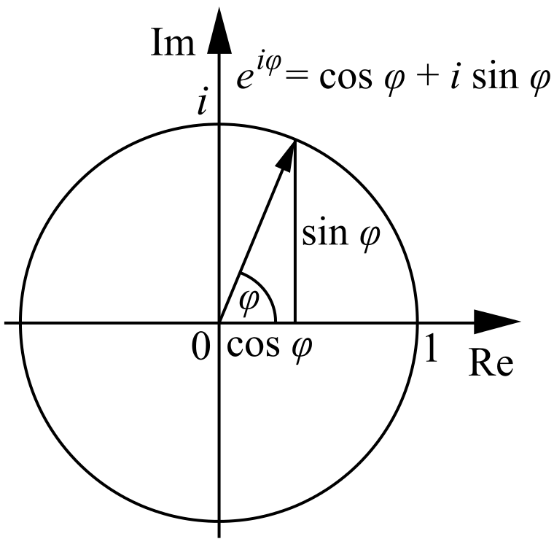
The Fourier transform
Euler’s formula
$$e^{it}=cos⁡(t)+isin(t)$$

Slide 8
Frequency
Amplitude
Frequency
Amplitude
Phase
Phase

Slide 9
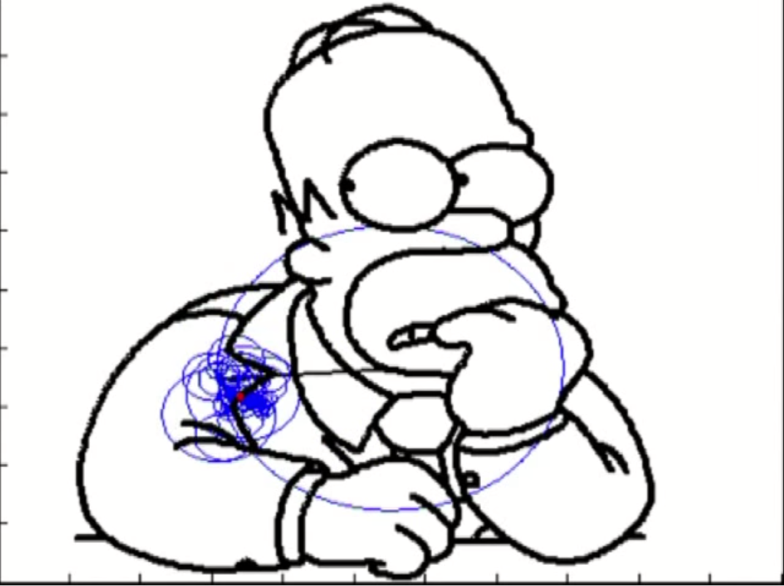
Any function
https://www.youtube.com/watch?v=QVuU2YCwHjw&feature=youtu.be

Slide 10
The Fourier transform
$$F\left(f\right)=\int_{−∞}^{∞}{f\left(t\right)e^{−i2πft}dt}$$
$f\left(t\right)$ is the function of time
$F\left(f\right)$ is the function of frequency

Slide 11
The inverse transform
$$f\left(t\right)=\int_{−∞}^{∞}{F\left(f\right)e^{i2πft}df}$$
$f\left(t\right)$ is the function of time
$F\left(f\right)$ is the function of frequency
$F\left(f\right)$ dictates the amplitudes and phases of each small circles, $e^{i2πft}$

Slide 12
The Fourier transform
$$F\left(f\right)=\int_{−∞}^{∞}{\frac{f(t)}{e^{i2πft}}dt}$$
$f\left(t\right)$ is the function of time
$F\left(f\right)$ is the function of frequency
Decomposing a function of time results in a function of frequency

