Slide 1
Fourier Transforms
Molly Livingstone & Mathew Knight

Slide 2
history
Sinusoidal analysis dates back millennia
Joseph Fourier’s breakthrough paper paved the way
Any function can be composed as a sum of sinusoids
Fourier Transform provided the most direct analysis yet
Notes:
MATT TALKING
-- Since Babylonian times, repeating patterns have arisen in nature that we’ve sought to understand by attempting to break them down into sums of simpler periodic functions, such as the movement of stars and planets in the sky.
-- In 1807, several decades of mathematical progress in sinusoidal theory culminated in Joseph Fourier releasing a paper with a breakthrough idea: that all functions can be represented as a composition of sinusoidal functions. Square waves, sawtooths, quadratics and anything else could supposedly be summarised with sines and cosines.
-- This resulted in an explosion in interest in the field of what we call Fourier Analysis.
-- The Fourier Transform was a dramatic development upon this, allowing the direct representation of any function in the time domain as a function in the frequency domain, and simplified swapping between the two.

Slide 3
Changing domains
Displays functions more simply as a sum of sinusoidal parts
Sinusoids are characterised by
Frequency
Amplitude
Phase
The frequency domain shows these features more clearly
Notes:
MOLLY TALKING
-- A function in time domain can be represented as a sum of periodic time domain functions. We used a periodic function to analyse because it presents a simple case.
-- One analogy is that if we have a smoothie, we can’t really work with the blended result to find out why it tastes like it does. But if we could put it through a machine that finds the recipe, the list of ingredients and how much of each was blended, we would know why it tastes that way, and we could change some ingredients to produce a different result. We could look at these ingredients and see that maybe one or two make most of the flavour, while others are only present in small amounts.
-- The Fourier transform is this ingredient machine.
-- It turns out that showing all these different graphs isn’t very convenient when there’s lots of them, but fortunately sinusoids can be represented numerically by 3 things: amplitude, frequency, and phase.
-- So we can see what these composite functions are all at once, by moving to the frequency domain, where we show amplitude and phase as functions of frequency

Slide 4
Visualising it
Notes:
MOLLY EXPLAINS
-- This a graph of a sinusoid that would be hard to describe mathematically at first glance.
-- What the animation is showing is the red function being split up into a sum of the five blue functions.
-- These are then separated back onto a graph of amplitude over frequency.
-- So what you can see here is the amount of each frequency involved in the mixture of the function.
-- The offset or phase is also an important feature but isn’t shown on this animation.

Slide 5
The integral
Notes:
MATT TALKING
-- So this is the equation for calculating a Fourier Transform
-- The Fourier Transform of a function x of t is the capital X of omega which is equal to this improper integral, which you can see has both time and frequency in it.
-- The j in the complex exponential is used in place of i because Fourier Transforms are very important in electrical engineering where lowercase i was taken a long time ago for current
-- Molly is working an example for us on the board now

Slide 6
example
Notes:
MATT TALKING, MOLLY WRITING
-- Function is one between negative half and positive half, otherwise it is zero, so it is a very simple function
-- This simplifies the infinite improper integral to a finite integral between the two points, with a straightforward integrand
>> Molly highlights that step
-- Then we get into the guts of the integration, proceeding as we’ve done a lot this semester
>> Molly shows square brackets
-- Converting complex exponentials to a sine function
>> Result changes to a sine function
-- And voila we get to the output transform function

Slide 7
Output
Notes:
MATT TALKING
-- So this is what the magnitude of that output function looks like, graphed against frequency.
-- As you can see this is a continuous function across a range of frequencies, to infinity, unlike the earlier examples which showed cases of a function only being comprised of a few discrete sinusoids.
-- Why is it so complex and spread out for a simple function like the rectangle?
-- Well basically it is because of the corners, and the narrow non-zero domain.
-- To form these an infinite number of sinusoidal functions is required to approximate closer and closer to the original function.

Slide 8
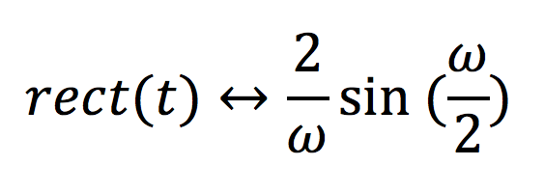
TRANSFORM PAIRS
We can now jump from time to frequency with our knowledge of that pair.
And we can now work with adjustments to the rectangle function, by using other known transform pairs.
Notes:
MOLLY TALKING
-- So now that we’ve done the transform integral the long way, it is correct to say that for this exact rectangle function, with a magnitude of 1 between -1/2 and 1/2, and 0 elsewhere, the transform will always be what you see here, making these a transform pair.
-- Why is this useful? It means if we have anything that closely resembles a rectangle function, instead of having to do the integration each time, we can use other known transform pairs to manipulate the result and find the fourier transform.
-- This process exists for every function.

Slide 9
Transform pairs
Notes:
MOLLY TALKING
For example, if the rectangle function was reflected in the vertical axis, the accompanying fourier transform would simply have negative signs in front of each omega as such
However, if instead the function was rect(2t), both the amplitude and the frequency of the original result would be halved
Translations in the time domain are even more complicated, however the fourier transform is a linear operation implying that scaling and addition of functions hold in this manner

Slide 10
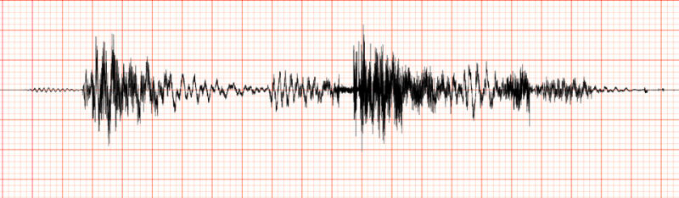
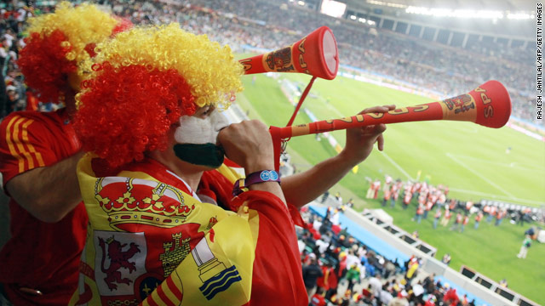
Applications
Earthquakes
Vuvuzelas
Notes:
MATT TALKING
-- How is it useful to see what frequencies form a function?
-- If we can record the vibration signal of an earthquake and decompose it into composite frequencies of shaking, we can identify the most intense vibration frequencies and design better buildings that don’t resonate with those frequencies, hopefully leaving them standing after big quakes, saving lives and money.
MOLLY TALKING
-- Sound pitches can be represented as frequencies. During the World Cup in South Africa, vuvuzelas became a huge problem with the crowd constantly emitting that droning noise that caused trouble for television broadcasters who sought to eliminate it by identifying the ~235Hz frequency that represented the large majority of vuvuzela noise, vastly improving the sound you heard on TV

