Slide 1
Young Fourier
III & Ψ

Slide 2
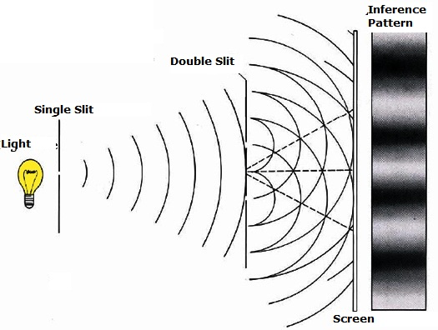
Young’s Experiment
Notes:
Say lookin 4 equation 4 diffraction pattern

Slide 3
Fourier Transform
What is it?

Slide 4
Application of Fourier
Goals:
Find function describing intensity of light on image plane
I=E²
Have mixtape go platinum

Slide 5
Things You Should Know…

Slide 6
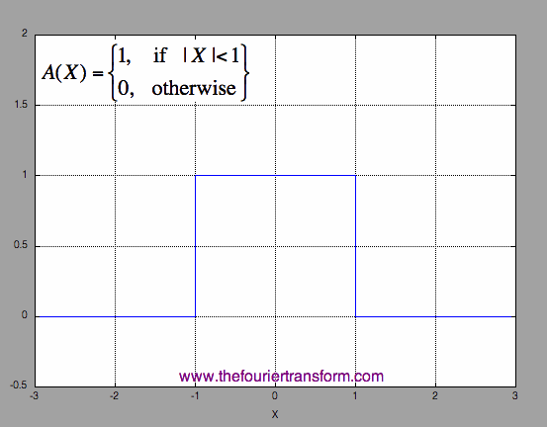
Rect_{x} function

Slide 7
Sinc function

Slide 8
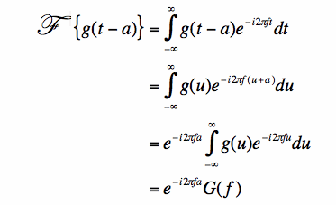
A Property of Fourier
funkycoolalgebraicshiftproperty

Slide 9
The 2-Slit Aperture Plane

Slide 10
Young Derivation
=Electric Field

Slide 11
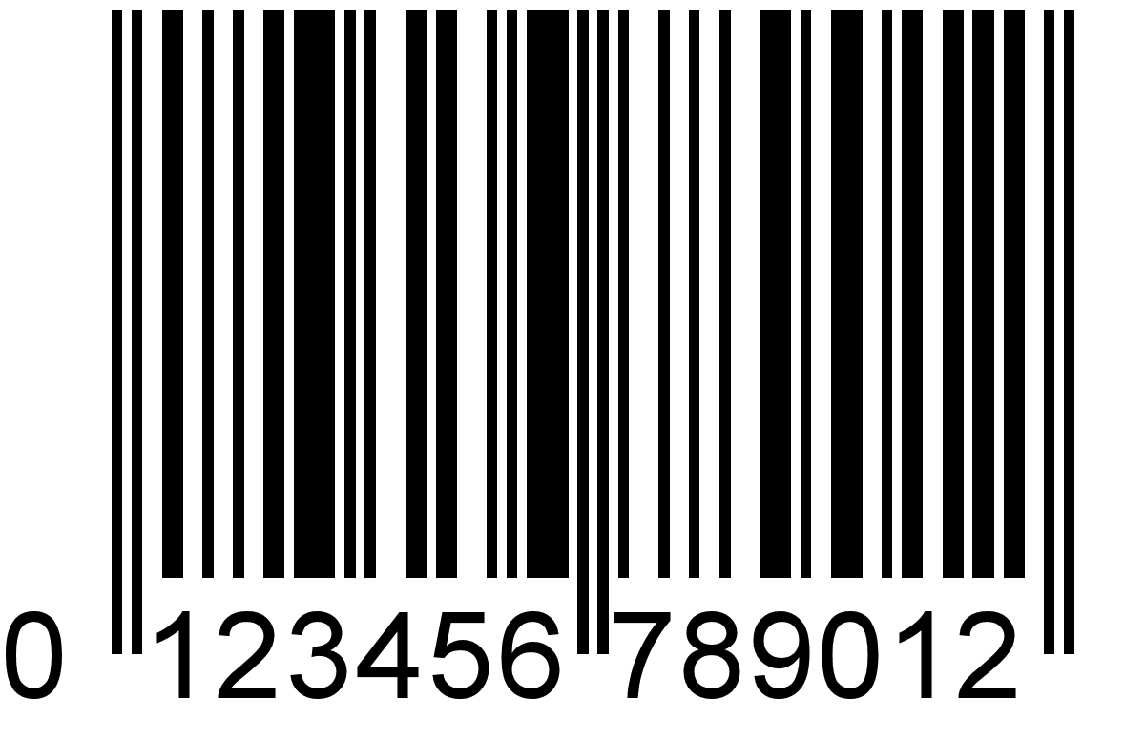
Intro
Young’s Experiment
Fourier Transform
Applications of Fourier
Things You Should Know (Interlude)
Rect_{x} Function
Sinc Function
A Property of Fourier
The 2-Slit Aperture Plane
Young Derivation
Diffraction Pattern (feat. Mathematica)

