Slide 1
MAPPING IS FUN
Making letters with the Exponential Function

Slide 2
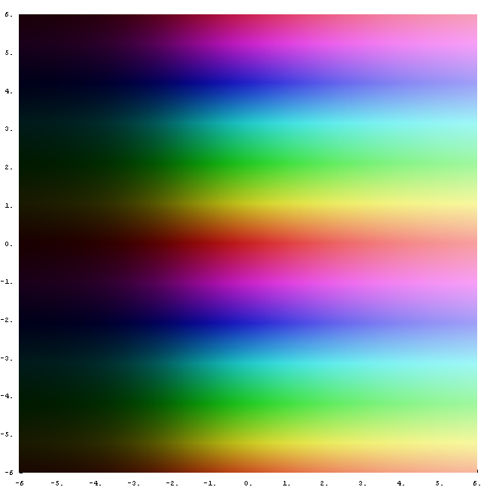
e^{z}
The dark to light indicates an increase in magnitude.
The repeating color bands indicate that the function is multivalued and has a period of 2π.
By Jan Homann - made with mathematica, own work, Public Domain, https://commons.wikimedia.org/w/index.php?curid=2509855

Slide 3
Mapping with e^{z}
-∞ maps to 0
∞ maps to ∞
Re(z) Maps to rays Im(z) Maps to arcs

Slide 4
M part 1
Z
i𝝅/2
w = e^{z}
z = t + i𝝅/2, -∞ < t ≤ ln2
w = e^{t}e^{i𝝅/2}, -∞ < t ≤ ln2
ln2
2i
W
i
1
2

Slide 5
M part 2
Z
i3𝝅/4
w = e^{z} + i + 1
z = t + i3𝝅/4, -∞ < t ≤ 0
w = e^{t}e^{i3𝝅/4} + i + 1, -∞ < t ≤ 0
2i
W
i
1
2

Slide 6
M part 3
Z
i𝝅/4
w = e^{z} + i + 1
z = t + i𝝅/4, -∞ < t ≤ 0
w = e^{t}e^{i𝝅/4} + i + 1, -∞ < t ≤ 0
2i
W
i
1
2

Slide 7
M part 4
Z
i𝝅/2
w = e^{z} + 2
z = t + i𝝅/2, -∞ < t ≤ ln2
w = e^{t}e^{i𝝅/2} + 2, -∞ < t ≤ ln2
ln2
2i
W
i
1
2

Slide 8
M!
2i
i
1
2

Slide 9
A part 1
Z
i𝝅/2
w = e^{z}
z = t + i𝝅/2, -∞ < t ≤ ln2
w = e^{t}e^{i𝝅/2}, -∞ < t ≤ ln2
ln2
2i
W
i
1
2
Notes:
Repeat - No Transition

Slide 10
A part 2
Z
w = e^{z} + 2i
z = t, -∞ < t ≤ 0
w = e^{t} + 2i, -∞ < t ≤ 0
2i
W
i
1
2

Slide 11
A part 3
Z
w = e^{z} + i
z = t, -∞ < t ≤ 0
w = e^{t} + i -∞ < t ≤ 0
2i
W
i
1
2

Slide 12
A part 4
Z
i𝝅/2
w = e^{z} + 1
z = t + i𝝅/2, -∞ < t ≤ ln2
w = e^{t}e^{i𝝅/2} + 1, -∞ < t ≤ ln2
ln2
2i
W
i
1
2

Slide 13
A!
2i
i
1
2

Slide 14
P part 1
Z
i𝝅/2
w = e^{z}
z = t + i𝝅/2, -∞ < t ≤ ln2
w = e^{t}e^{i𝝅/2}, -∞ < t ≤ ln2
ln2
2i
W
i
1/4
1/2
Notes:
Repeat - No Transition

Slide 15
P part 2
Z
i𝝅/2
w = e^{z} + 3i/2 + ¼
z = ln(½) + it, -𝝅/2 < t ≤ 𝝅/2
w = ½ e^{it} + 3i/2 + ¼
-𝝅/2 < t ≤ 𝝅/2
ln(½ )
-i𝝅/2
2i
W
i
1/4
1/2

Slide 16
P!
2i
i
1/4
1/2

Slide 17
I part 1
Z
w = e^{z} + 2i
z = t, -∞ < t ≤ 0
w = e^{t} + 2i, -∞ < t ≤ 0
2i
W
i
1
2
Notes:
Repeat - No Transition

Slide 18
I part 2
Z
i𝝅/2
w = e^{z} + ½
z = t + i𝝅/2, -∞ < t ≤ ln2
w = e^{t}e^{i𝝅/2} + ½, -∞ < t ≤ ln2
ln2
2i
W
i
½
1

Slide 19
I part 3
Z
w = e^{z}
z = t, -∞ < t ≤ 0
w = e^{t}, -∞ < t ≤ 0
2i
W
i
1
2

Slide 20
I!
2i
i
½
1

Slide 21
N part 1
Z
i𝝅/2
w = e^{z}
z = t + i𝝅/2, -∞ < t ≤ ln2
w = e^{t}e^{i𝝅/2}, -∞ < t ≤ ln2
ln2
2i
W
i
1
2
Notes:
Repeat - No Transition

Slide 22
N part 2
Z
i3𝝅/4
w = e^{z} + 2
z = t + i3𝝅/4, -∞ < t ≤ ln2
w = e^{t}e^{i3𝝅/4} + 2, -∞ < t ≤ ln2
ln2
2i
W
i
1
2

Slide 23
N part 3
Z
i𝝅/2
w = e^{z} + 2
z = t + i𝝅/2, -∞ < t ≤ ln2
w = e^{t}e^{i𝝅/2} + 2, -∞ < t ≤ ln2
ln2
2i
W
i
1
2
Notes:
Repeat - No Transition

Slide 24
N!
2i
i
1
2

Slide 25
G part 1
Z
w = e^{z} + 1 + i
z = it, 𝝅/2 < t ≤ 2𝝅
w = e^{it} + 1 + i, 𝝅/2 < t ≤ 2𝝅
2i
W
i
1
2

Slide 26
G part 2
Z
w = e^{z} + 1 + i
z = t, -∞ < t ≤ 0
w = e^{t} + 1 + i, -∞ < t ≤ 0
2i
W
i
1
2

Slide 27
G!
2i
i
1
2

Slide 28
S part 1
Z
3π/2
w = e^{z} + 1/2 + 3i/2
z = ln(½) + it, -𝝅/2 < t ≤ 3𝝅/2
w = (½)e^{it} + 1/2 + 3i/2,
-𝝅/2 < t ≤ 3𝝅/2
ln2
-π/2
2i
W
i
1
2

Slide 29
S part 2
Z
π/2
w = e^{z} + 1/2 + i/2
z = ln(½) + it, -𝝅 < t ≤ 𝝅/2
w = (½)e^{it} + 1/2 + i/2,
-𝝅 < t ≤ 𝝅/2
ln2
-π
2i
W
i
1

Slide 30
S!
2i
i
1
2

Slide 31
F part 1
Z
i𝝅/2
w = e^{z}
z = t + i𝝅/2, -∞ < t ≤ ln2
w = e^{t}e^{i𝝅/2}, -∞ < t ≤ ln2
ln2
2i
W
i
1
2
Notes:
Repeat - No Transition

Slide 32
F part 2
Z
w = e^{z} + 2i
z = t, -∞ < t ≤ 0
w = e^{t} + 2i, -∞ < t ≤ 0
2i
W
i
1
2
Notes:
Repeat - No Transition

Slide 33
F part 3
Z
w = e^{z} + i
z = t, -∞ < t ≤ 0
w = e^{t} + i -∞ < t ≤ 0
2i
W
i
1
2
Notes:
Repeat - No Transition

Slide 34
F!
2i
i
1
2

Slide 35
U part 1
Z
π/2
w = e^{z} + i
z = πi/2 + t, -∞ < t ≤ 0
w = e^{t} + 2i, -∞ < t ≤ 0
2i
W
i
1
2

Slide 36
U part 2
Z
π/2
w = e^{z} + i + 2
z = πi/2 + t, -∞ < t ≤ 0
w = e^{t} + 2i, -∞ < t ≤ 0
2i
W
i
1
2

Slide 37
U part 3
Z
2π
π
w = e^{z} + i + 1
z = it, π < t ≤ 2π
w = e^{t} + i + 1, π < t ≤ 2π
2i
W
i
1
2

Slide 38
U!
2i
i
1
2

Slide 39
2i
2i
2i
2i
2i
2i
2i
i
i
i
i
i
i
i
1
2
1
1/4
1/2
1/4
1/2
½
1
1
2
1
2
2i
2i
i
i
½
1
1
2i
2i
2i
i
i
i
1
2
1
2
1
2
(actual quote) ??

