Slide 1
Circuit Analysis Using Complex Variables
by
Jonah Taylor
&
Scott Lew

Slide 2
Overview
Introduction
Complex Circuit Forms
The Complex Ohm’s Law

Slide 3
Introduction: AC Circuits
Most common type of circuits in everyday life.
Driven by time dependent, usually sinusoidal potential.
In circuit analysis we are trying to find the current in the circuit and voltage across components.
When dealing with ac circuits this leaves us D.Es and messy algebra.

Slide 4
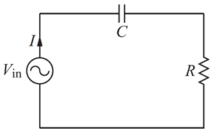
A Simple Example
Schematic of a series RC circuit.
Applying KVL we get .
Assume voltage has the form Vpcos(ωt) and current has the form
Plug in and solve for .
Easier with complex exponentials

Slide 5
The Better Way
Assume current and voltage have the form
and respectively.
Plug in and take derivatives:
Cancel exponentials and rearrange terms:

Slide 6
The Better Way
Isolate the current
Realize bottom is a complex number and put it in form
where
Using this
Our final answer is

Slide 7
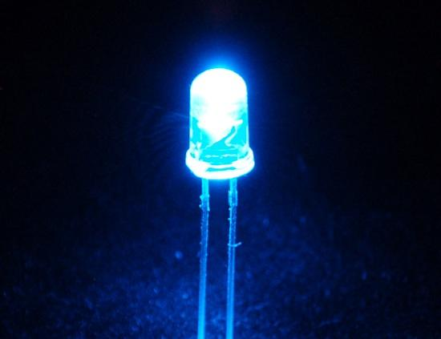
The Complex Ohm’s Law
The Even Better Way
Observe the previous equation used earlier:
This equation has similarities to the famous Ohm’s Law for resistors:
The RC circuit discussed earlier can be generalized to include inductors to the mix.
These three components can be generalized to all have resistance called Impedance.

Slide 8
Complex Impedance
Resistors
Capacitors
Inductors
Unfortunately, resistors don’t have a complex form:
Similar to what was seen in the previous equation:
The complex form of an inductor:
Real & Imaginary
Real part of complex impedance: Resistive Impedance or Resistance.
Imaginary part: Reactive Impedance or Reactance, denoted by

Slide 9
Complex Ohm’s Law
Series
Parallel
where
The Rules for Circuit Analysis

Slide 10
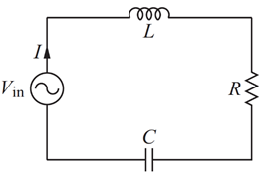
A Series LRC Circuit Example
Following the Series Rule:
Combining with Complex Ohm’s Law:
Performing similar algebra as the other we have:
Circuit Diagram
where

Slide 11
A Series LRC Circuit Example
Using we obtain:
Taking only the real part:
With this, we have found the current and have successfully analyzed the AC circuit.

Slide 12
END

