Slide 1
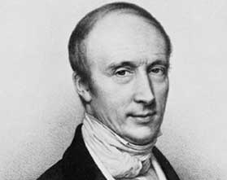
Kandace Korver

Slide 2
HERE ARE TODAY’S CATEGORIES
Silence
Timer
Cheer

Slide 3
Cauchy
Theorems
Silence
Timer
Cheer

Slide 4
Cauchy
Applications
Silence
Timer
Cheer

Slide 5
Cauchy Theorems | Cauchy Applications
100 | 100
200 | 200
300 | 300
Silence
Timer
Cheer

Slide 6
Theorem – 100 pts
Answer
Silence
Timer
Cheer

Slide 7
Answer Theorem – 100 pts
Cauchy – Goursat Theorem
Silence
Timer
Cheer

Slide 8
Theorem – 200 pts
Answer
Silence
Timer
Cheer

Slide 9
Answer Theorem – 200 pts
Cauchy Riemann Equations
Silence
Timer
Cheer

Slide 10
Theorem – 300 pts
Which Cauchy Theorem allows one
to calculate real integrals using contour integrals?
Answer
Silence
Timer
Cheer

Slide 11
Answer Theorem – 300 pts
Silence
Timer
Cheer

Slide 12
Application – 100 pts
Answer
Silence
Timer
Cheer

Slide 13
Answer Application – 100 pts
Silence
Timer
Cheer

Slide 14
?

Slide 15
Application – 200 pts
Answer
Silence
Timer
Cheer

Slide 16
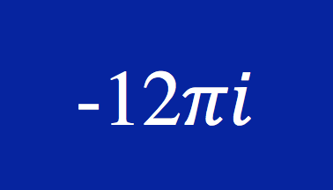
Answer Application – 200 pts
Silence
Timer
Cheer

Slide 17
Application – 300 pts
Answer
Silence
Timer
Cheer

Slide 18
Answer Application – 300 pts
Silence
Timer
Cheer

Slide 19
Final
Answer
Silence
Timer
Cheer

Slide 20
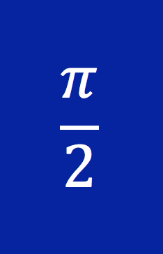
Final Answer
Silence
Timer
Cheer

