Slide 1
Solving Cubic Equation
Using Girolamo Cardano’s Formula
Complex Analysis
Lisa, Sherry

Slide 2
OVERVIEW
History of cubic problems
Decomposing a cube geometrically
Steps to get depressed form
Example to test derived formula
Real world application
Conclusion

Slide 3
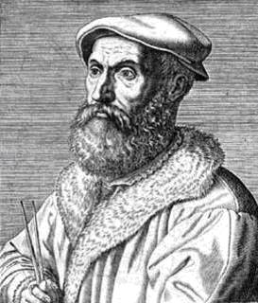
INTERESTING HISTORY OF CUBIC PROBLEMS
Luca Pacioli
Brought up the question
Scipione del Ferro
“Cubic and thing equal to number”
x³=Ax+B
Nicolo Tartaglia
Solved both x³=Ax+B
and
x³=ax²+b
Gerolamo Cardano
obtained the solution to both cubics from Tartaglia and published the solutions in his Ars Magna.

Slide 4
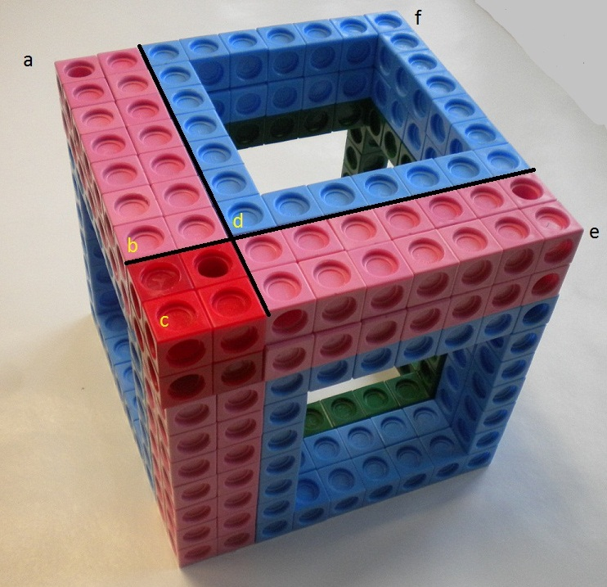
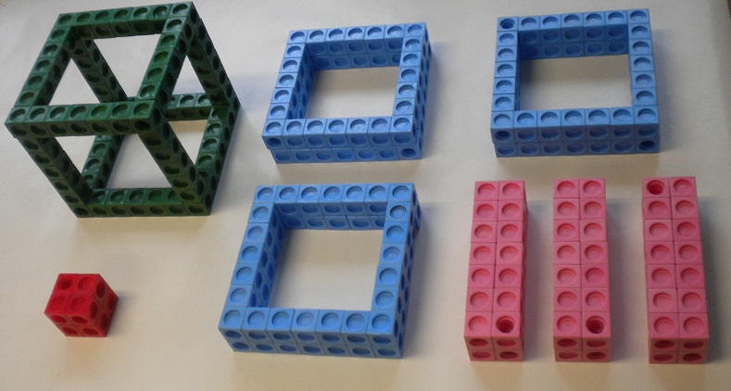
DECOMPOSITION OF CUBE INTO 8 PARTS
(y+t)³=y³+3y²t+3t²y+t³
y²t
y²t
y
y³
t
t³
y²t
t²y
t²y
t²y

Slide 5
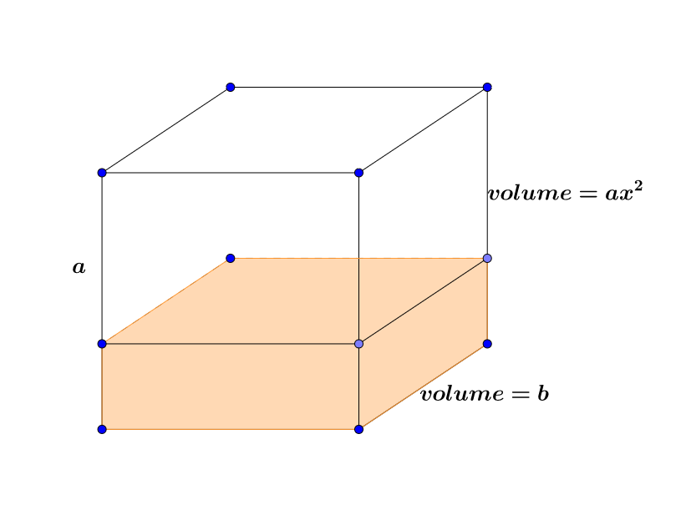
ORIGINAL PROBLEM: CUBE EQUAL TO SQUARE AND A NUMBER
Volume of a solid with same base but with height of a
x
x³=ax²+b
Volume of the cube
Volume difference between the original cube and the solid

Slide 6
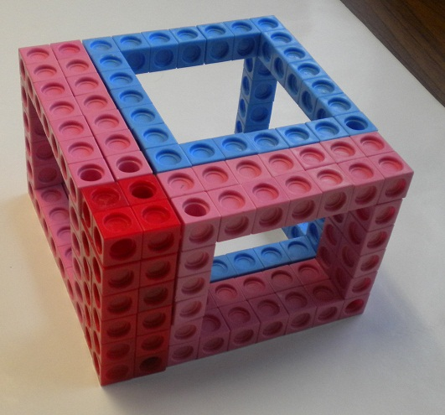
DEPRESSION STEP:From “Cube Equal to Square and A Number” To “Cube Equal to Thing and A Number”
Our goal: depress x³=ax²+b to y³=Ay+B
Step 1:
We set a solid with the same base as the original cube but with height a
y
t
a
x

Slide 7
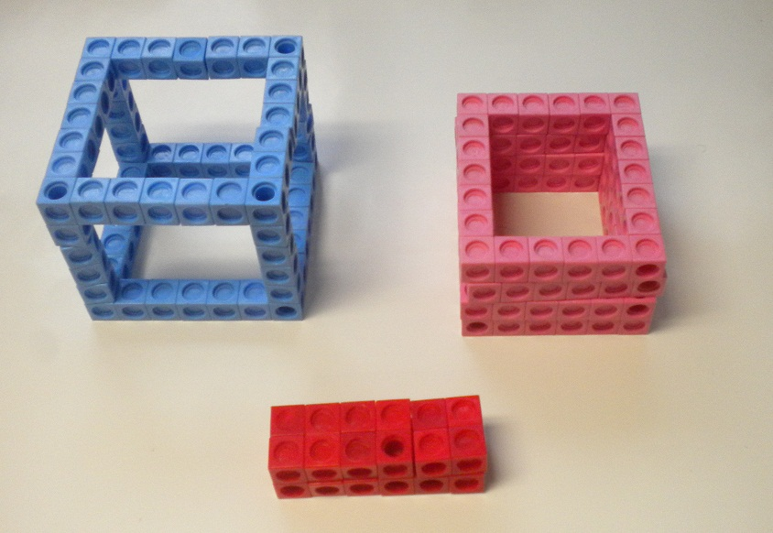
Step 2:
Decompose the new solid we just set.
y
t
a
(y+t)²a=t²a+y²a+2tya

Slide 8
Step 3:
In order to keep the volumes of solids with base y² to be the same, we need to figure out the relation between y and t, in other words, the position of the cut point b.
The volume of solid in the original cube with base y²: 3y²t
The volume of solid in the new solid with the same base: y²a
We get t=a/3
General way of substitution for cubic equation z³+az²+bz+c=0:
z=x-(a/3)

Slide 9
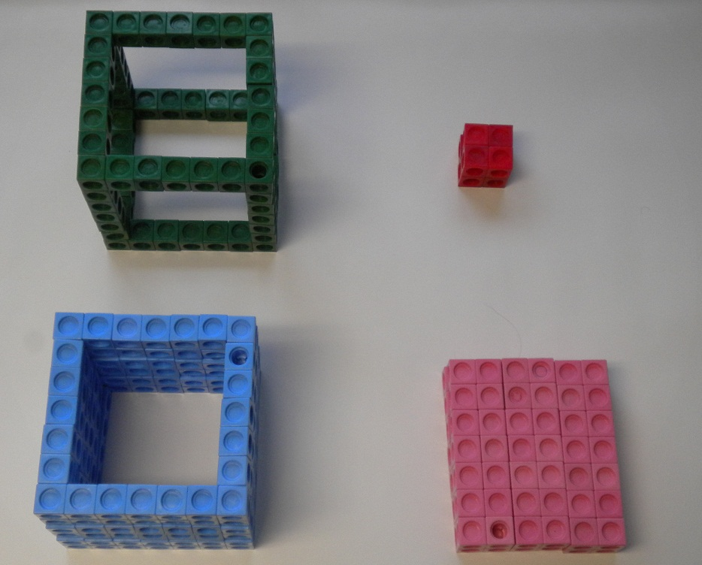
Step 4:
Rearrange the parts of each and juxtapose the two decomposition
The original cube
The solid

Slide 10
Step 5:
Plug t=a/3 in (y+t)³=y³+3y²t+3t²y+t³, whose left hand side equals to t²a+y²a+2aty +b. After cancellation, we have y³=(a²/3)y+(2a³/27)+b
What left of original cube
What left of the solid
Volume difference between the original cube and the new solid, b

Slide 11
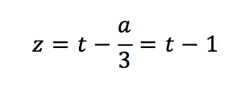
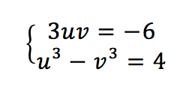
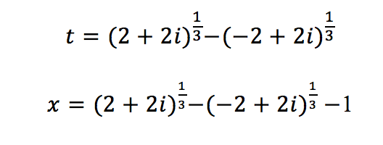
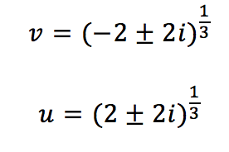
EXAMPLE TO EXAMINE THIS METHOD!
Suppose we have
We can substitute
Then we obtain
Since we know
If we let
we get
Substitute back

Slide 12
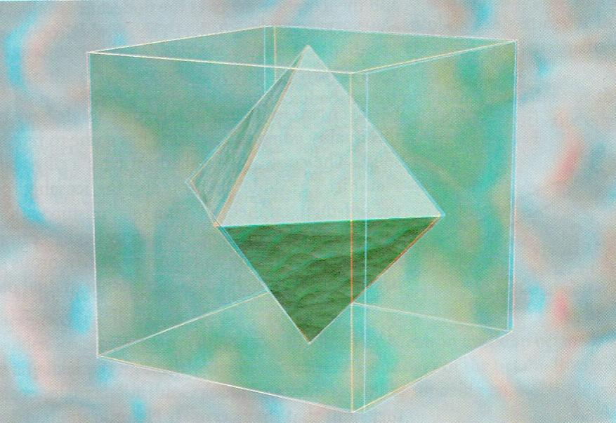
REAL WORLD APPLICATION
Descartes: Transformation from solid cubic geometry to planar curves.
Cubic Bezier curves: in Postscript (including Postscript fonts), and in most drawing and graphics programs, like Adobe Illustrator, Powerpoint, etc.
The drag of airplanes
Used in thermodynamics in chemical industry
Bézier path in Adobe Illustrator

Slide 13
CONCLUSION:
Use geometric way to interpret the formula for cubic equations.
Test an example for the general formula derived by algebraic approach.
Cubic problems are basic yet crucial in our life and the derived formula helps people solve many real world problems.

Slide 14
OTHER THINGS INCLUDED IN OUR PROJECT PAPER:
Algebraic Approach To Derive General Cubic Equation
Finding the other two solutions of cubic equations.
Value of cubic formulas

Slide 15
WORK CITED:
Branson, William B. "Solving the Cubic with Cardano." Mathematical Association of America. N.p., n.d. Web. 08 Apr. 2016. <http://www.maa.org/press/periodicals/convergence/solving-the-cubic-with-cardano-introduction>.
"Solving Cubic Polynomials." Sam Houston State University. N.p., n.d. Web. 7 Apr. 2016. <http://www.shsu.edu/kws006/Math_History/4_Calculus_files/SolvingCubics.pdf>.
Zill, Dennis G., and Patrick D. Shanahan. "Applications." Complex Analysis: A First Course with Applications. 3rd ed. N.p.: Jones & Bartlett Learning, n.d. 41-42. Print.
Cardano, Girolamo, “Ars Magna or the Rules of Algebra,” translated by T. Richard Witmer, 1993, New York: Dover Publications. Originally published by MIT Press, 1968.

Slide 16
Thank you!

