Slide 1
Conformal brain mapping
BY: Zack Conrad and michal nowicki

Slide 2
Overview
Essential Definitions
Complex Mathematics of Conformal Mapping
Brain Mapping Applications

Slide 3
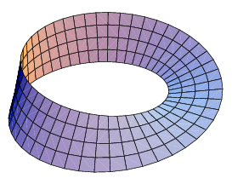
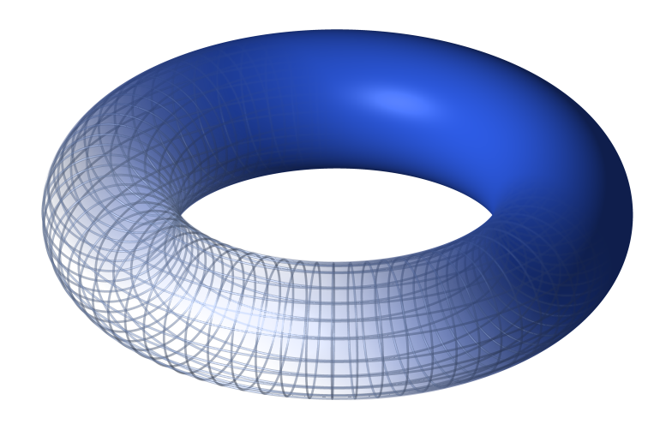
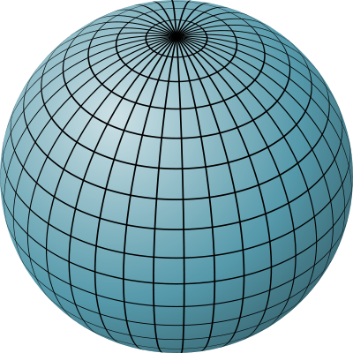
Essential definitions
Orientable Surface
A surface is orientable if a two-dimensional shape on its surface cannot be turned into its mirror image by moving it continuously around the surface
Genus Zero
A zero genus surface is a surface with zero cuttings along a simple closed curve without rendering the manifold disconnected

Slide 4
Essential definitions (Cont.)
Conformal Mapping
A transformation that preserves local angles
An analytic function is conformal at any point where it has a non-zero derivative
Stereographic Transformation
Conformal method to compose a sphere onto a plane by assigning each point on the sphere to a point on the plane
Mobius Transformation (Linear fractional transformation)
Conformal method of mapping the extended complex plane to itself

Slide 5
Complex mathematics of conformal mapping
$T\left(z\right)=\frac{az+b}{cz+d} where ad−bc≠0$
Maps circles and lines to circles and lines
Ideal for preserving landmarks
T(z) is the composition of a finite number of rotations, translations, magnifications, and inversions

Slide 6
Brain mapping applications

Slide 7
Process of brain mapping
Brain mesh is transposed onto a sphere
A stereographic projection transforms the sphere to the complex plane
Mobius transformation maps the pre-image to another image on the complex plane
Another stereographic projection transforms the final image back onto the surface of a sphere

Slide 8
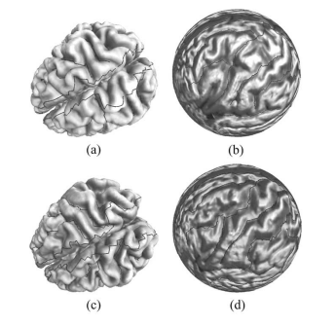
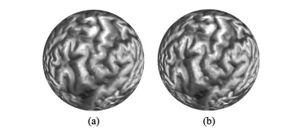
Benefits of conformal mapping
Preserves local angles making it ideal for preserving landmarks
Does not depend on the resolution of the original mesh of the brain
ftp://ftp.math.ucla.edu/pub/camreport/cam04-17.pdf
ftp://ftp.math.ucla.edu/pub/camreport/cam04-17.pdf

Slide 9
conclusion
Conformal brain mapping is used to transpose the image of a brain onto a sphere through a series of conformal mapping procedures (stereographic and Mobius)
This is used to, depending the Mobius transformation, allow for detailed analysis of different sections of the brain

