Slide 1
A Python Complex Analysis Program
Leah Winfrey

Slide 2
Why I chose to do this
Wolframalpha
Learn more about the properties of complex numbers

Slide 3
Options
Simplify a complex equation
Ex: -34i^5 + 87i^1834 = -87 - 34i
Modulus of a Complex Number
Ex: 15 - 2i = sqrt(229) = 15.1327
Polar form of a Complex Number
Ex: sqrt(2) + 15i = (15.07, 84.6˚)
Solve a quadratic equation with Complex Numbers
az^2 + bz + c = 0 where a, b,c are complex numbers
Ex: z^2 + (2i - 3)z + 5 - i = 0
Solutions: 1 + i and 2 - 3i

Slide 4
How to use it
Download necessary computer software and download program here
http://bit.ly/1Wj5aVh
Use this link and run the program without the software
http://bit.ly/1XOAiuA

Slide 5
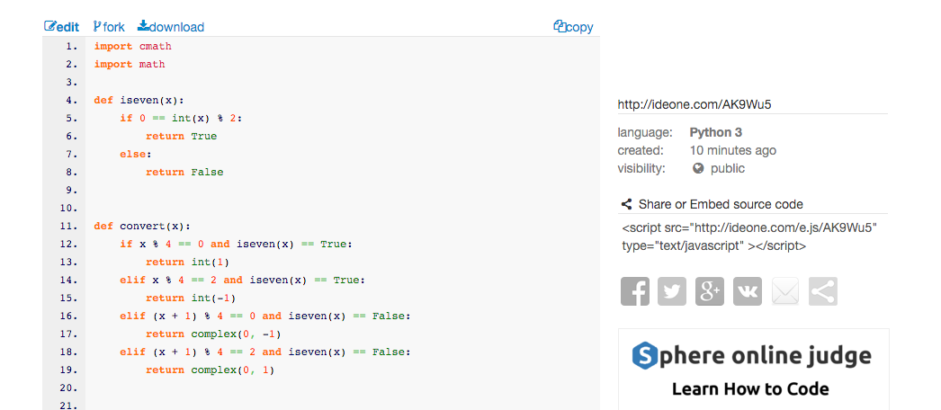

Slide 6
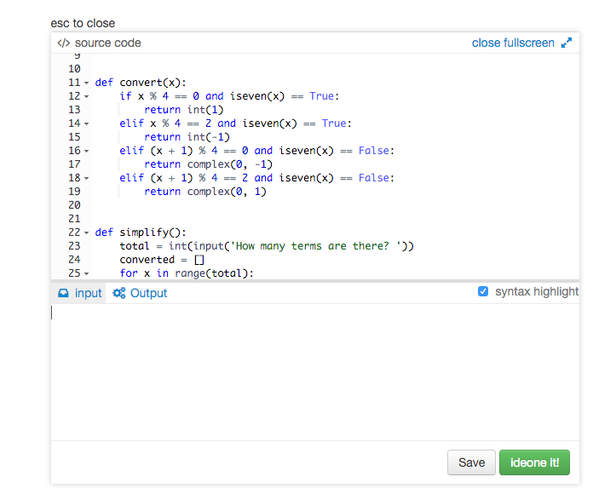
1 = Simplify a complex equation
How many terms are there?
Enter the terms
2 = Modulus of a Complex Number
What is the complex number?
3 =Polar form of a Complex Number
What is the complex number?
4 = Solve a quadratic equation with Complex Numbers
What is the complex number of a?
b?
c?

Slide 7
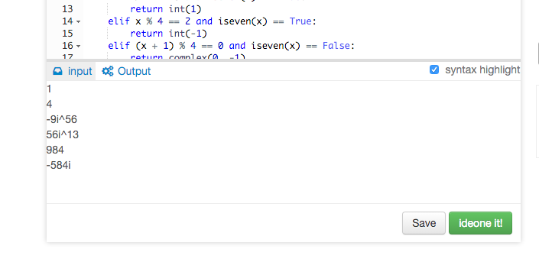
1 = Simplify a complex equation
How many terms are there?
Enter the terms
2 = Modulus of a Complex Number
What is the complex number?
3 =Polar form of a Complex Number
What is the complex number?
4 = Solve a quadratic equation with Complex Numbers
What is the complex number of a?
b?
c?

Slide 8
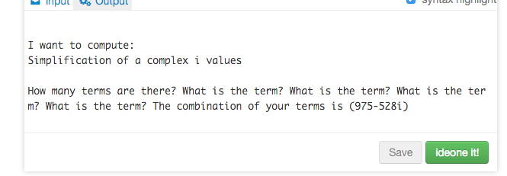
1 = Simplify a complex equation
How many terms are there?
Enter the terms
2 = Modulus of a Complex Number
What is the complex number?
3 =Polar form of a Complex Number
What is the complex number?
4 = Solve a quadratic equation with Complex Numbers
What is the complex number of a?
b?
c?
* we input: -9i^56, 56i^13, 984, -584i

Slide 9
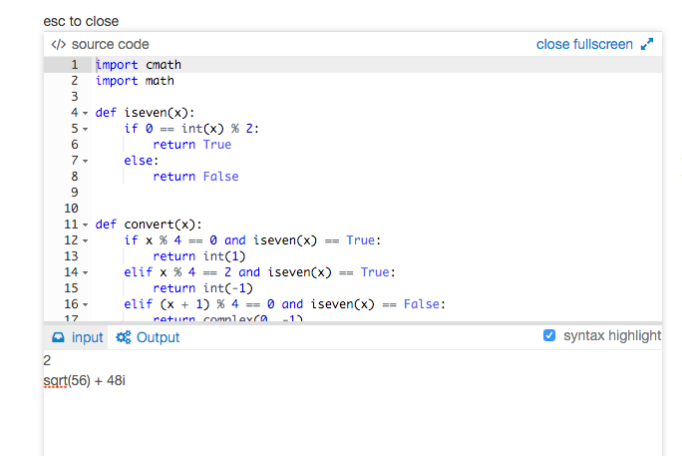
1 = Simplify a complex equation
How many terms are there?
Enter the terms
2 = Modulus of a Complex Number
What is the complex number?
3 =Polar form of a Complex Number
What is the complex number?
4 = Solve a quadratic equation with Complex Numbers
What is the complex number of a?
b?
c?

Slide 10
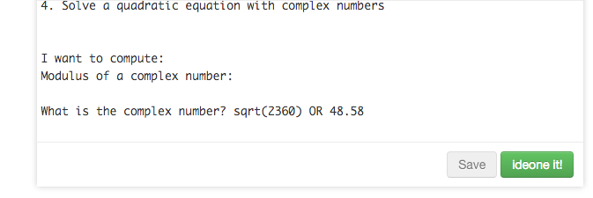
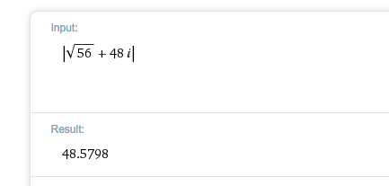
1 = Simplify a complex equation
How many terms are there?
Enter the terms
2 = Modulus of a Complex Number
What is the complex number?
3 =Polar form of a Complex Number
What is the complex number?
4 = Solve a quadratic equation with Complex Numbers
What is the complex number of a?
b?
c?
* we input: sqrt(56) + 48i

Slide 11
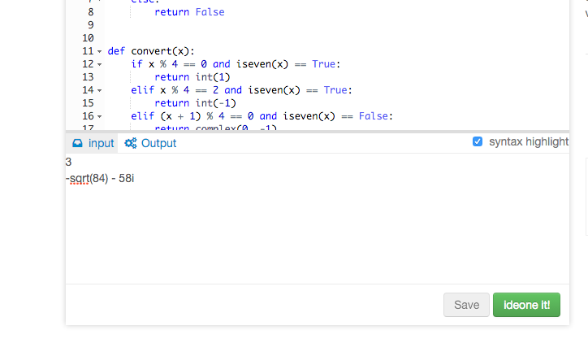
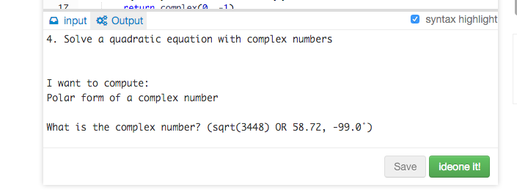
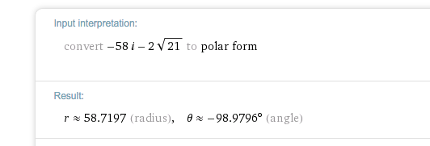
1 = Simplify a complex equation
How many terms are there?
Enter the terms
2 = Modulus of a Complex Number
What is the complex number?
3 =Polar form of a Complex Number
What is the complex number?
4 = Solve a quadratic equation with Complex Numbers
What is the complex number of a?
b?
c?

Slide 12
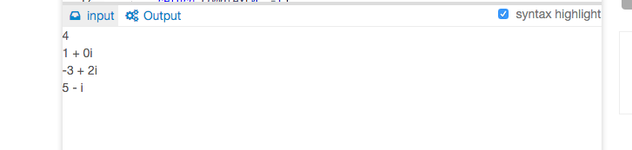
1 = Simplify a complex equation
How many terms are there?
Enter the terms
2 = Modulus of a Complex Number
What is the complex number?
3 =Polar form of a Complex Number
What is the complex number?
4 = Solve a quadratic equation with Complex Numbers
What is the complex number of a?
b?
c?

Slide 13
A few caveats to this program
Option 1 (simplification) can only handle integer inputs and i-values
Can’t use sqrt(x) or sqrt(x)i
Can’t do (5 + 3i)^2 + (89 - 2i)
Option’s 2 - 4 must be entered in x +/- yi form
Can’t be x+yi
Must do 1 + 0i for 1 OR 0 + i for i
Can use sqrt(x) or -sqrt(x)!!
http://bit.ly/1Wj5aVh (<-- download program)
http://bit.ly/1XOAiuA (<-- website link)

