Slide 1
Complex Analysis
in
Quantum Computing
By Peter Renn

Slide 2
What is Quantum Computing?
Uses a data structure called “qubits” or quantum bits
Quantum superposition of two binary values or quantum states
Represented by a wave function
Normalization conditions apply
Qubits can be electrons, photons, neutrons, or even whole atoms
Anything with measurable spin
As soon as a qubit is measured the wave function collapses
Qubit takes on defined binary value
Entanglement allows superluminal “transfer” of information
Not always useful
Limited applications
Potential for cryptography and factoring
Shor’s Algorithm
Factoring very large numbers much faster than conventional computing
Notes:
-Conventional computers use bits,
-quantum computers use “qubits”.
-inherently undefined upon creation.
-exist as a superposition of the two binary states: 1 or 0 (spin up or spin down).
-The probability of each state is defined by that state’s coefficient.
-COMPLEX COEFFICIENTS

Slide 3
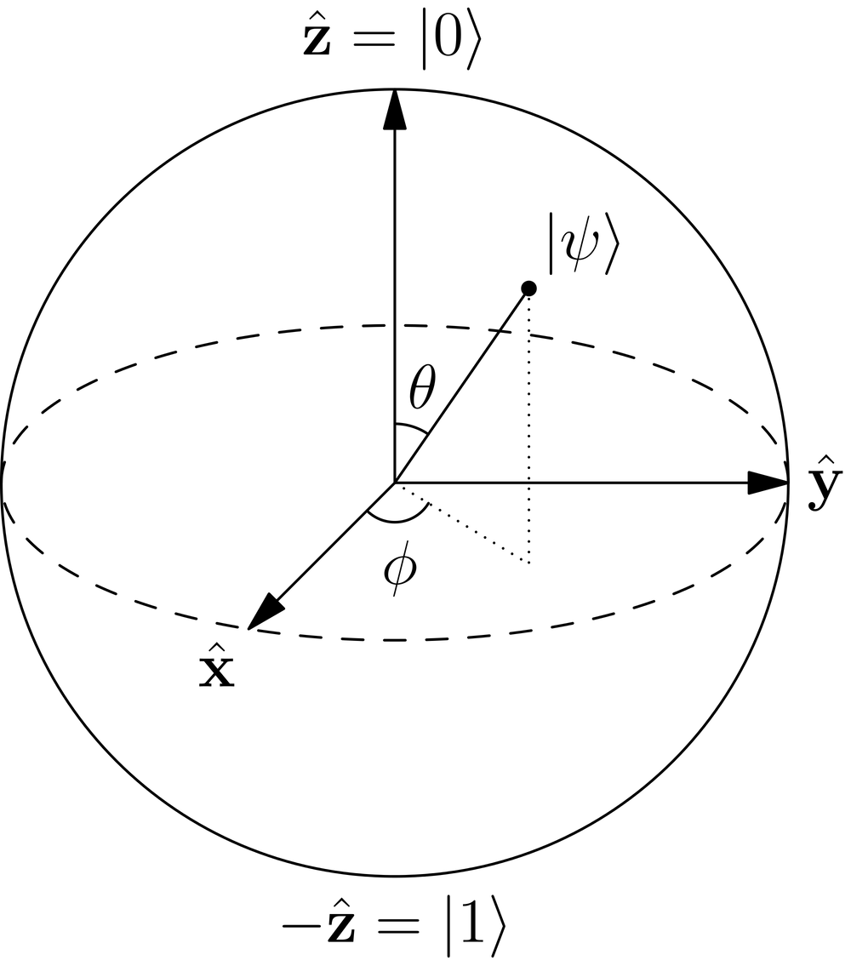
Bloch/Riemann Sphere
Bloch Sphere
Describes qubits as a superposition
North pole is the “ㅣ0 〉” state
South pole is the “ㅣ1 〉” state
Azimuthal angle describes the “phase” of the qubit
States can be written in Dirac Notation
Intuitive definitions
Riemann Sphere
Conformal mapping of extended complex plane
Derives the concept of a “point at infinity”
Notes:
-The unit sphere is the starting point for the connection between Quantum Computing and Complex Analysis.
-qubits can be represented as a vector on the Bloch Sphere
-Riemann Sphere is a representation of the entire complex plane
-both areas require a definition of the point at infinity

Slide 4
The Point at ∞ in Quantum Computing
Quantum superposition of states can be represented as a wave function
Define the wave function as:
Normalization condition on coefficients:
Simple “correspondence” between the complex projective space and the sphere:
With a little bit of algebra, the wave function can be rewritten as:
What happens when b is zero? (α becomes undefined)
Must define a point at infinity in order to make this relation one-to-one
As α ➝ ∞, the wave function goes to the |0〉 (North Pole of Sphere).
Notes:
-Say we want to map a qubit to the complex plane.
- take the quotient of the two complex coefficients.
- This is a term we can define as alpha.
- The wave function can then be written in terms of alpha as such.
-But what happens in a purely “0” state?
-This would geometrically be the north pole, but mathematically alpha would become undefined.
-So we define this point as the point where alpha is equal to infinity
- allows the wave function to become purely “0”, since the “1” term is like 1/infinity, whereas the “0” term is infinity/infinity = 1.

Slide 5
Quantum Logic Gates in the Complex Plane
Logic gates are what allow computers to compute
Quantum logic gates are what allow quantum computers to work
Quantum logic gates take the form of unitary matrix operators.
Unitary matrix, meaning UU* = Identity Matrix
Example: Hadamard Gate:
This is a very common quantum gate
Shor’s Algorithm uses several of these
Notes:
Logic gates are what allow computers to function.
Quantum logic gates can be represented as unitary matrices.
-the hadamard gate.
-creates an additional superposition of the two states.

Slide 6
Quantum Logic Gates written as LFTs
Linear Fractional Transformations (or Möbius Transformations) have associated matrices
Using this association, one may write quantum logic operators as linear fractional transformations in the complex plane
Example: Hadamard Gate:
Notes:
-we can write an associated matrix in this form.
-equating quantum logic gates and this form for linear fractional transformations
-quantum logic gates represented in the complex plane

Slide 7
Other Common Logic Gates as LFTs
Pauli-X gate (Quantum “NOT” gate)
Pauli-Y gate
Pauli-Z gate
Identity Gate
Notes:
The results are remarkably simple.

Slide 8
Resolution & Summary
Complex Analysis and Quantum Computing share quite a bit of mathematical structure, even if the connection isn’t always obvious
The point at infinity is defined in quantum computing out of necessity to maintain a one-to-one mapping
Taking advantage of the geometric relationship between the Riemann Sphere and the Bloch Sphere we can plot qubits on the extended complex plane
Quantum logic gates can be represented as Möbius transformations
This result shows the intrinsic relationship between math, nature and technology
Notes:
So in summary,

Slide 9
Thank You!

Slide 10
Citations & References:
Le Bellac, Michel. A Short Introduction to Quantum Information and Quantum Computation. Cambridge, GB: Cambridge University Press, 2006. ProQuest ebrary. Web. 21 April 2016.
Rieffel, Eleanor, and Polak, Wolfgang. Quantum Computing. Cambridge, US: MIT Press, 2011. ProQuest ebrary. Web. 21 April 2016.
Beardon, Alan F. A Primer on Riemann Surfaces. Cambridge: Cambridge UP, 1984. Print.
Bijurkar, Rahul. "REPRESENTATION OF QUDITS ON A RIEMANN SPHERE." (n.d.): n. pag. Web. 21 Apr. 2016.
Christian, Von Baeyer Hans. Information: The New Language of Science. Cambridge, MA: Harvard UP, 2004. Print.
Griffiths, David J. Introduction to Quantum Mechanics. Upper Saddle River, NJ: Pearson Prentice Hall, 2005. Print.
Kendon, Vivien M., and William J. Munro. "Entanglement and Its Role in Shor's Algorithm." (n.d.): n. pag. Trusted Systems Laboratory. HP Laboratories Bristol, 5 Dec. 2005. Web. 21 Apr. 2016.
Laussy, Fabrice P. Mathematical Methods II Handout 27. The Riemann and the Bloch Spheres. 23 Apr. 2014. Universidad Auto ́noma De Madrid, Madrid.
Lee, Jae-weon, Chang Ho Kim, and Eok Kyun Lee. "Qubit Geometry and Conformal Mapping." (n.d.): n. pag. 16 Sept. 2002. Web. 21 Apr. 2016.
Zill, Dennis G. Complex Analysis: A First Course with Applications; Third Edition. N.p.: Jones and Bartlett Learning, 2015. Print.

