Slide 1
November 17, 2023
Lgbtq Issues in law and policy after marriage equality:
The post-Obergefell changing landscape
Will Tentindo
Staff Attorney, The Williams Institute at UCLA School of Law

Slide 2
INTRODUCTION
The struggle for queer rights has progressed socially, legally, and politically—where do advocates find themselves in 2023?

Slide 3
Queers of all trades
Constitutional Law
Equal Protection
Due Process
Employment Law
First Amendment Law
Speech, Assembly, and Religion
Other Antidiscrimination Law
Criminal Law
Healthcare Law
And more…

Slide 4
Why?
The law has historically been made by cisgender and heterosexual people and reflects a fixed, cisgender, and heterosexual understanding of life in nearly all legal arenas.

Slide 5
Major Federal Victories in LGBTQ equality
Lawrence v. Texas, right to have privacy concerning same-sex intimate relationships
Matthew Shepard Hate Crimes Prevention Act
Don’t Ask Don’t Tell Repeal
U.S. v. Windsor, overturning of DOMA
Obergefell v. Hodges, legalized gay marriage across the country
Bostock v. Clayton County, ban employment discrimination against LGBTQ people
Respect For Marriage Act
What do the majority of these have In common?
Notes:
Mention difference between federal and state protections

Slide 6
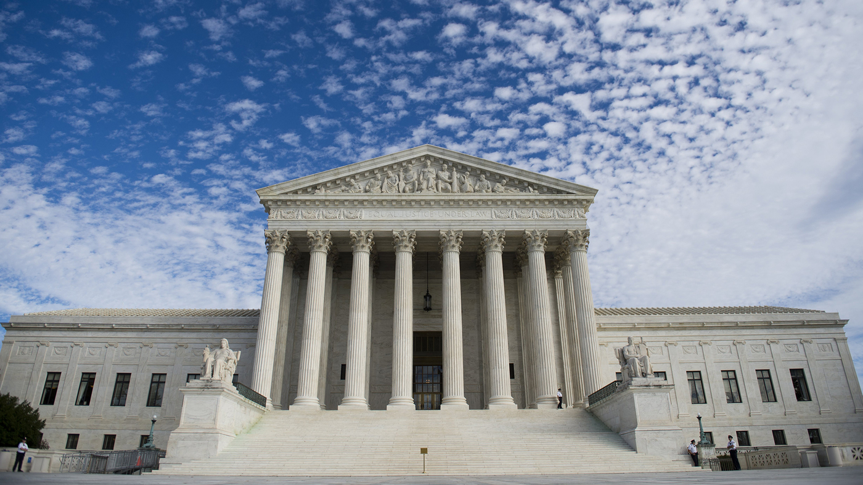

Slide 7
On the docket
L.W. v. Skrmetti
Tennessee passed a gender-affirming care ban.
Plaintiffs challenged the ban and the Biden Administration “intervened” on behalf of plaintiffs.
The 6th Circuit Court of Appeals upheld the ban.
Both plaintiffs and the Biden Administration appealed that decision to the Supreme Court.
Notes:
L.W. v. Skrmetti

Slide 8
L.W. v. Skrmetti
Should courts apply heightened scrutiny when analyzing gender-affirming care bans?
Are transgender people a quasi-suspect class?
Do parents have a fundamental right to give their child gender-affirming medical care?
Let’s look at What these mean…

Slide 9
Constitutional Law Primer
The Equal Protection Clause
14th Amendment: “Nor shall any State ... deny to any person within its jurisdiction the equal protection of the laws.”
Applies to federal government too under the Due Process Clause of the Fifth Amendment
Tiers of Scrutiny:
Strict
Intermediate or Heightened
“Rational Basis with Bite”
Rational Basis

Slide 10
Constitutional Law Primer
The Due Process Clause
5th Amendment: “No person shall ... be deprived of life, liberty, or property, without due process of law.”
14th Amendment: “nor shall any State deprive any person of life, liberty, or property, without due process of law.”
Fundamental Rights Under the Due Process Clause Receive Strict Scrutiny
(Mostly)

Slide 11
Strict Scrutiny
Law must be narrowly tailored to serve a compelling government interest.
What receives strict scrutiny?
Laws that impact a fundamental right or target a suspect class
What classifications are suspect?
Race, national origin, religion, and alienage

Slide 12
Strict Scrutiny
Korematsu v. United States (1944)
Established strict scrutiny review of race-based classifications
Upheld the forcible relocation and incarceration of Japanese people in internment camps during WWII
Trump v. Hawai’i (2018)
Overturned Korematsu
Upheld the ban on people traveling to the United States from certain Muslim-majority countries

Slide 13
Intermediate Scrutiny
Law must be substantially related to an important government interest.
What receives intermediate scrutiny?
Laws that impact a quasi-suspect class.
What is a quasi-suspect class?
Sex or gender and “illegitimacy” (whether or not your parents were married when you are born)
Notes:
Also called heightened scrutiny. Discrete and insular minority, inherent trait, highly visible, disadvantaged historically, lacked effective political representation.

Slide 14
Intermediate Scrutiny
Craig v. Boren (1976)
Court established intermediate scrutiny, which was a line of reasoning pioneered by future Supreme Court Justice Ruth Bader Ginsburg.
U.S. v. Virginia (1996)
Also called the VMI case.
Court creates an additional burden on the state, state must provide an “exceedingly persuasive justification.”

Slide 15
Intermediate Scrutiny
Geduldig v. Aiello (1974)
California had a temporary disability insurance program
Pregnancy is not a quasi-suspect classification
What?
Dobbs v. Whole Women’s Health (2022)
The main focus of the case is the fundamental right to an abortion
Secondary line or reasoning concerns the EPC. The court held that abortion bans were not subject to heightened scrutiny based on Geduldig

Slide 16
Rational Basis
Law must have a legitimate state interest and be rationally related to that interest.
What receives rational basis review?
“Rational Basis with Bite” and Romer v. Evans (1996)

Slide 17
Constitutional vs statutory protections
If the government or a governmental actor discriminates, that action may be constitutionally prohibited.
Private discrimination is banned under statute in certain circumstances. For now, only Title VII (Employment Nondiscrimination) protects LGBTQ people.

Slide 18
State Law
States can have stronger protections for LGBTQ people.
For example, California has additional nondiscrimination protections, prohibits conversion therapy, and allows trans and nonbinary people in prison to be housed according to their gender identity, among other additional protections.
Federal law can be thought of as the baseline.
Some issues of law are exclusively reserved to the federal or state government
Example: trans people in the military is exclusively under federal law and each state is in charge of their own state identification documents.
Notes:
But federal government can become involved if it passes laws, and federal courts can wield authority over the state governments.

Slide 19
Key takeaways
The Supreme Court analyzes laws that discriminate against certain groups using ”tiers of scrutiny.”
The court has historically struggled with how to apply the tiers to LGBTQ people.
It is now being directly asked to answer this question in L.W. v. Skrmetti.
The court is just one arena of achieving equality, but it has historically been the most important for LGBTQ people.

Slide 20
Landmark Decisions
Bowers v. Hardwick (1986)
Romer v. Evans (1996)
Lawrence v. Texas (2003)
U.S. v. Windsor (2013)
Obergefell v. Hodges (2015) – Our Starting Point Today
Bostock v. Clayton County (2020)
303 Creative v. Elenis (2023)

Slide 21
Obergefell v. Hodges
Fundamental Right to Marry
Strict Scrutiny
Some language of equal protection, but court did NOT extend heightened scrutiny to state marriage bans
Justice Anthony Kennedy’s language
Line of cases before Obergefell
Windsor and Hollingsworth v. Perry

Slide 22
After Obergefell
Marriage equality litigation strategy
Who is able to get married and who is not?
Disability rights, focus on lesbian and gay people
What tangible benefits derive from marriage?
Financial benefits, family status
Where are people still unprotected?
Discrimination, over-incarceration, homelessness, medical care
What narratives did the marriage equality movement employ?
Cisgender-heteronormative idea of relationships and family compared to queer understanding of “chosen family”

Slide 23
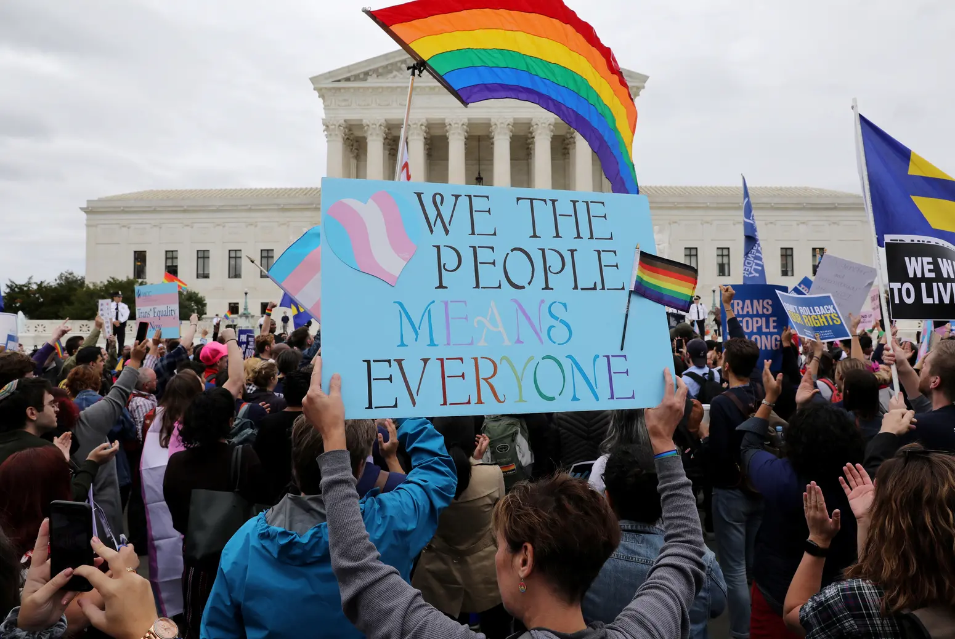
”Married on Sunday, fired on Monday”
Notes:
Harms of discrimination, both material and nonmaterial harms to the psyche (minority stress theory)

Slide 24
Bostock v. Clayton County
Title VII of the Civil Rights Act
“…because of sex.”
Price Waterhouse v. Hopkins (1989) & sex stereotyping
Concerning a statutory protection, not a constitutional right
“Statutory Interpretation” and Textualism

Slide 25
Bostock v. Clayton County
End Result: Title VII of the Civil Rights Act, which prohibits discrimination in employment based on sex (among other characteristics), bars sexual orientation and gender identity discrimination.
Can we apply this reasoning elsewhere?
Title IX – Athletics
Constitutional Law – Intermediate Scrutiny

Slide 26
303 Creative v. Elenis
Exceptions to public accommodations nondiscrimination law.
State cannot compel a business engaging in expressive conduct to deliver specific messages that violate her beliefs
Masterpiece Cakeshop v. Colorado Civil Rights Commission (2018)
22 States Lack Public Accommodations Discrimination Laws
The Supreme Court’s decision in 303 Creative v. Elenis presents major questions about enforcing these laws in states that do.

Slide 27
303 Creative v. Elenis
End Result: The First Amendment provides for an exception to public accommodation nondiscrimination laws under certain circumstances.
Future issues: How far does this decision reach?
Other nondiscrimination laws? What is “expressive conduct”
Other protected classes?
The Religious Freedom Restoration Act and religious healthcare
Can government employees raise similar objections?

Slide 28
After Obergefell
Comparing the Cases
Bostock
Area of Law:
Employment Discrimination
Question:
Is SOGI included in the statutory plain meaning of “sex?”
Result:
Discrimination Banned
303 Creative
Area of Law:
Accommodations Discrimination
Question:
Does the freedom of speech grant an exception?
Result:
Discrimination Permitted

Slide 29
Key Takeaways
After the battle for marriage equality, LGBTQ people pushed forward and pursued new avenues to achieve equality.
So far, the two major cases have concerned the extent of nondiscrimination protections.
One case expanded federal protections and one case limited state protections.

Slide 30
Where To next?
Building on the foundations of what we’ve established…
Lawrence = Gay people are entitled to some degree of privacy and protection under the law
Obergefell = respect for same-sex couples, fundamental right to marry.
Bostock = LGBTQ identities and discrimination against them are based upon sex stereotypes and sex.
But… extending 303 Creative = Discrimination against LGBTQ people (based on religious beliefs?) may have some broader protection.
How do we apply these frameworks to new issues?

Slide 31
Back to L.W. v. Skrmetti
Could become the third major decision impacting LGBTQ people from the Supreme Court in the post-Obergefell era.
The court is being asked to grapple with the history of discrimination against LGBTQ people, and to adopt a formal framework for analyzing laws discriminating against LGBTQ people.

Slide 32
On the Docket SOON
Conversion Therapy and the First Amendment
Tingley v. Ferguson
Gender-Affirming Care and the Americans with Disabilities Act
Williams v. Kincaid
Government’s Role in Combating Misinformation
Murthy v. Missouri

Slide 33
Emerging Legal Issues
Parental Rights
Right to give their child gender-affirming care
Right to know of their child’s identity at school
Right to control the education of their child
Relitigating Fundamental Rights Cases in light of Dobbs
Lawrence and the Marriage Equality cases
Defining “Sex” and the Scope of Bostock
Different Contexts: Schools, Athletics, Incarceration
But also, Artificial Intelligence & What does it mean to be gender diverse under the law?

Slide 34
Where Do we find ourselves now?
LGBTQ Rights relies on decades of precedent brought by other groups of people who were unjustly discriminated against.
Addressing continually unmet needs and shifting to an intersectional perspective of what LGBTQ equality means

Slide 35
Key Takeaways
Vast majority of LGBTQ wins in federal law came from the Supreme Court, and advocates are still pursuing equality at the court.
The movement for LGBTQ equality requires an understanding of a wide range of legal areas because the law reflects a cis-heteronormative worldview.
The court may adopt a stronger standard for reviewing laws discriminating against LGBTQ people in the future.

Slide 36
Contact The Williams Institute
Tentindo@law.ucla.edu

