Slide 1
Patricia Seed, Ceremonial Possession in Europe’s Conquest of the New World 1492-1640 (Cambridge UP, 1995)

Slide 2
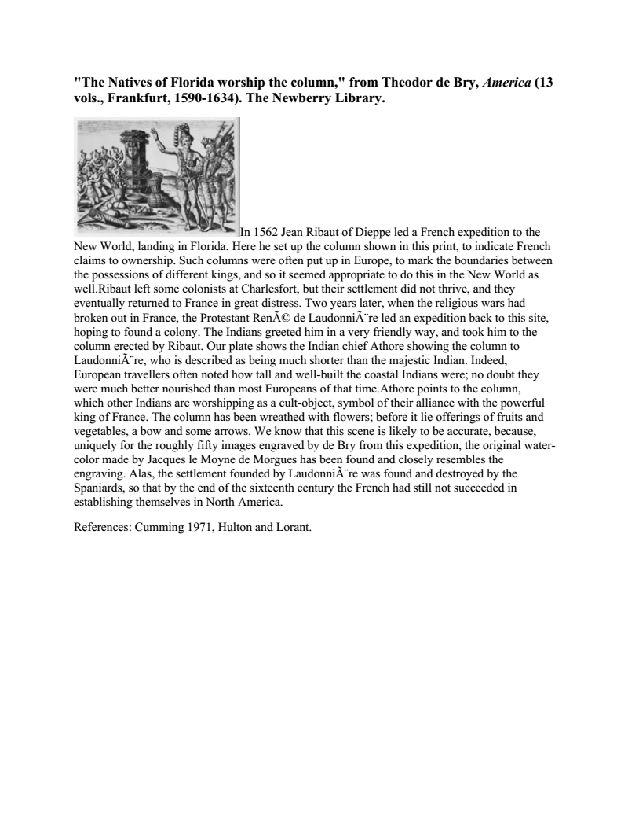
Her cover image is French pole in Florida

Slide 3
French
Reproduce grandeur of royal processions
For example in Florida, they set up a pole as they did for marking boundaries in Europe
2 years later French found indigenous people worshipping the pole and decorating it with fruit and flowers.
French conclude with dialogue with locals.
In another example, the French guided natives into cutting a cross from a tree an planting it. Native participation is sign of consent.
Ceremonial like Spanish, but more flexibility to occasion/location.

Slide 4
Ceremonial practices differed among European nations, but each legitimized “right to rule” with symbolic gestures.
Thus, between 1492-1640 European nations claimed “ownership” of parts of New World.
Each nation followed familiar “actions, gestures, movements, or speeches” ( p. 3)
Each nation did not fully understand the other European nations’ symbolic gestures and in conflicted territory, argued for own national interest.

Slide 5
Critics did not prefer cultural practices of another nation.
Spaniard Las Casas
Dutchman Adiaen Van Der Donck
Englishman Roger Williams
Each critiqued colonialism from within own legal and cultural traditons. (p. 11)

Slide 6
Spaniards
Make solemn speeches (The Requirement as stated by the crown. Handout.)
Notaries certify Requirement read to assembled natives. (p. 1300
Launch military attack in requirement that natives observe Catholicism.

Slide 7
The Portuguese
Measured the height of midday sun and the position of stars at night to figure out location astronomically. They recorded the specific numbers.
Portuguese influenced by Hebrew and Arabic math and astronomy.
Portuguese superimposed the grid of latitudes upon lands and they put up pillars.
Then they took the land by sword.
“Discovery” signified establishment of dominion.

Slide 8
National differences
Literacy required for Spanish, Portuguese, and Dutch rituals of possession.
Literacy not required for French or English rituals of possession. French did ritualized movement (procession). English used everyday movements and physical objects (farming)

Slide 9
16th-17th c. Heirs to Roman Empire
Portuguese value farflung empire.
French use Roman arches and Latin inscriptions. Prefer alliances with natives to Roman tyrrany.
English use Virgil and other Roman garden literature. Use Latin in legal documen
Spanish heir to Catholic Roman empire.
Dutch in 17th c. talk of Roman-Dutch law.
……………………………….vs…………………………………
Later 19th c. colonialism talk of nation-state not of heir to Rome.

Slide 10
The Dutch
“Discovery” also significed dominion, but linked to maps, rather than astronomy.
Drew very detailed maps indicating latitudes on studying harbors and coastlines.
Later Dutch commanders required to create “perfect maps and descriptions.”
Maintain territory through commerce and repeated voyages.

Slide 11
The English
Laid out hedges and fences as in shires of England.
Started planting and cultivating.
Talked about “heathen land.”
Built architectural structures.
Not ceremonial like French or Spanish.
Houses, gardens, and fences signified English dominion.

