Slide 1
An Analysis of the n-Queens problem
Saleem Karamali

Slide 2
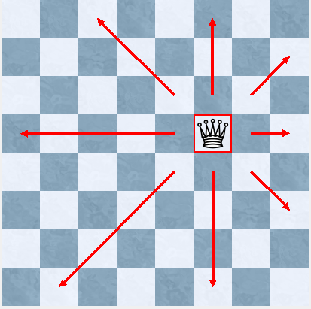
Movement of a Queen on a Chessboard

Slide 3
N-Queens Problem

Slide 4
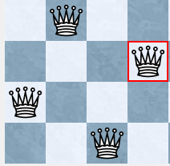
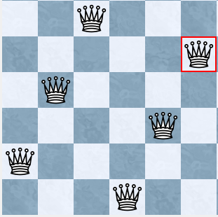
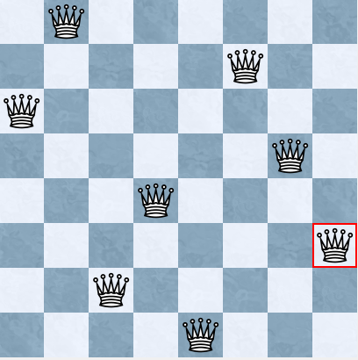
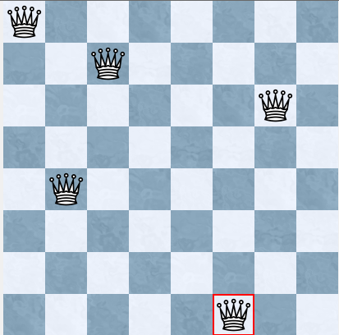
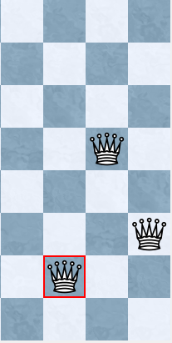
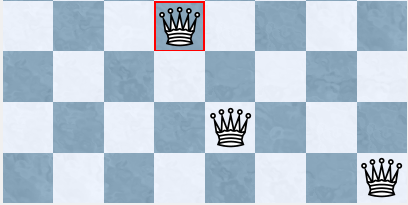
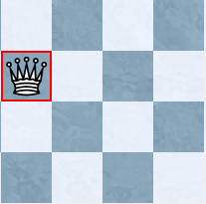
N-Queens Problem
Place n queens on an n x n chessboard such that no two queens attack each other.

Slide 5
Notation/Conventions
n x n solution: A valid arrangement of n queens for an n x n board.
Q(n): Number of n x n solutions
Since no two queens can share a column, we identify solutions by the row of each queen as we move from right to left.
Start counting at zero (from the bottom left)
An n x n solution is a permutation of {0, …, n-1}
But not every permutation gives a solution
{1,3,0,2}

Slide 6
Partial Table of Number of Solutions
n | 4 | 5 | 6 | 8 | 12 | 24 | 26
Q(n) | 2 | 10 | 4 | 92 | 14,200 | 227,514,171,973,736 | 22,317,699,616,364,044

Slide 7
History
1848: Problem proposed by Bezzel for n = 8
1850: Gauss claims Q(8) = 92
1874: Pauls and Glaisher independently prove Gauss’s claim
1874: Pauls proves that Q(n) > 0 for all $n≥4$
20th Century: Problem becomes a benchmark
for combinatorial optimization
2009: Q(n) found for n = 26

Slide 8
Time Complexity
How many operations are needed to complete a problem
In this case, we are interested in how the number of operations increases as n increases
If $f\left(n\right)>0$and $g\left(n\right)>0,$ then $f\left(n\right)=Ο\left(g\left(n\right)\right)$ iff
$∃N>0$such that $f\left(n\right)≤Cg\left(n\right)$ for some $C>0$, for all n > N
Example: Brute-force examination of every possible
permutation of {0, …, n-1} is $Ο(n!)$

Slide 9
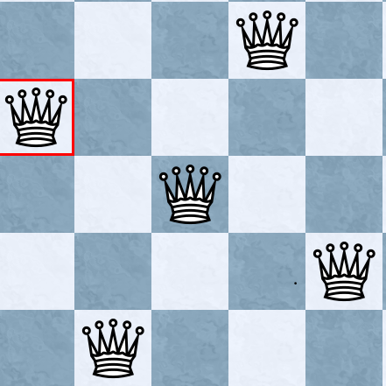
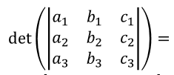
Gunther’s Determinant Method
Key point: The determinant of an n x n matrix consists of a sum of n! products of elements.
Each product contains exactly one element from each row and column
If we represent an n x n board as a generic n x n matrix, then the determinant contains every possible arrangement of queens with no row and column attacks.
Eliminating the diagonal attacks gives each n x n solution
But how do we identify these attacks?
$−a_{3}b_{2}c_{1}+a_{2}b_{3}c_{1}+a_{3}b_{1}c_{ 2}−a_{1}b_{3}c_{2}$ $−a_{2}b_{1}c_{3}+a_{1}b_{2}c_{3}$

Slide 10
Constructing the Matrix
$$\left[\begin{matrix}a_{1} & b_{2} & c_{3} & ⋯ \\ & & & \\ & & & \\ & & & \end{matrix}\right]$$

Slide 11
Constructing the Matrix
$$\left[\begin{matrix}a_{1} & b_{2} & c_{3} & ⋯ \\ β_{2} & & & \\ γ_{3} & & & \\ ⋮ & & & \end{matrix}\right]$$

Slide 12
$$\left[\begin{matrix}a_{1} & b_{2} & c_{3} & ⋯ \\ β_{2} & a_{3} & b_{4} & \\ γ_{3} & β_{4} & a_{5} & ⋱ \\ ⋮ & & ⋱ & ⋱\end{matrix}\right]$$
Terms along the same diagonal have either the same variable name or the same index
We take the determinant, and then eliminate these terms

Slide 13
Eliminating Diagonals in a 4 x 4 Matrix
$$M=\left[\begin{matrix}a_{1} & b_{2} & c_{3} & d_{4} \\ β_{2} & a_{3} & b_{4} & c_{5} \\ γ_{3} & β_{4} & a_{5} & b_{6} \\ δ_{4} & γ_{5} & β_{6} & a_{7}\end{matrix}\right]$$
Each term corresponds to a placement of 4 queens at positions given by the factors of the term.

Slide 14
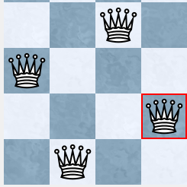
$c_{3}β_{2}b_{6}γ_{5}$: {2,0,3,1}
$b_{2}c_{5}γ_{3}β_{6}:\{1,3,0,2\}$

Slide 15
Determinant Method Time Complexity
Generate n! terms: $Ο\left(n!\right)$steps
By hand, only feasible up to n = 5

Slide 16
Dynamic Programming: Finding Q(n) in Stages
Place a queen on an n x n board one at a time
As we add queens, we want to keep memory of which arrangements of fewer queens work.
We don’t need to generate every possible permutation
We will see that the time complexity is exponential < factorial

Slide 17
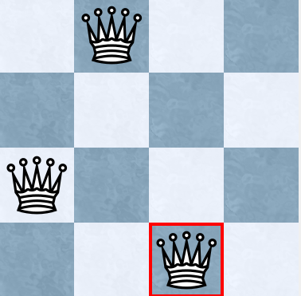
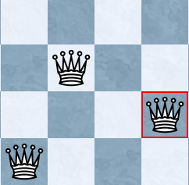
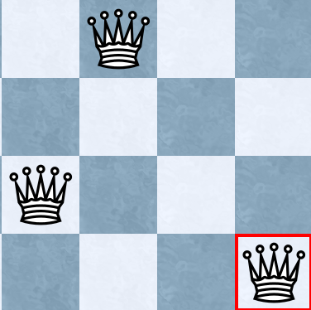
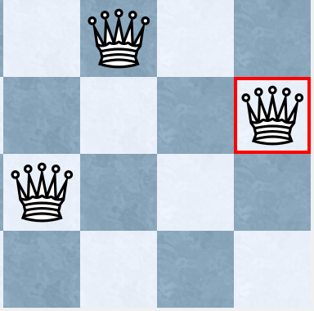
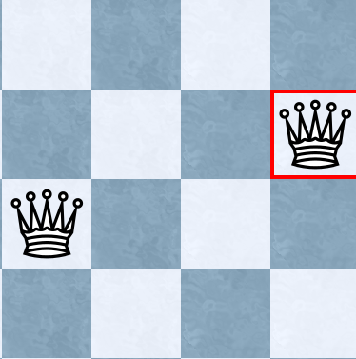
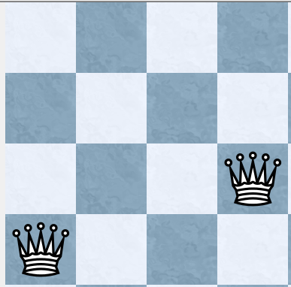
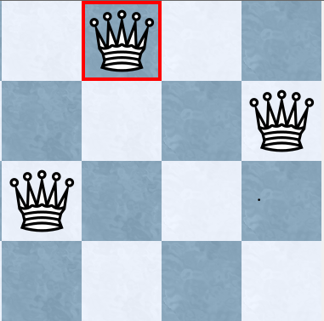
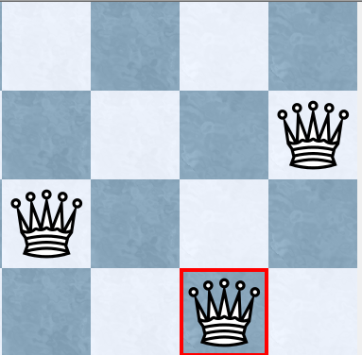
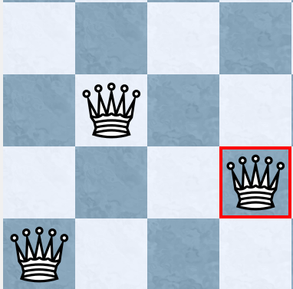
Notes:
REMEMBER TO NOTE THAT EVEN JUST THAT METHOD IS USEFFUL BECAUSE IT BRINGS THE COMPLEXITY DOWN FROM FACTORIAL TIME TO POLYNOMIAL TIME.

Slide 18
Equivalence Classes of Positions
We can further decrease the number of positions we need to consider using a theorem of Rivin and Zabih (1992)
Terminology
Closed line: Any of n rows, n columns, or 4n-2 diagonals which already contains a queen (total of $6n−2$ possible closed lines)
Feasible candidate: A valid arrangement of $≤n$ queens (the result obtained at any stage)
Completion: An arrangement of remaining queens that can be added to a feasible candidate to produce a solution
Notes:
REMEMBER TO NOTE THAT EVEN JUST THAT METHOD IS USEFFUL BECAUSE IT BRINGS THE COMPLEXITY DOWN FROM FACTORIAL TIME TO POLYNOMIAL TIME.

Slide 19
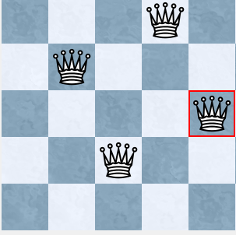
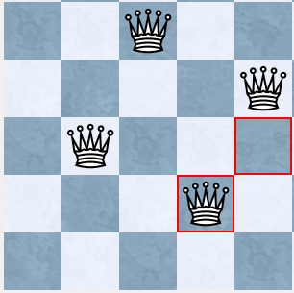
Theorem
Let two feasible candidates $C_{1}$ and $C_{2}$ be given. If $C_{1} and C_{2}$ have the same set of closed lines, then a completion of $C_{1}$ is also a completion of $C_{2}$
Now when placing a new queen, we must only consider attacks on the $6n−2$ possible closed lines, instead of all $n^{2}$squares

Slide 20
Proof
Let S be the set of closed lines
Let m be the number of queens in $C_{1}$
Let C be a completion of $C_{1}$
Since each added queen contributes 4 new closed lines (a row, column, and two diagonal), $C_{2}$ must also have m queens.
Then since C completes $C_{1}$, and $C_{2}$ also contains m queens, adjoining C to $C_{2}$ will result in n queens.
Further, none of these queens is on any line in S.
So there are no attacks added when adjoining C to $C_{2}$
So adjoining C to $C_{2}$ gives a solution.

Slide 21
Algorithm
Initialize QUEUE = {$\left\langle ∅,1\right\rangle \}$
for every square:
Let T be a set of the four lines containing this square
for each tuple $\left\langle S,i\right\rangle$ in QUEUE such that S ∩ T = $∅$:
if $\left\langle S∪T, j\right\rangle ∈QUEUE,$replace j with $i+j$
Otherwise, add $\left\langle S∪T,i\right\rangle$ to QUEUE
SOLUTIONS = 0
for each set $\left\langle S,i\right\rangle$ in QUEUE:
if S contains all rows, SOLUTIONS = SOLUTIONS + i
Notes:
OK, so this is what the actual algorithm looks like…

Slide 22
Dynamic Programming Time Complexity
$6n−2$ closed lines
$n$ rows
$n$ columns
$4n+2$ diagonals
Each element of QUEUE is a set of closed lines
Max length of QUEUE = $2^{6n+2}$
(size of power set of set of closed lines)
We check each element in QUEUE $n^{2}$times
Integer arithmetic for each square: Low degree polynomial $f(n)$
Total time complexity: $Ο(n^{2}f\left(n\right)2^{6n−2}$)

Slide 23
Conclusion
Dynamic Programming likely among the fastest techniques to solve the problem
As more optimization techniques are developed, they may be applicable to n-Queens
Work being done to calculate Q(27)
Behavior of Q(n) still largely unknown

Slide 24
Acknowledgements
Professor Knoerr
The Oxy Math Department

Slide 25
References

Slide 26
Finding one solution
Search method (Sosic & Gu)
Algorithm/steps:
1. Generate a solution corresponding to a random permutation of {0, … , n-1}
2. Check every column
If the queen in that column is attacked, check whether swapping it with another queen will decrease the number of total attacks.
If so, make the swap
If not, continue to the next column
3. If swaps were made, go to step 2.
If no swaps were made and there are no total attacks, end the algorithm
If no swaps were made but there still are attacks, go to step 1

Slide 27
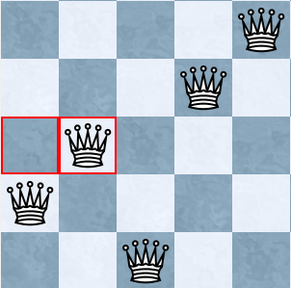
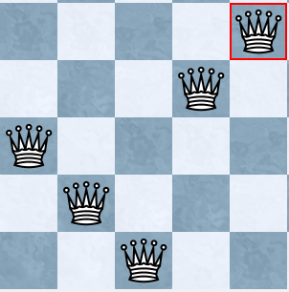
Example
Consider the initial position {2,1,0,3,4}
Column 0
Swap with column 1: 2 attacks
Total number of attacks: 4

Slide 28
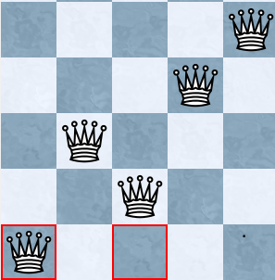
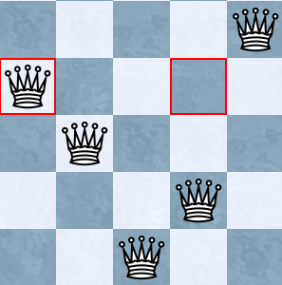
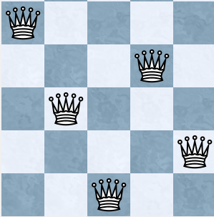
Position: {1,2,0,3,4}
Swap column 0 and 2: 2 attacks
Swap column 0 and 3: 2 attacks
Swap column 0 and 4: 0 attacks
Total number of attacks: 2

Slide 30
Time complexity of the Search Method
Not all initial positions lead to a solution
For those that do:
During each iteration, we decrease the number of swaps by at least 1
During each iteration, we consider $n^{2}$pairs of queens
Maximum steps to find the solution: $n^{3}$
Experimental results show an average of $Ο(n log\left(n\right))$ steps, even if multiple initial positions are needed

