Slide 1
Several Ways of Evaluating the Matrix Exponential
In partial fulfillment of the Senior Comps requirement
By: Hector Lopez
Advisor: Prof. Ron Buckmire

Slide 2
Outline:
Introducing the Matrix Exponential
Method 1: Cauchy’s Integral Formula
Method 2: Putzer’s equation via Laplace Transforms
4. Conclusion

Slide 3
Motivation
Consider the linear ordinary differential equation $y^{′}=Ay$ where A is a scalar$.$ Using Separation of Variables to find the general solution, we get $y\left(t\right)=C_{0}e^{At}.$
Now, assume we have the following linear ODE ${\vec{x}}^{′}=A\vec{x},$ where $A$ is a $n x n$ matrix, and $\vec{x}$is a column vector that satisfies the initial condition $\vec{x}\left(0\right)= {\vec{x}}_{o}$. Then, $\vec{x}(t)=e^{At}{\vec{x}}_{o}$.

Slide 4
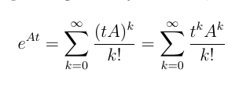
Natural way of defining it is by using definitions of the exponential function and extending them to matrices.
We are going to be using this particular matrix with $λ_{1}=4, λ_{2}=−2.$

Slide 5
The Cauchy Integral Formula
This method is the most unique and elegant way of evaluating for the matrix exponential.
Interesting result: given an analytic function f(z) and a point $z=z_{0},$ we can determine $f(z_{0})$.

Slide 6
In the case of a square matrix, we define the Cauchy Integral as
Select a function $f\left(z\right)$ that is analytic
Find the eigenvalue/poles
Determine a contour , or closed boundary, that surrounds every eigenvalue.
$$f\left(z\right)=e^{zt}$$

Slide 7
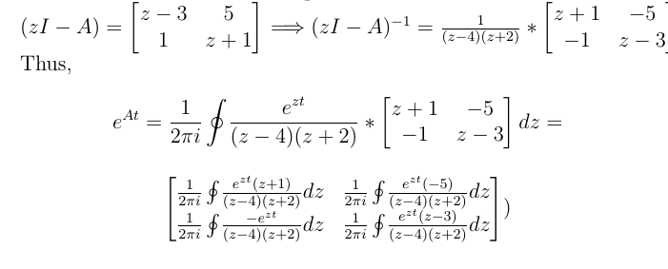
Process
Each element in the matrix above has poles at $z=4$ and $z=−2$(i.e. the eigenvalues of the matrix, A).

Slide 8
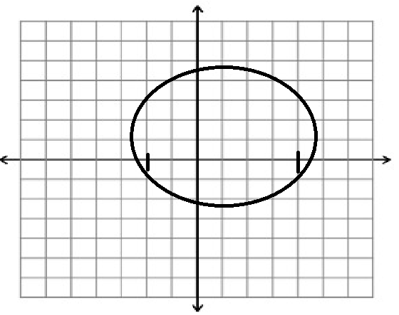
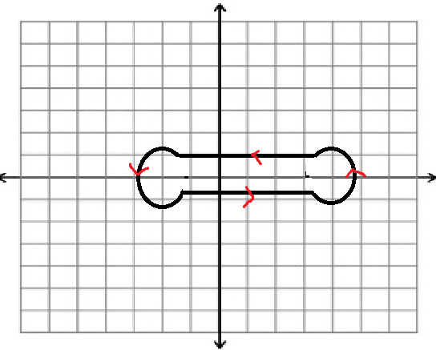
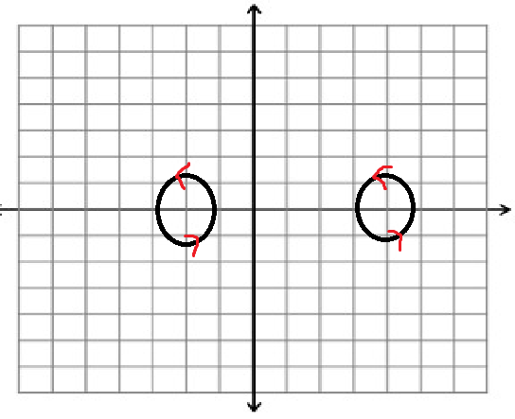
Contour
Circle centered at 1 with radius $3+ε.$
Deformation Theorem: the contour can be deformed in any way as long as it encloses all eigenvalues of A.

Slide 9
First element :
Thus, $= =$
Repeat the process for each Cauchy Integral.

Slide 10
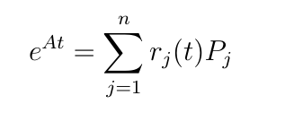
Method 2: Putzer’s equation
Given the eigenvalues,${ λ}_{1},…,{ λ}_{n},$ of an arbitrary square matrix, the matrix exponential can be evaluated as follows
where $r_{j}$are the exponential functions and $P_{j}$ are n x n matrices.

Slide 11
Putzer’s Equation Defined
Define n x n matrices $P_{1}, …, P_{n}$ by the following
The functions $r_{1}\left(t\right), …, r_{n}\left(t\right)$ are defined by the recursive system

Slide 12
Laplace Transformations
Useful technique for solving linear ODE equations
Laplace Transformation is denoted as
Inverse Laplace Transformation:
Since we are dealing with a system of ordinary differential equations, we are using the Laplace Transformation of a derivative.
Apply this to the recursive system:
.

Slide 13
If we apply the Laplace Transformation to $r_{j}^{′}$, we develop a general way of solving for the recursive system of equations. Recall:
Take the inverse Laplace Transformation,

Slide 14
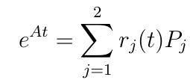
Example
Now, let’s evaluate the matrix exponential using the matrix that was previously introduced.
Eigenvalues of our matrix :

Slide 15
Finally,
This solution is identical to the solution that we obtained from using Cauchy’s Integral Formula.

Slide 16
Cayley-Hamilton Theorem

Slide 17
For n eigenvalues, the general characteristic polynomial equation is given by
Thus, by the Cayley-Hamilton Theorem, we can replace the $λ$in the equation with the original matrix, $A$.

Slide 18
Proof
According to the Cayley-Hamilton Theorem
for any square matrix A. From this theorem, we are able to introduce two facts:
(1)
(2) implies
Now, verify that $\vec{x}(t)$ is a solution to the ODE.

Slide 19
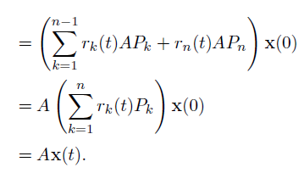

Slide 20
Recall:

Slide 21
Conclusion
We have given multiple methods to evaluate for $e^{At}$. One uses complex analysis techniques while the other uses rules and practices from Ordinary Differential Equation.
Other methods use techniques from Linear Algebra, Calculus, ODE, Complex Analysis, etc.
Cauchy Integral Formula
Putzer’s Equation
Laplace Transformations
Cayley- Hamilton Theorem

Slide 23
Lagrange Interpolation

