Slide 1
Predator-Prey Population Cycles
Jack Sinclair & Shane Moore

Slide 2
Linearization of the Lemming-Stoat Model
Linearize at ten years (t=10) and the fixed point (lemming,stoat)=(x,y)=(10⁻¹,10^{-2.5})
Complex eigenvalues and is therefore periodic

Slide 3
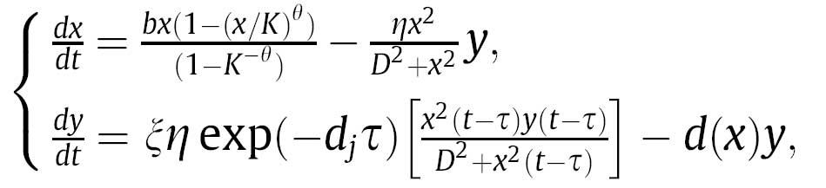
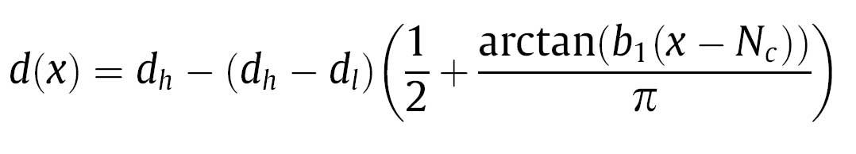
Lemming-Stoat Model

Slide 4
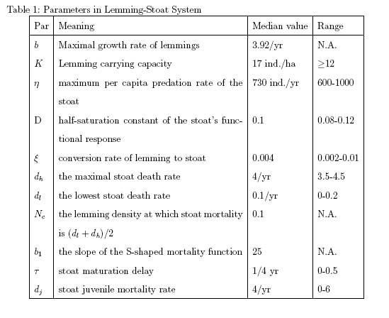
Input Average Values

Slide 5
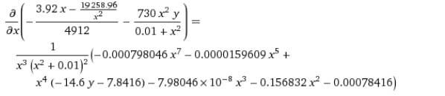

Partially Derive the Model (Lemming)

Slide 6
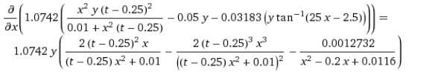

Partially Derive the Model (Stoat)

Slide 7
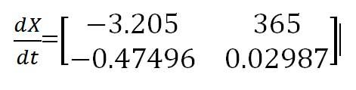
Find Eigenvalues
The point (x,y)=(10⁻¹,10^{-2.5}) with t=10 produces the following Jacobian Matrix
Which yield the complex eigenvalues:
{-1.5855 - 13.0678·î, -1.5855 + 13.0678·î}

Slide 8
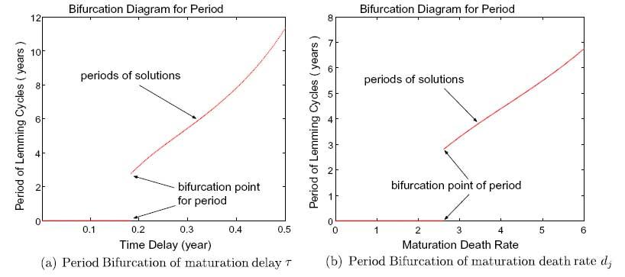
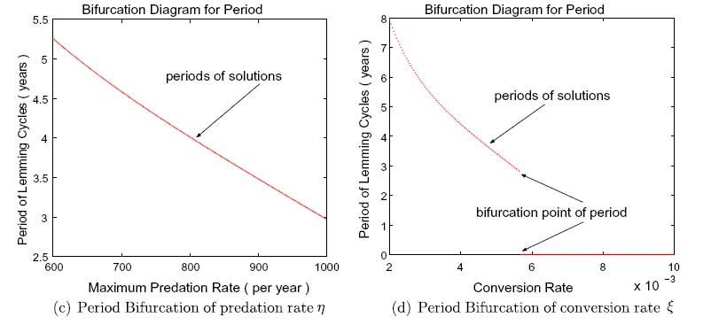
Sensitivity Testing
- Individually increase and decrease each parameter to see its effect on cycle period.
- Bifurcation value (𝛕 = 0.2) for maturation delay.

Slide 9
Additional Predator-Prey Systems
Hare-lynx system
  Similar system of differential equations
  Only parameter for maturation delay remained significant
  Maturation delay value (𝛕 = 1.5)
Moose-wolf system
  Wolf maturation delay time of 1.8 years estimates a 38 year population cycle period.
  Falls in line with past estimates and observations.

Slide 10
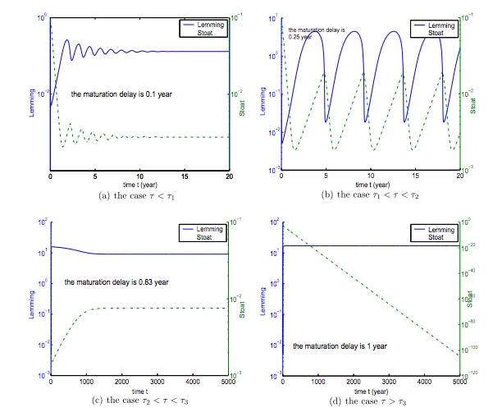
Bifurcation
- Threshold values of maturation delay which differ for each predator-prey system.
- No population cycles in cases a, c, and d.
- Periodic populations in case b.

Slide 11
Conclusion
- Oscillating population cycles corroborated through an analysis of the linearized system.
- Maturation delay of the predator species is a key determinant for period lengths of population cycles.
- Bifurcation values of the maturation delay parameter signal changes in the predator-prey population relationship.

