Slide 1
Jacobi Elliptic Functions from a Dynamical Systems Point of View
Original Paper by Kenneth R. Meyer
Project and Presentation by Andrew Featherston and Jesse Kreger

Slide 2
Topic Overview and Results
We will examine three Jacobi Elliptic Functions that can be defined by a three dimensional system of ordinary differential equations.
We will analyze this three dimensional system using techniques we have learned in this class.
We will show how we can use Jacobi Elliptic Functions to compute a difficult integral.
Thesis: Jacobi Elliptic Functions can be defined as a set of functions that satisfy a three dimensional first order system of differential equations. These functions can then be used in a wide variety of scientific contexts, such as dealing with certain algebraic expressions.

Slide 3
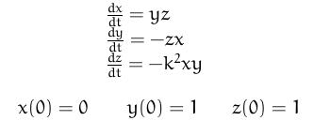
What are Jacobi Elliptic Functions?

Slide 4
Properties of Jacobi Elliptic Functions
Group of basic elliptic functions
Similar to trigonometric functions
Used to anti-differentiate certain expressions and have many uses in real world sciences such as physics, chemistry, and engineering.

Slide 5
Jacobi Elliptic Functions
There are three Jacobi Elliptic Functions we will be dealing with:
  Sine amplitude = sn(t,k)
  Cosine amplitude = cn(t,k)
  Delta amplitude = dn(t,k)

Slide 6
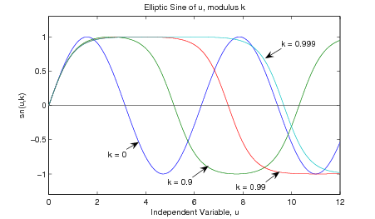
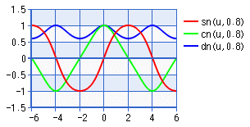

Slide 7
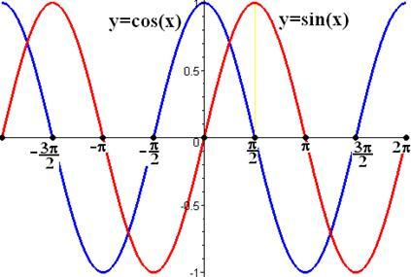
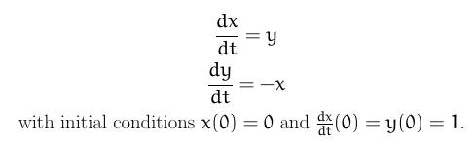
Functions Defined By ODEs
We can use a differential equation approach to define functions. We will use the trigonometric functions cosine and sine as one such example.
Our approach is to define cosine and sine as the harmonic oscillating functions that satisfy this two dimensional system.

Slide 8
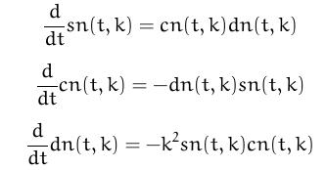
Jacobi Elliptic Functions as a System of ODEs
By letting x=sn(t,k) y=cn(t,k) z=dn(t,k) we have:
And since our initial conditions are satisfied as well, our system is satisfied.

Slide 9
Proposition:
As k approaches 0 from the right we have:
  sn(t,k) sin(t)
  cn(t,k) cos(t)
  dn(t,k) 1

Slide 10
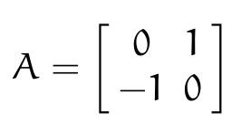

Proof
When k=O our third differential becomes O. Therefore, z=dn(t,k) is a constant and we are left with the following two dimensional system assuming z=1:

Slide 11
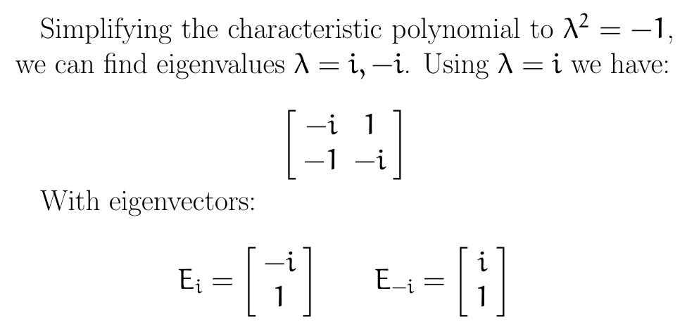
Proof Continued
This is a simple coupled system of ordinary linear differential equations. Using techniques learned in this class we can find the general solution.

Slide 12
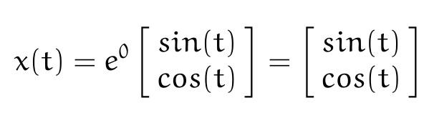
Proof Continued
Using Euler’s formula and Section 3.4 of our textbook we can find that the solution to our system will be:
And thus we have shown x=sin(t) and y=cos(t).

Slide 13
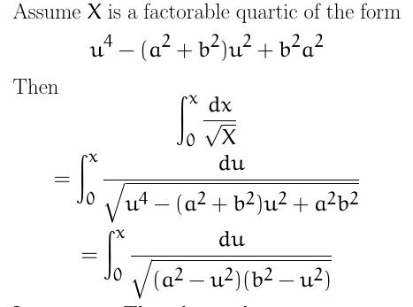
Application: Integrating Factorable Quartics

Slide 14
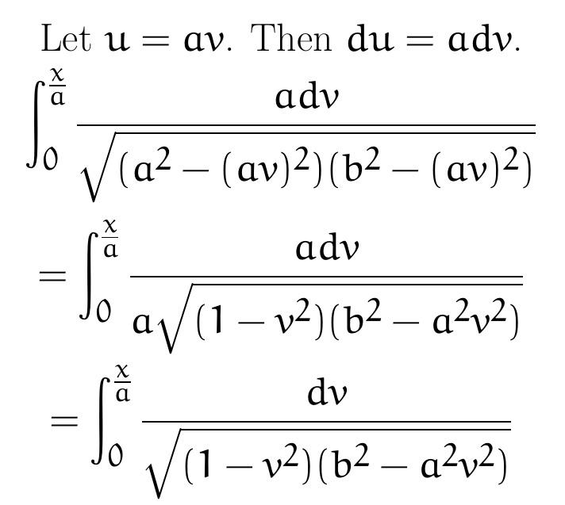

Slide 15
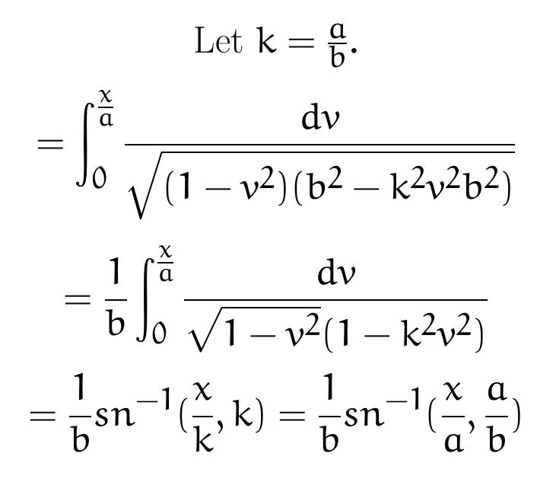

Slide 16

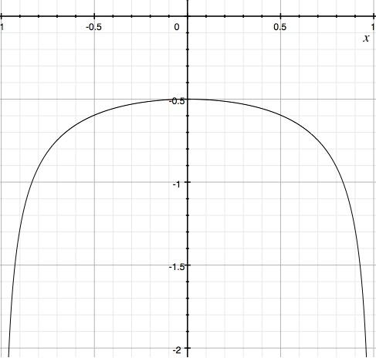
Real World Example
Jesse decided to build an arch
Area between top of arch and the x-axis modeled by F(x)
Andrew Featherston is a blimp aficionado, wants to see arch in blimp
For safety reasons Jesse worried about average distance between blimp and arch
x-axis from 0 to 1 is path of blimp
Average distance of blimp from arch will be F(x)/1=F(x)

Slide 17
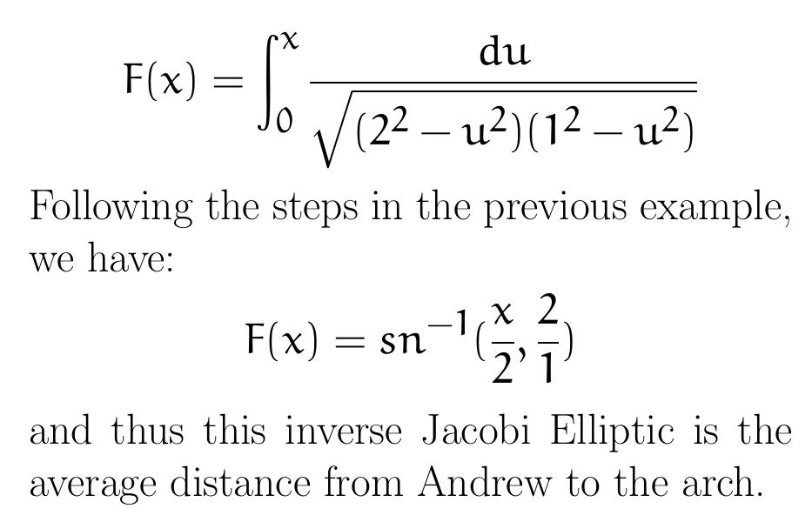

Slide 18
Conclusion
Jacobi Elliptic Functions can be defined in terms of a system of differential equations
  Adds depth and theory to elliptic functions
  Use basic ODEs theorems, ideas, and techniques
Jacobi Elliptic Functions have many applications to math and sciences
  Anti-differentiation
  Physics
  Engineering
  Chemistry

Slide 19
Works Cited
Blanchard, Paul, Robert L. Devaney, and Glen R. Hall. Differential Equations. Boston, MA: Brooks/Cole, Cengage Learning, 2012. Print.
Meyer, Kenneth R. "Jacobi Elliptic Functions from a Dynamical Systems Point of View." The American Mathematical Monthly 108.8 (2001): 729-37. JSTOR. Web. 10 Oct. 2013.
National Institute of Standards and Technology. Jacobian Elliptic Functions Properties. Digital Library of Mathematical Functions. Web. 6 Nov. 2013.
Weisstein, Eric W. "Jacobi Elliptic Functions." Wolfram MathWorld. Web. 6 Nov. 2013.

