Slide 1
Delay Differential Equations and Their Applications in Biology
Meredith Heller & Sofia Palmer

Slide 2
Introduction
ODEs have been used to model many different types of systems including biological ones
But they often “cannot capture the rich variety of dynamics observed in natural systems” (Forde 1)
DDEs include a time delay which makes the systems more logical and accurate biologically
Thesis: Delay differential equations include the time delays that inherently exist in biological processes, proving that delay differential equations more accurately model the life sciences

Slide 3
ODEs vs. DDEs
Main difference is in their initial conditions’
  ODEs: initial instant of time → x(t₀) = x₀
  DDEs: needs the values for all past values of time , in simple DDEs the initial time interval is: [t₀- τ, t₀]
    τ is a positive constant, that stands for a specific point in time
    t₀- τ stands for a “previous time”

Slide 4
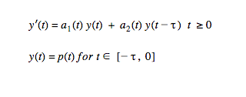

Solving: Method of Steps
In order to solve DDE’s using Method of Steps, need a history function
On the interval y(t) is given by p(t) so we can say it is solved for this interval and call it
Note: when then becomes

Slide 5

Solving: Method of Steps Cont.
This equation is now an ordinary differential equation because is known, it is

Slide 6
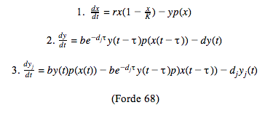

Lotka-Volterra Model with a Delay
The Lotka-Volterra Predator-Prey Model with delays is shown below:
  x is the population of prey, y is the population of mature predators, y_{j} is the population of juvenile predators

Slide 7
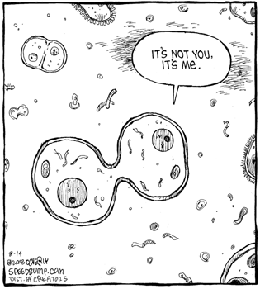
Breast Cancer Model with DDEs
Golnar Newbury uses delay differential equations in his/her research in breast cancer.
Uses two other models to create a new model that incorporates time delay for cells in the interphase stage, mitosis phase, as well as the ways in which Paclitaxel, a cycle specific drug, targets tumor cells.

Slide 8
Conclusion
DDEs were developed 10-20 years ago, compared to other math concepts this is new, therefore there is more to learn
More difficult and complex to solve than ODEs, but luckily technology can be a great aid to solve DDEs
The inclusion of delays in mathematical systems which are modeling biological phenomena is a theory and concept that will continue to develop over time, with more research done on them there should be an easier way to solve and analyze them

Slide 9
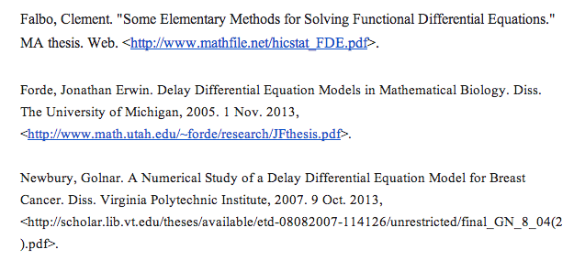
Works Cited

